Slide 1
Why Latvia?
Discover business opportunities

Slide 2
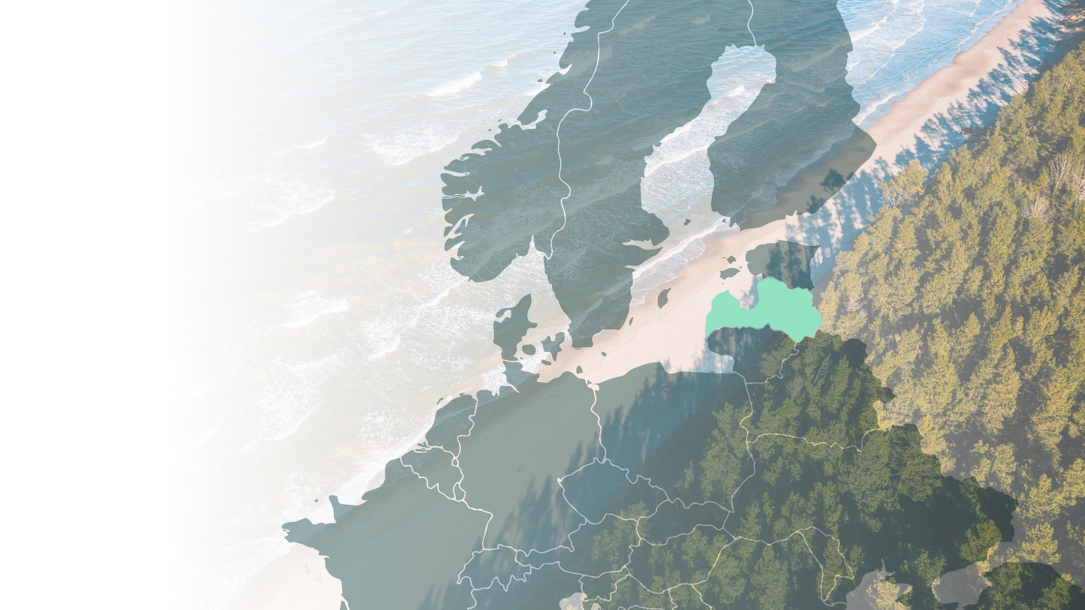
Latvia is a European state
with economy growing faster than EU average
Government: Parliamentary Republic
Capital: Riga
Currency: Euro
Population: 1.9 million
GDP (2023) EUR 43.91 billion
GDP growth (’24 est) 2.5%
Language: Latvian
Part of:

Slide 3
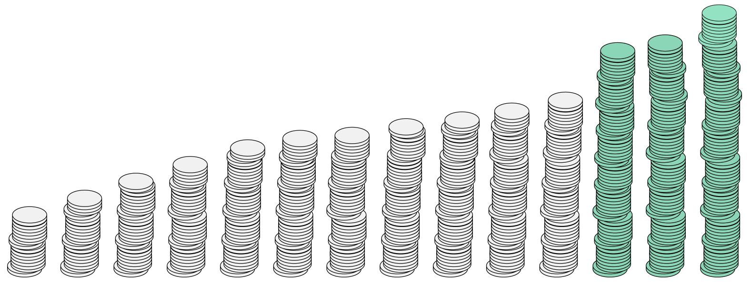
Foreign investments
are steadily growing
24.6
CAGR +9%
22.6
21.2
16.1
16.8
14.7
15.3
13.5
13.6
12.5
11.5
10.2
8.1
9.3
2010
2011
2012
2013
2014
2015
2016
2017
2018
2019
2020
2021
2022
1H 2023

Slide 4
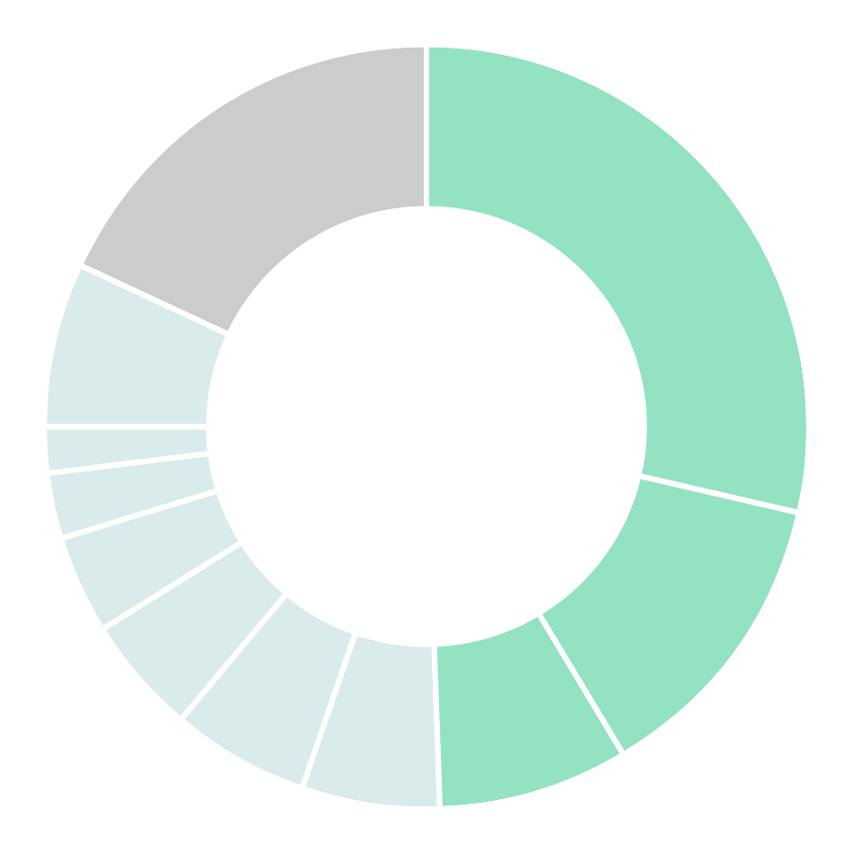
Mostly coming
from the EU states
FDI into Latvia by investor countries
18%
Non-EU
29%
7%
Other-EU
Sweden
2%
Norway
3%
Luxemburg
13%
4%
Denmark
5%
Estonia
Netherlands
6%
Cyprus
8%
6%
Germany
Lithuania

Slide 5
Latvia is an inclusive,
digitally advanced, and
cost-efficient EU country

Slide 6
#2
International Tax
Competitiveness Index
among OECD countries
(Tax Foundation, 2023)
Latvia is an inclusive, digitally advanced, and cost-efficient EU country
Notes:
https://taxfoundation.org/research/all/global/2023-international-tax-competitiveness-index/

Slide 7
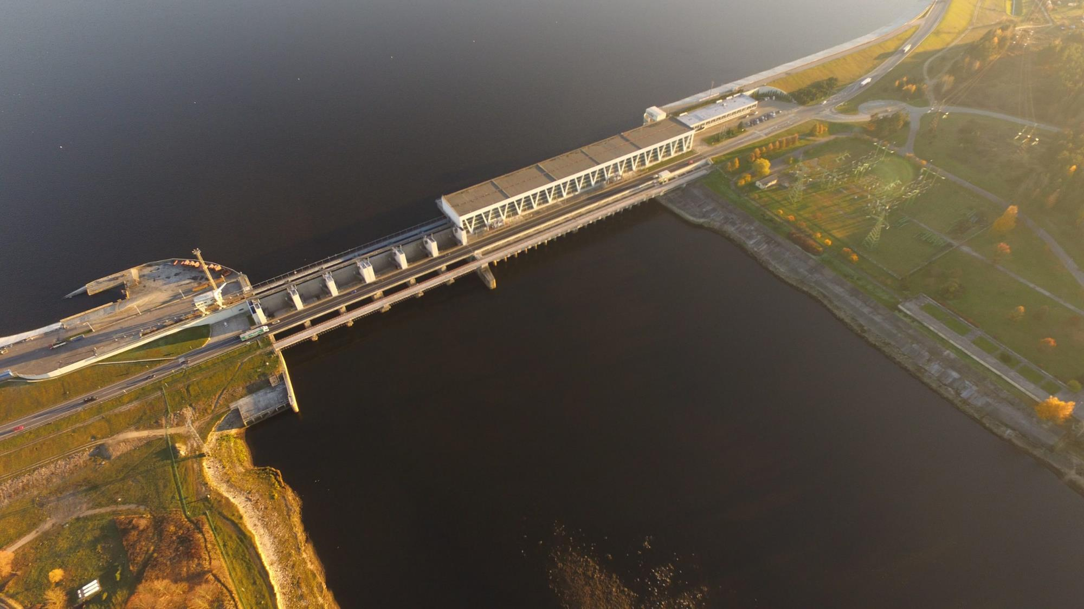
#3
In the EU
for share of renewable energy
(Eurostat, 2022)
Latvia is an inclusive, digitally advanced and cost-efficient EU country

Slide 8
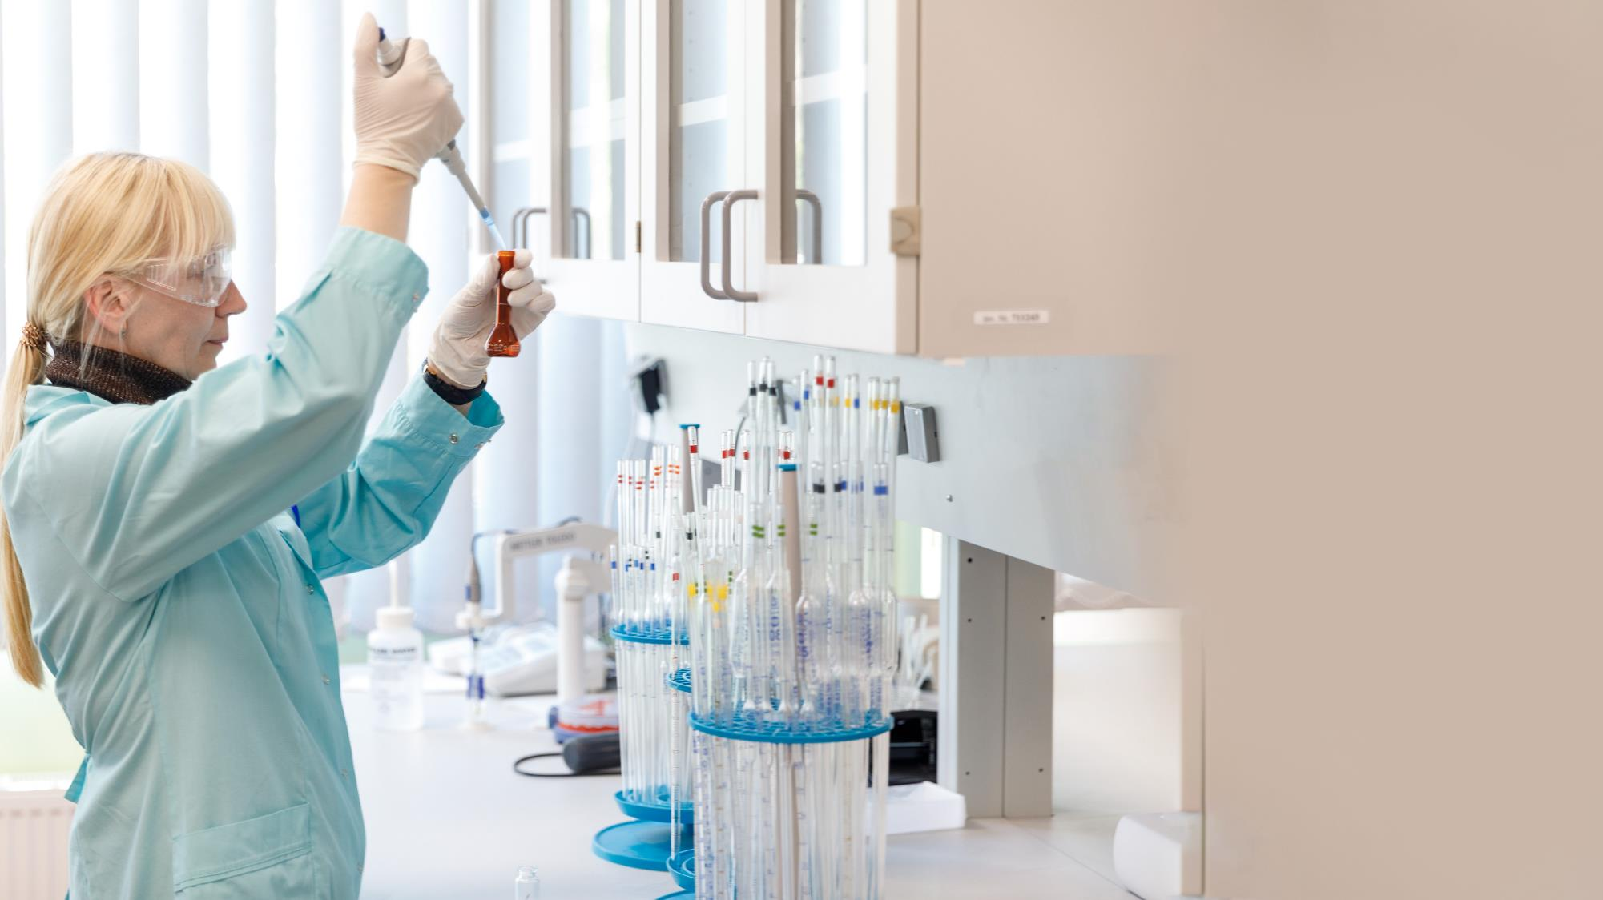
#1
With the highest
women inventor rate
in Europe – 30.6%
(European Patent Office, 2022)
Latvia is an inclusive, digitally advanced, and cost-efficient EU country
Notes:
Source: https://investinlatvia.org/en/news/latvia-has-highest-proportion-of-female-inventors-in-europe

Slide 9
eID
Digital ID for signing documents
and remote access to 120+ government services
Latvia is an inclusive, digitally advanced, and cost-efficient EU country

Slide 10
With the world-class ICT infrastructure
that secures our high rankings in ICT
1st
91%
5th
84%
23%
1st
Mobile data usage among OECD countries
Households with Internet access
Among EU for high-speed internet coverage in households
Share of eGovernment service usage of all internet users
Female ICT specialists, 2x EU average
5G military
test site
in Europe
(OECD, 2022)
(Eurostat, 2022)
(Eurostat, 2022)
(DESI, 2022)
(Eurostat, 2022)
Notes:
Source:
https://investinlatvia.org/en/news/latvia-among-best-in-europe-for-high-speed-internet-access
Latvia performs well in providing digital public services to its citizens and businesses. Latvia has a highshare of e-government users (84% of internet users) https://digital-strategy.ec.europa.eu/en/policies/desi-latvia; file:///C:/Users/kristine.smilga/Downloads/DESI_2022__Latvia__eng_jWa6RzSSeHQORX0NbZ9K9FyDc4_88703.pdf

Slide 11
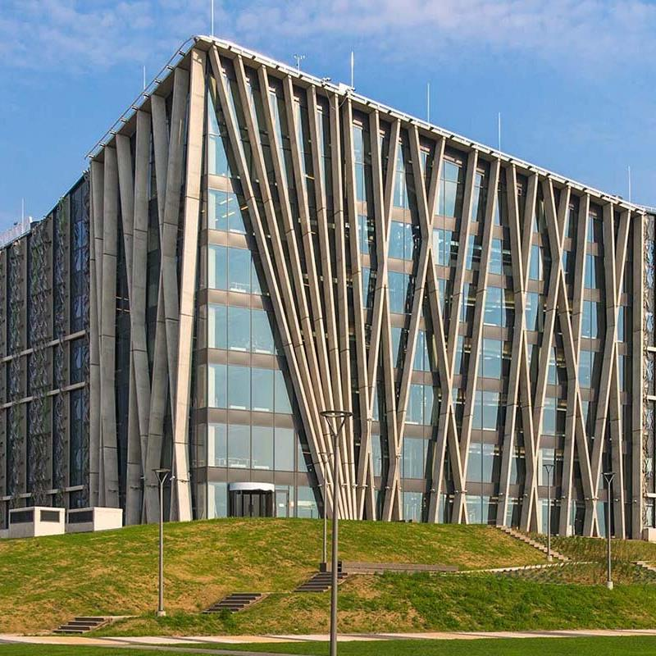
Latvia invests in education to continue its innovative development
45.5%
5.9%
57.6%
25%
of the employed (age 25-34) hold higher education degrees)
GDP expenditure on education
Female students
STEM students
(European Commision, 2022)
(European Commision, 2022)
(Latvian statistics office, 2022)
(Latvian statistics office, 2022)
Notes:
Source: https://op.europa.eu/webpub/eac/education-and-training-monitor-2022/en/country-reports/latvia.html

Slide 12
Latvia is on a mission to become the HQ of sustainable innovations
Some of our largest
success stories

Slide 13
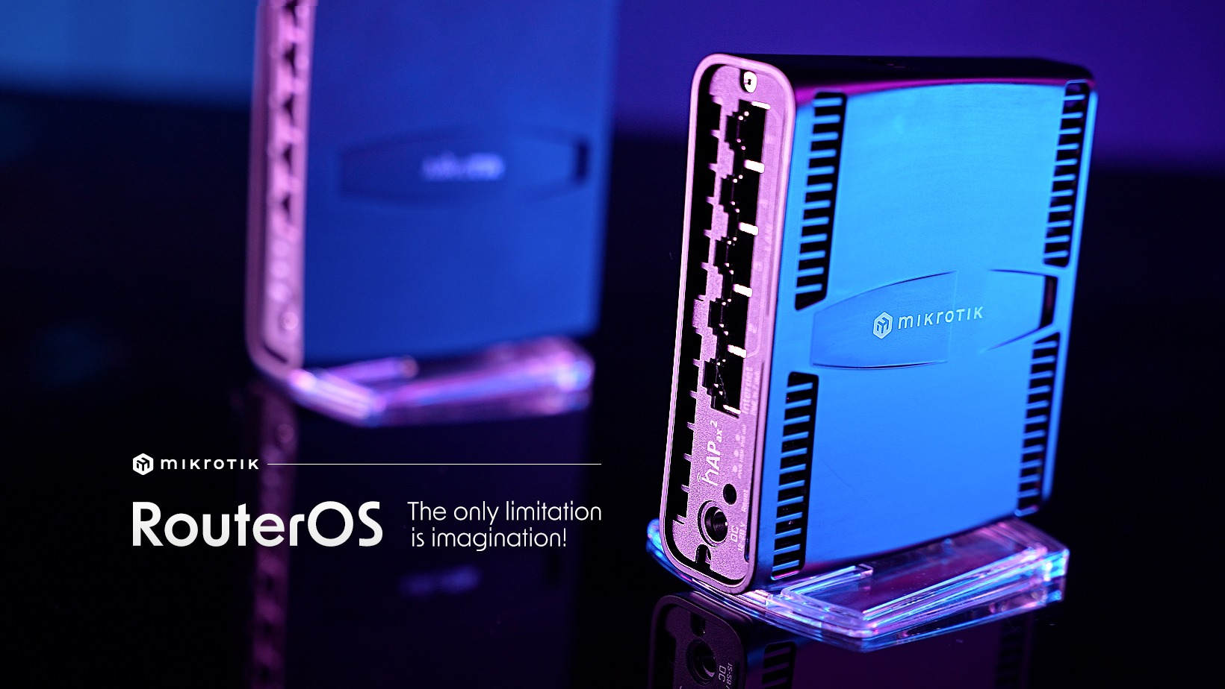
MikroTik
One of the world
leaders in networking,
hardware, and software

Slide 14
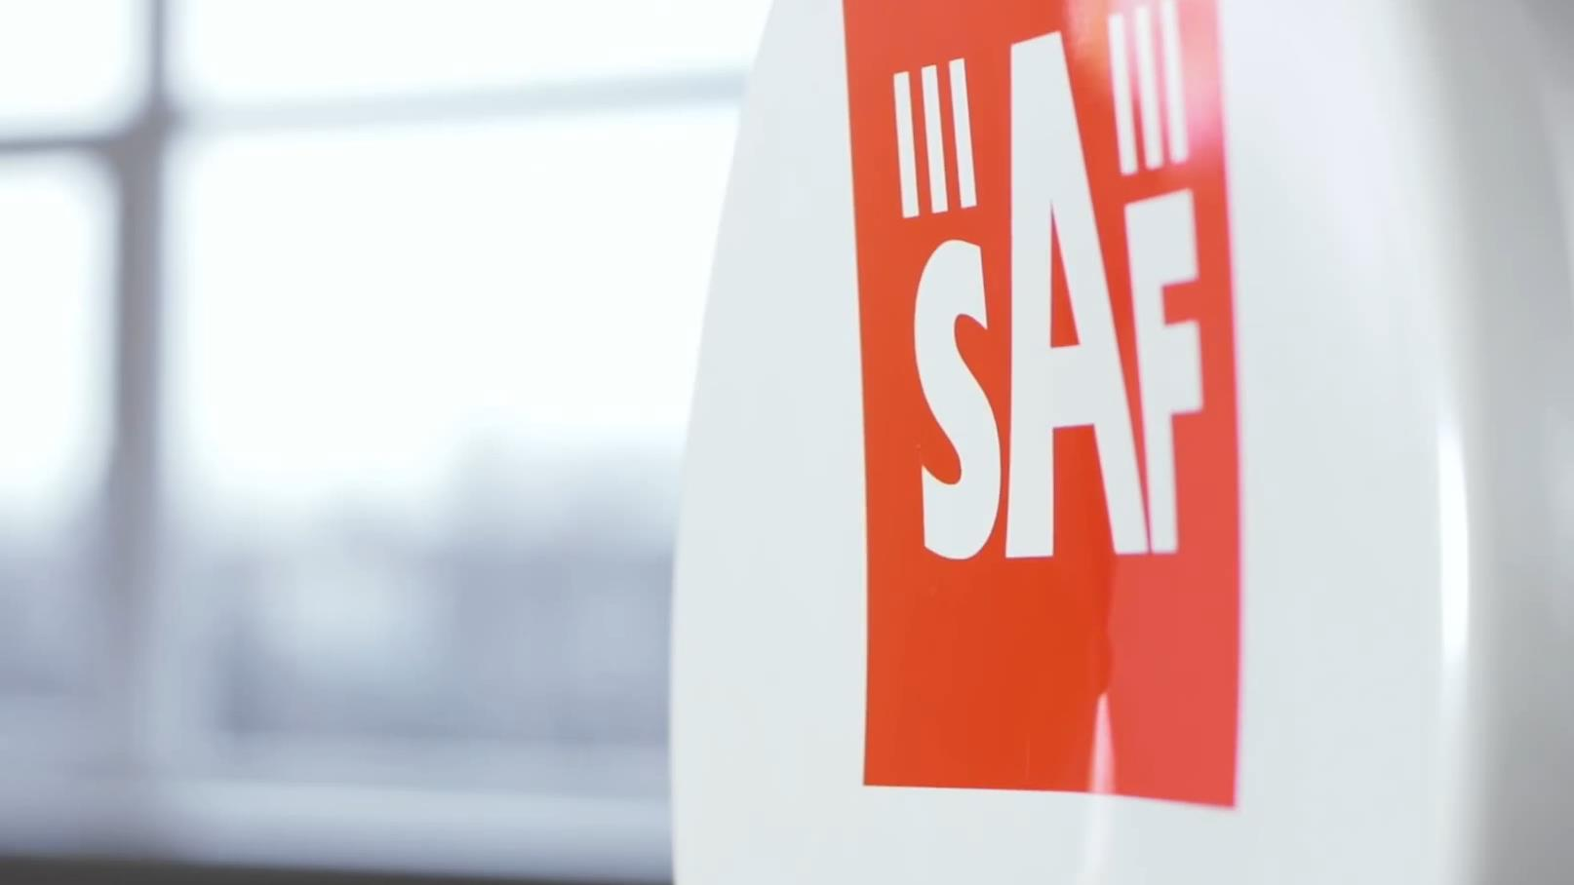
SAF Tehnika
Carrier-grade
microwave data
transfer solutions

Slide 15
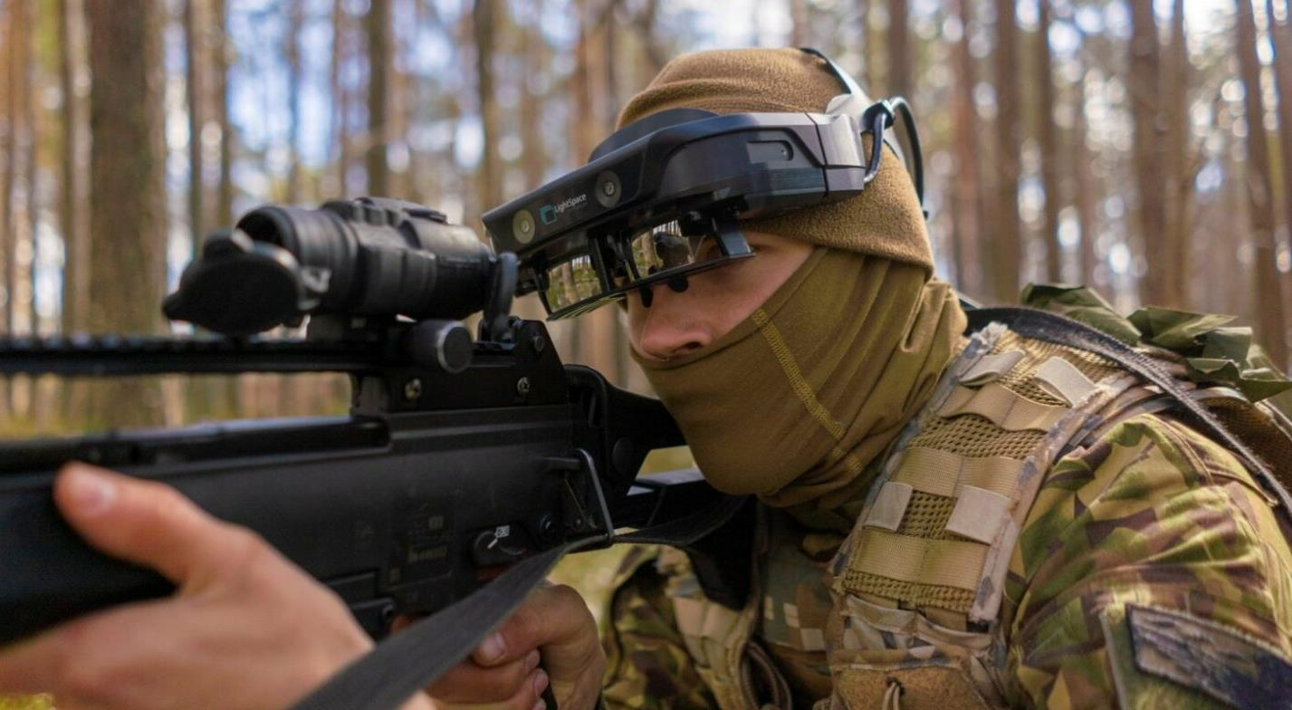
Lightspace
Unique multifocal AR headsets for civil and military purposes

Slide 16
Lightguide
The world's leading optical fiber production lab

Slide 17
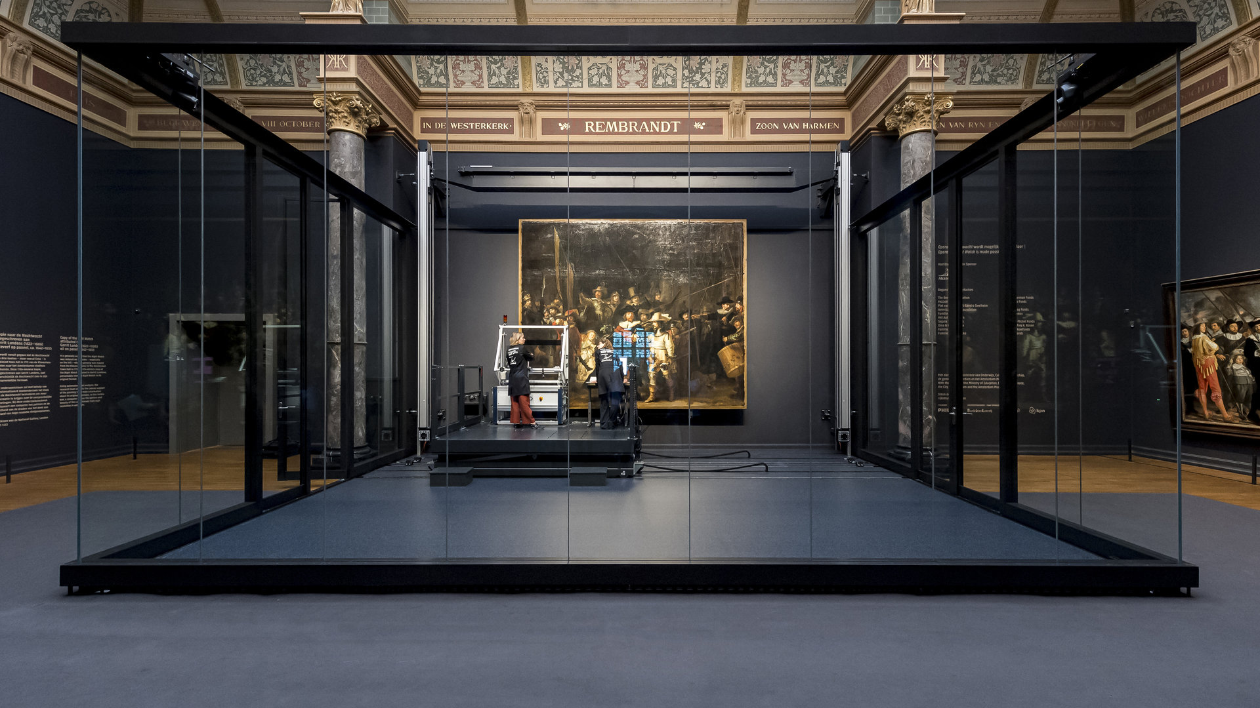
Groglass
Anti-reflective, shatter resistant glass. Protects masterpieces in the world’s best museums: from Paris Louvre and London National Gallery to Beijing Forbidden City.

Slide 18
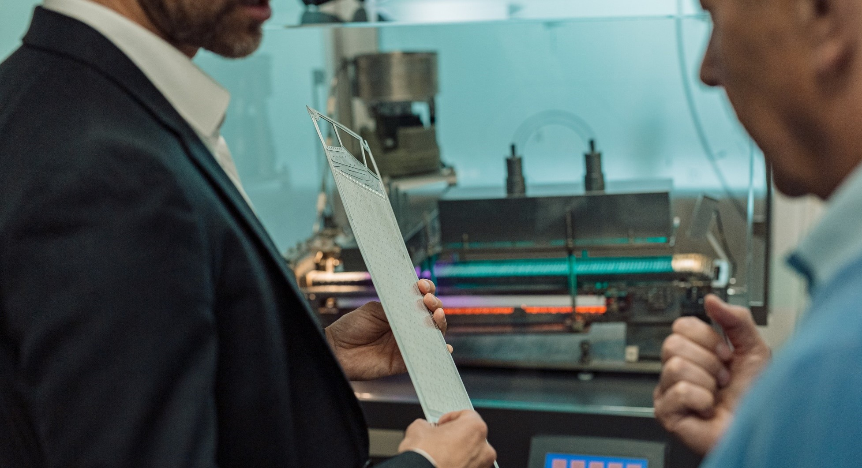
Naco Technologies Empowers the Green Hydrogen Revolution Through Future-Proof Nano-Coatings

Slide 19
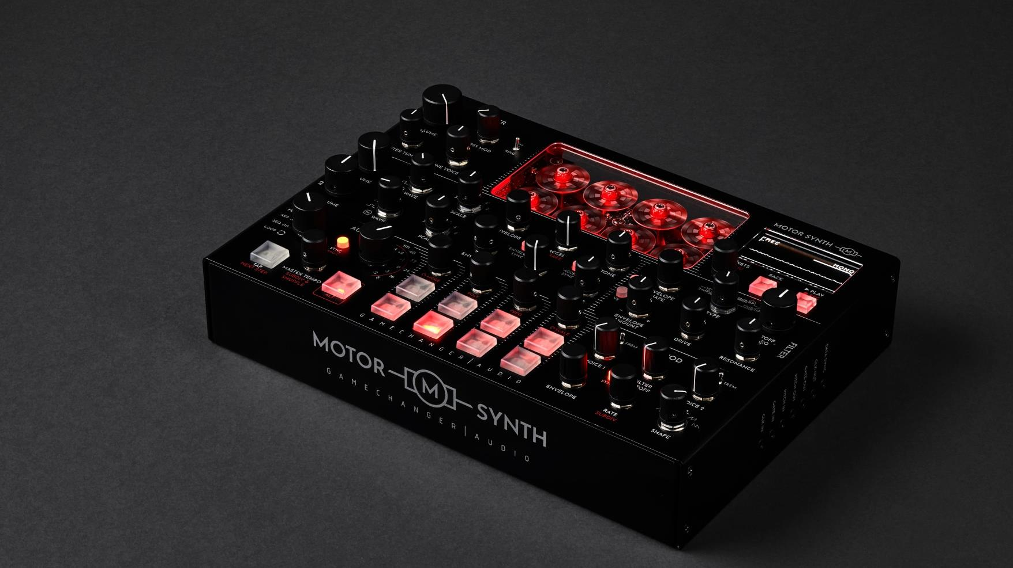
Gamechanger
Audio
Revolutionary technologies for creating music. Electro-mechanical synthesizers and innovative guitar pedals used by musicians worldwide

Slide 20
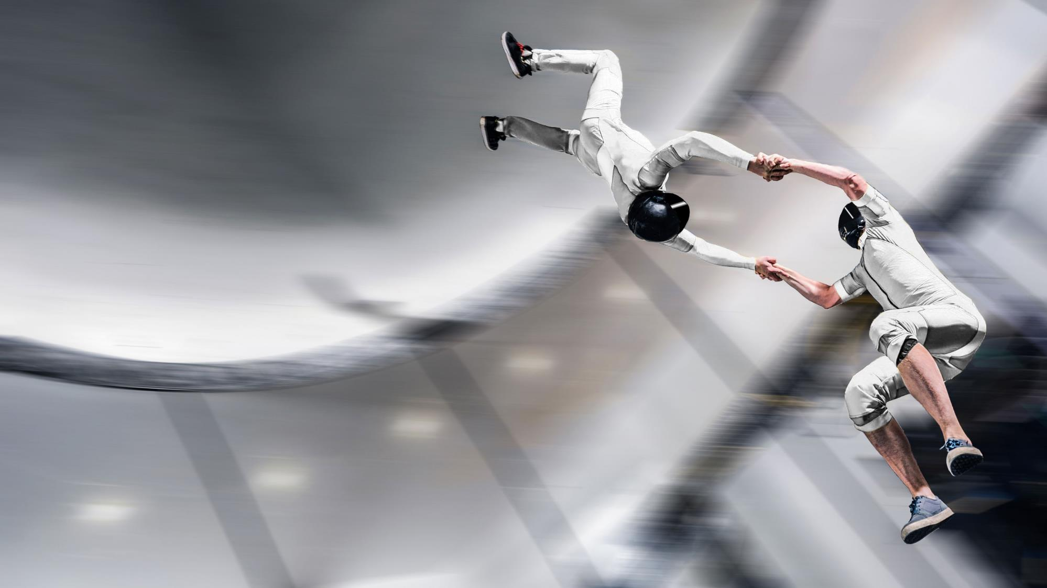
Aerodium
The world's largest wind tunnel constructed
for a Mission Impossible movie starring Tom Cruise

Slide 21
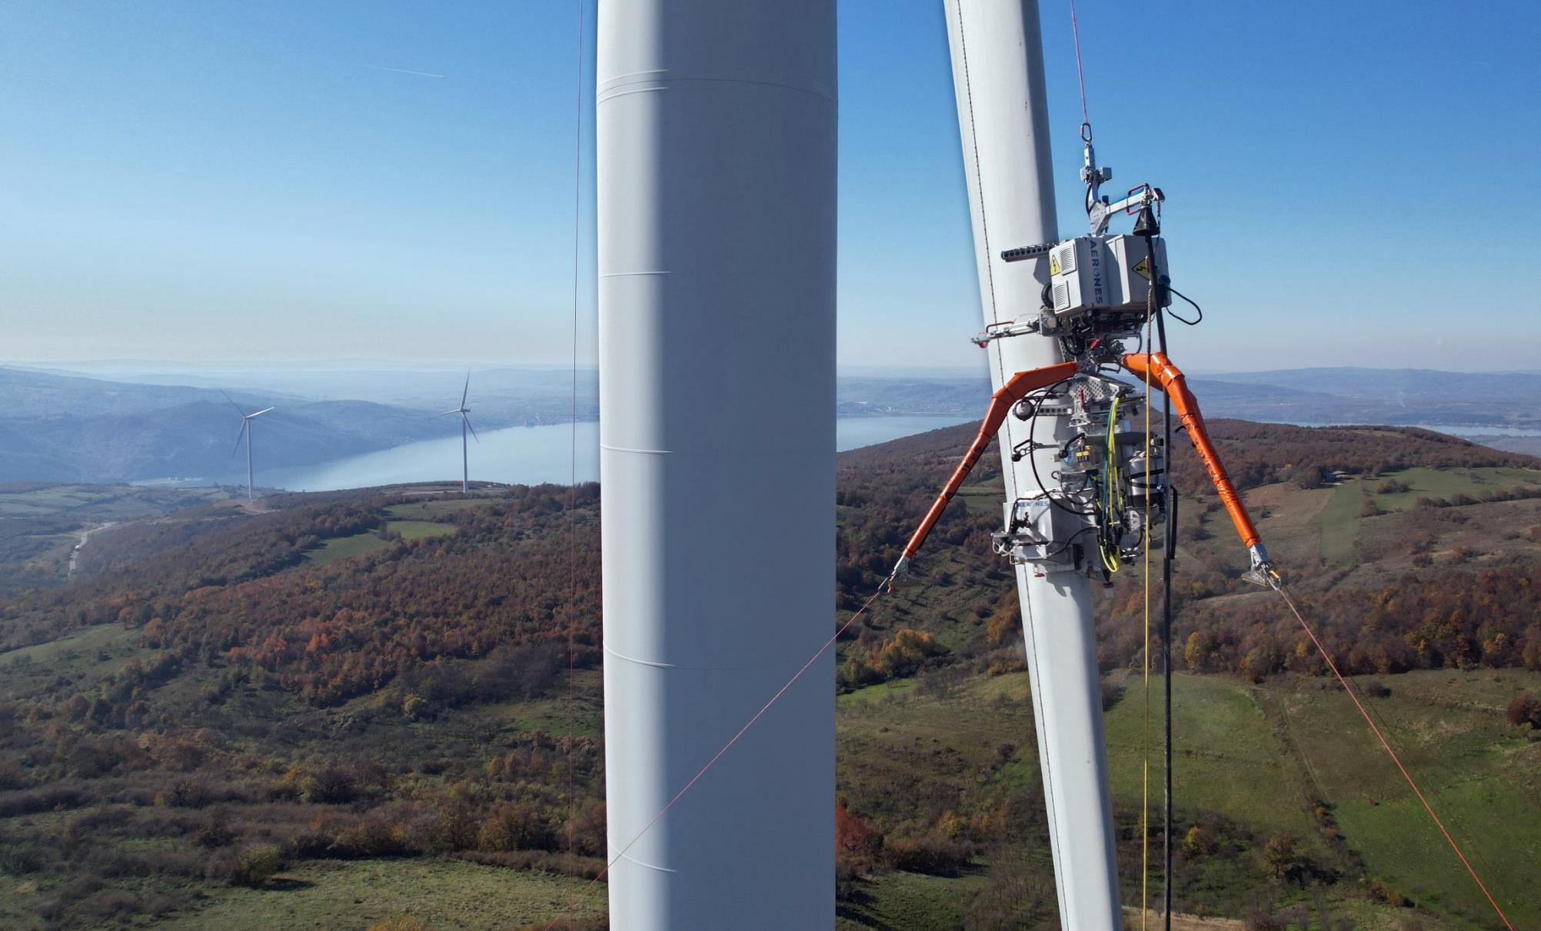
Aerones
First-ever robotic systems for wind turbine care and maintenance

Slide 22
Swotzy
A solution for optimization of last-mile deliveries for small and medium business

Slide 23
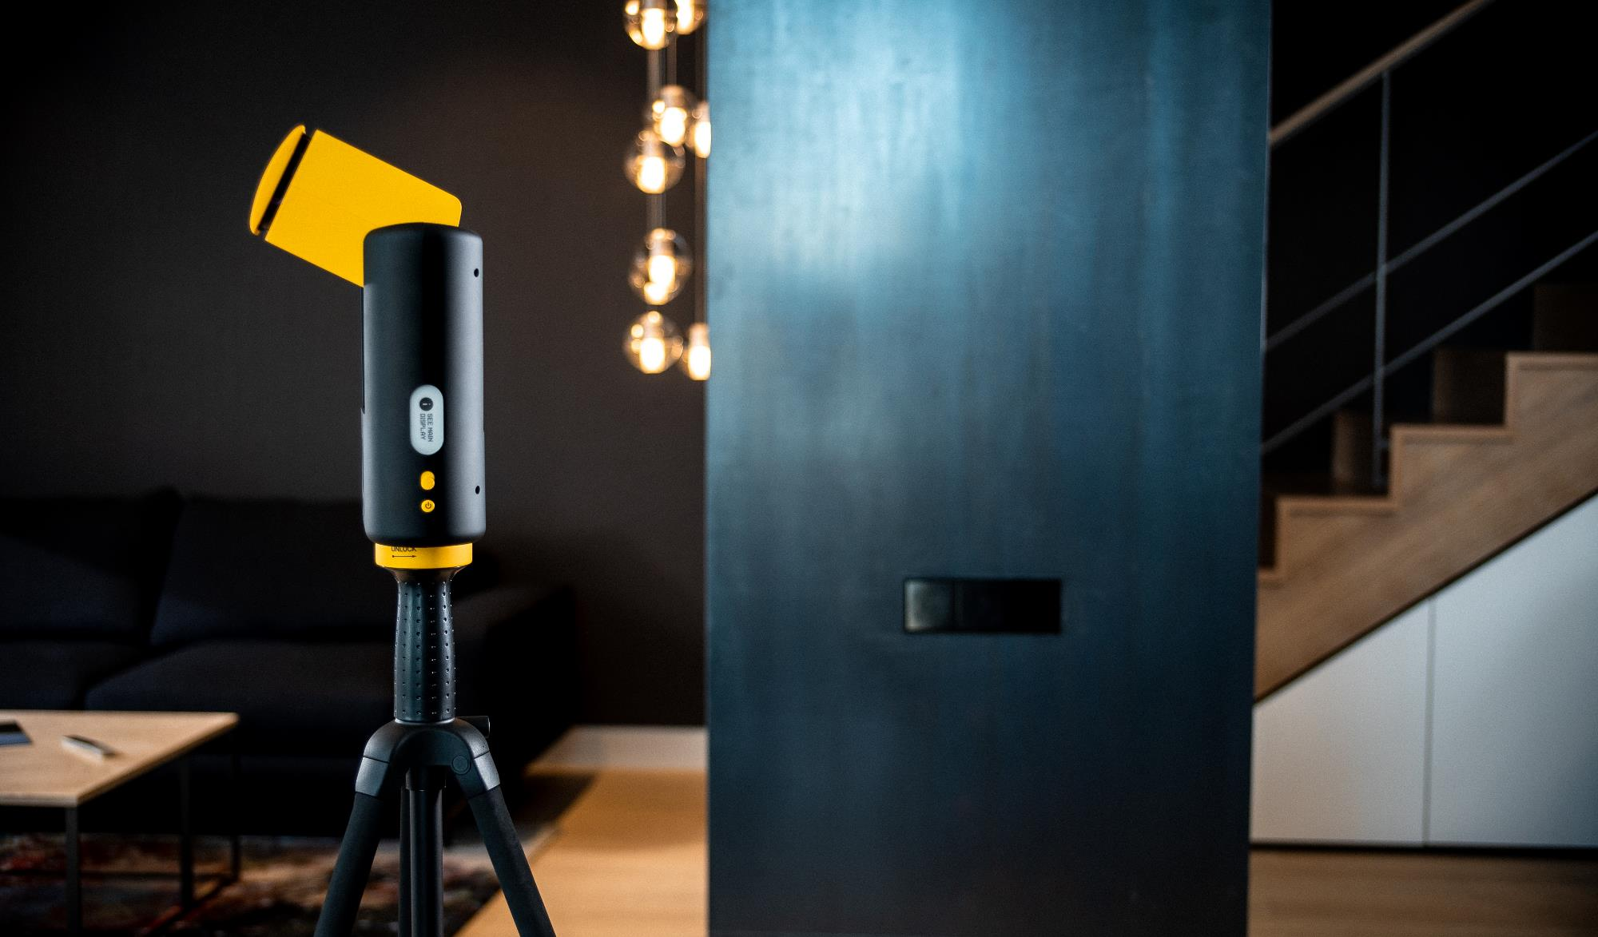
Giraffe360
A 360 degree camera for seamless property scans for real estate agents

Slide 24
Our main
values are

Slide 25
Our main values are
Ready for
any
challenges
Connecting
worlds
apart
Natural
playground

Slide 26
Ready for
any
challenges
Focusing on human drive, challenges,
and maximizing innovations
In the 2023 World Ice Hockey Championships, the Latvian men's ice hockey team won the bronze medal

Slide 27
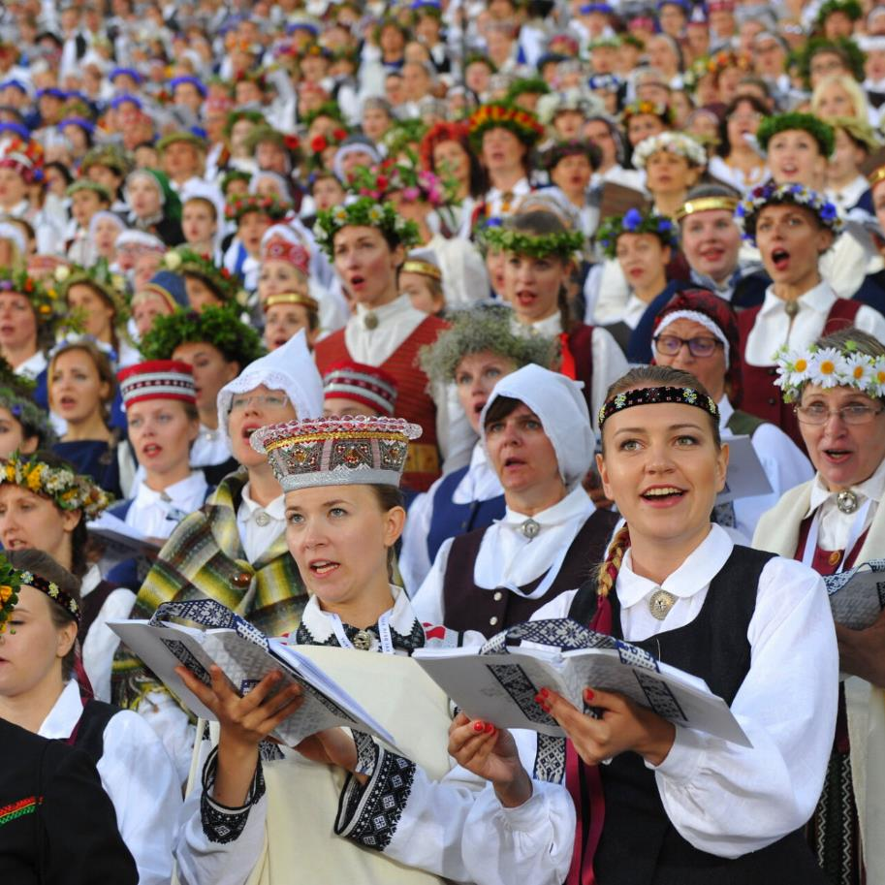
Connecting
worlds
apart
Uniting countries, industries,
societies, and people
The Latvian Song and Dance Festival hosts over 40,000 participants, making it one of the world's largest amateur choral and dancing events

Slide 28
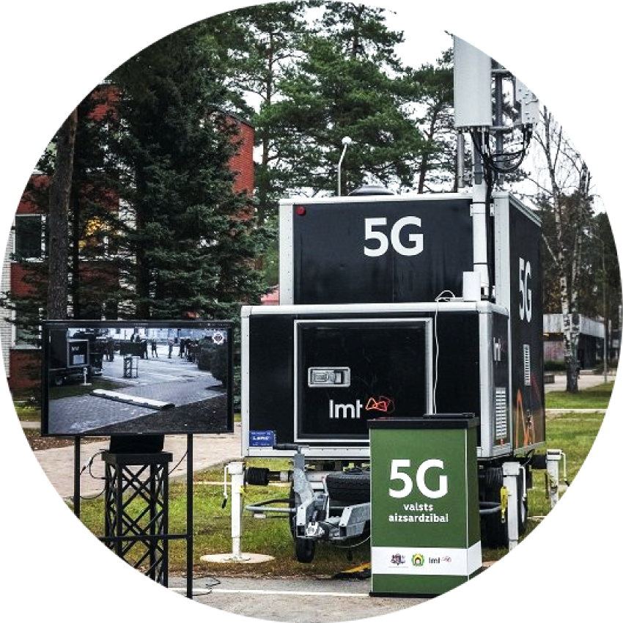
Natural
playground
Flexible to test and develop tech, and legislative
instruments for innovations
9 easy-to-use testbeds in drone, smart city, defence, mobility, and other verticals

Slide 29
Aiming further
for five key
smart sectors

Slide 30
Biomedicine,
Medical Technologies,
and Pharmaceutics
Photonics,
Smart Materials,
Technologies
and Engineering
Smart Energy
and Mobility
ICT & Smart City
Knowledge-intensive
Bioeconomy

Slide 31
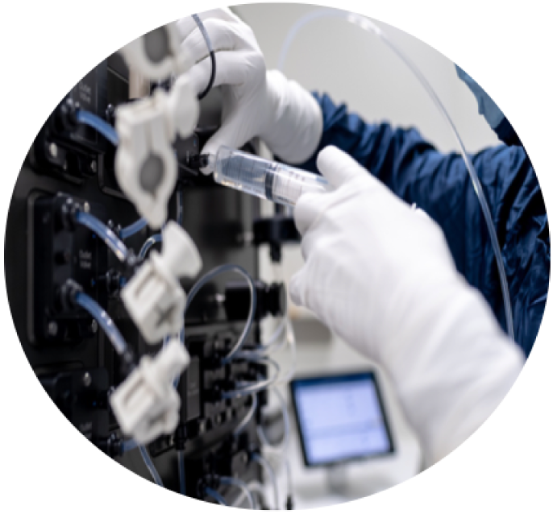
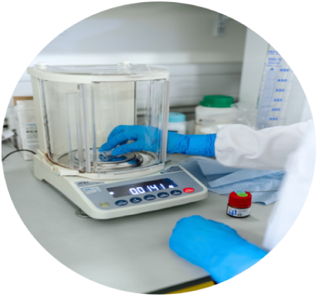
Biomedicine, Medical Technologies, and Pharmaceutics
One of the leaders in precision medicine research
Big data infrastructure focus
Developing organs on a chip
Long-established capabilities in chemistry R&D

Slide 32
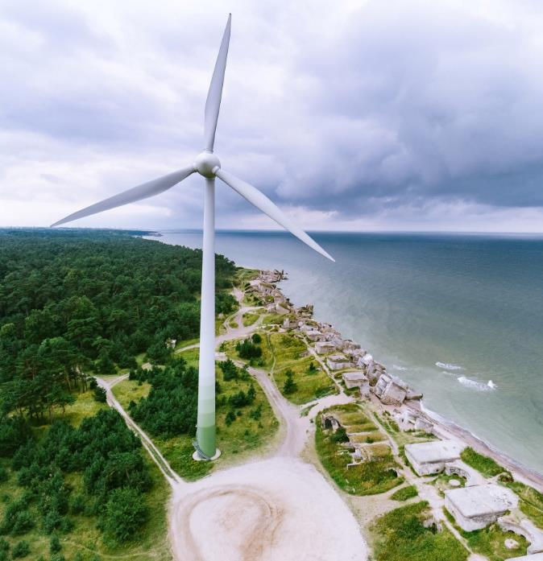
Smart Energy and Mobility
The largest offshore wind potential
in the Baltics at 16GW
Major players working on hydrogen tech
Target price at 40 EUR/MW
3TWh annual capacity Latvian-Estonian
offshore wind park

Slide 33
Knowledge-intensive Bioeconomy
Food exporter with increasing capacity
2nd in the EU with agriculture land
hectares per person
Wood product research and export with constantly increasing forest areas

Slide 34
Photonics, Smart Materials, Technologies & Engineering Systems
World's leading players in the development, manufacture and supply of optical fibers
5G routers and Thermal Night Vision
Cameras production
Creating a microchip design center of excellence
Deep Tech Atelier - the largest science-intensive technology conference in the Baltics (1000+ participants, 54 countries; dates for 2024 - May 16-17)

Slide 35
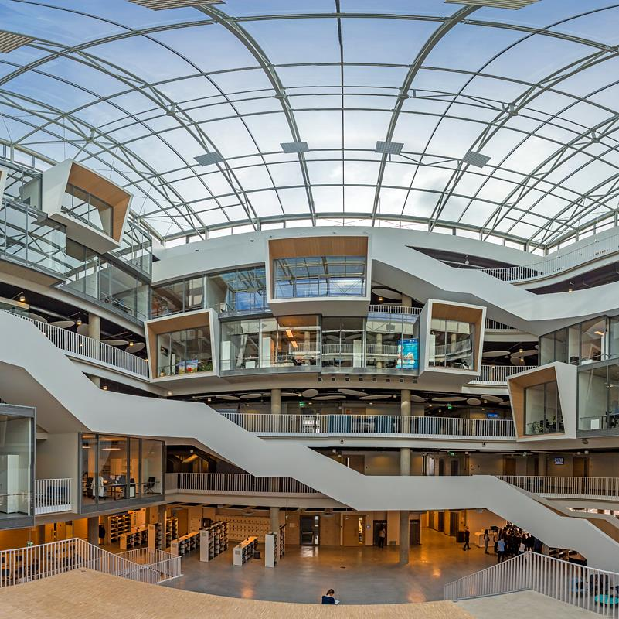
ICT & Smart City
Baltic leaders in exporting ICT services and product manufacturing
LATVIAN QUANTUM INITIATIVE unites 4 leading research institutions in quantum technologies
9 easy-to-use testbeds in drone, smart city, defence, mobility, and other verticals
5G Techritory – Europe's leading 5G ecosystem forum
Home to space infrastructure and niche technologies in precision, data, and energy
Notes:
LATVIAN QUANTUM INITIATIVE unites 4 leading research institutions in quantum technologies. Excellence in quantum algorithms and software, theory of quantum nanoelectronics, quantum sensors, and communication. More information: https://www.quantumlatvia.lu.lv/en/about/news/detail-view/t/71269/

Slide 36
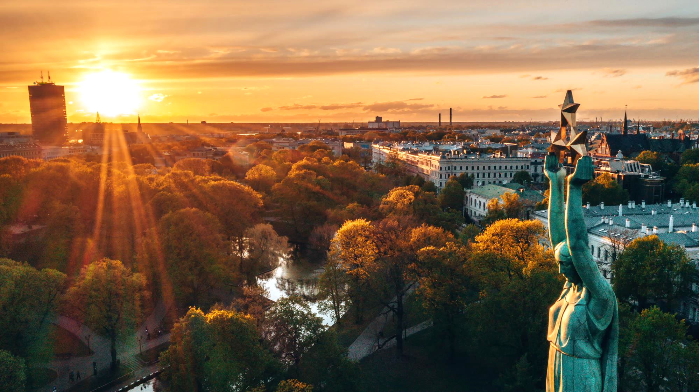
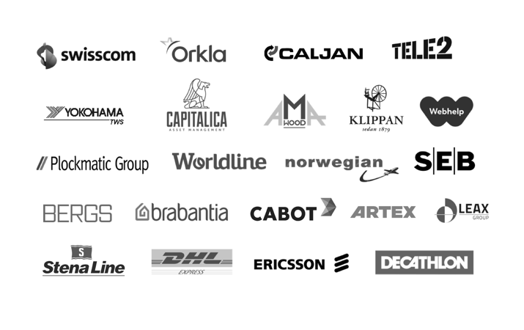
They have
chosen Latvia

Slide 37
And it feels
like home
Notes:
KR: And therefore probably another quite important thing is that it feels like home. Therefore, we're welcoming you, and we're ready to answer any of your questions. Thank you very much.

Slide 38
Our mission – your achievements
www.investinlatvia.org www.liaa.gov.lv www.latvia.eu

