Slide 1
Explore
Latvia

Slide 2
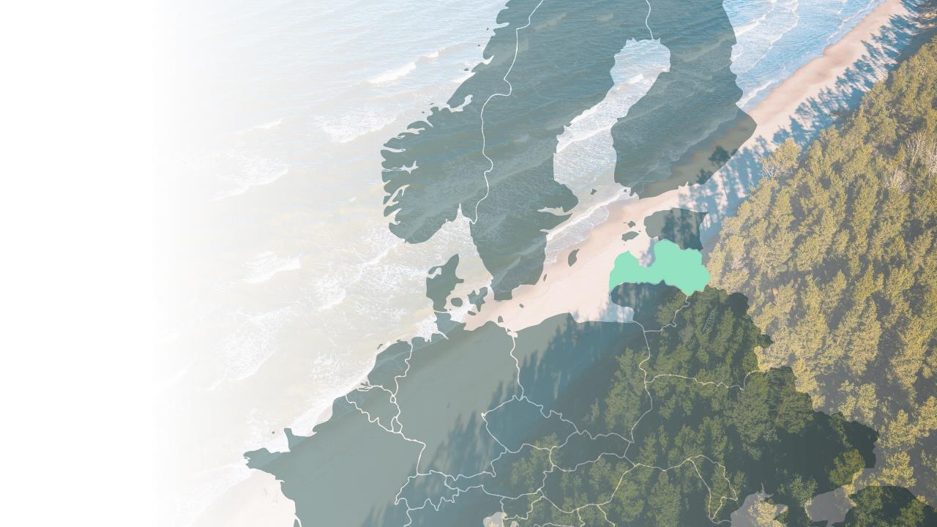
Key Facts
Government: Parliamentary Republic
Capital: Riga
Currency: Euro
Population: 1.9 million
GDP (2023) EUR 43.91 billion
GDP growth (’24 est.): 2.5%
Language: Latvian
Part of:

Slide 3
Nature,
culture,
heritage
inspire us to innovate
Reinis Hofmanis
Notes:
You may have heard that we excel in fields like 5G innovation, space research and quantum computing. Latvians are a nation of doers.
But you can also come across the fruits of local innovation at shops. Many companies find inspiration in nature, creating unusual consumables. Madara Cosmetics, for example, produces organic skincare with ingredients like birch sap, freshwater mud and chanterelle extract. Fermentful makes a vegan kefir alternative from green buckwheat, and Nutriboom freeze-dries pickled vegetables to create a healthy snack.

Slide 4
Well-connected
to the world and each other
Shutterstock I Juris Jugs
Notes:
Neither places, nor people are far from each other in Latvia. Once you land at Riga International Airport, arrive at the port or coach station, even the furthest points in the country are reachable in three to four hours’ time by road and rail. As our national airline, AirBaltic provides direct flights to over 100 destinations. Serving as the air hub of the North EU and Baltics, it offers up to 100 direct flights, located just 9 kilometers from Riga International Airport. Ferries operate to and from 2 port cities in Latvia – Liepaja and Ventspils. The ferry between Liepaja and Travemunde in Germany operates up to 5 times a week with sailing duration from 26 hours.
Also, Latvians can be found everywhere we go in the world. The diaspora community is thriving and well-connected all around the world.

Slide 5
Weather
blessed with four
distinct seasons
Latvia Travel
Notes:
Latvians indulge in the outdoors throughout the year, enjoying the four distinct seasons that the country is blessed with. The favourable Northern European climate and landscapes have nurtured Olympic medal-winning teams in beach volleyball, BMX and bobsleigh, talents in ice hockey, basketball and biathlon.
This is what makes us strong and resistant in daily life, sports, and business.

Slide 6
Pure northern nature
and plenty of space to
breathe
Reinis Hofmanis
Notes:
Firmly in the European North, Latvia is home to the likes of roe deer, lynx and woodpeckers who live in its dense forests of birch trees pines, firs and fellow non-tropical species. Woodland, natural meadows, agricultural lands and pastures peppered with deep blue lakes, winding rivers and boglands – such are the classic Latvian landscapes. The 500-kilometre coastline is another jewel in Latvia’s crown. Forests in Latvia cover ~ 53% of the country's territory.

Slide 7
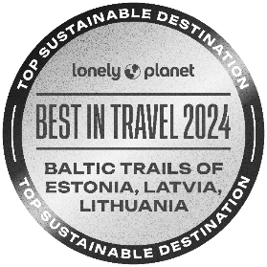
Baltic trails -
best
in travel 2024
Artis Veigurs
Notes:
The breathtaking nature trails in Latvia and other Baltic states are truly a sight to behold, and their excellence is underscored by Lonely Planet, which has honored Baltic trails as the Best in Travel for 2024.
In Latvia, nature trails are so abundant that just taking a step outside feels like finding yourself on one! The opportunity offered by Latvia's trails often surprises many, allowing them to truly find themselves in the midst of a bog rather than just observing it from a distance. "Walk in the swamp" might sound dull, but not when experienced in Latvia. The same applies to various landscapes, cliffs, formations, and other natural objects – everything is close, accessible, often without crowds. A tourist can feel like a part of nature, not just an observer!

Slide 8
From ancient roots to
complex contemporary
I
identity
Jānis Bautra
Notes:
The architecture, heritage sites and museums of Latvia guide visitors on a journey through time, revealing the historical events that have touched, shaped and bruised the place and its people. Around 9000 BC, the first people started to live on what is now Latvian soil. Around 3000 BC, the first Finno-Ugric tribes arrived, followed by the Baltic tribes. Our pagan ancestors lived in tune with the rhythms of nature until German crusaders sought to convert them to Christianity. The 12th century marked the start of the tumultuous crusades.
National sentiment began to grow in strength culminating in the founding of an independent Republic of Latvia in 1918. The events of World War II and the ensuing Soviet occupation interrupted this independence. However, in 1990 Latvia declared its freedom once again after years of a successful Singing Revolution – the Baltic people’s peaceful revolt against the occupying regime. Today, Latvia is a member of the European Union, NATO and the Schengen area. Its people have found a way to transform a complicated past into a bright future, finding inspiration in nature, culture and the arts.
The cultural and historic heritage of Latvian architecture spans many centuries, from authentic rural homesteads to unique samples of wooden architecture, to luxurious palaces and manors, churches, and impressive Art Nouveau buildings. There are outstanding architectural gems to be seen not just in the capital city of Riga, but also in towns, villages, and the more remote regions of Latvia. The controversial Soviet legacy in architecture also covers several decades, with striking samples all across the territory of Latvia.

Slide 9
Cultural
scene that engages, energizes, and inspires
Edijs Andersons
Notes:
Riga is home to the renowned Latvian National Opera and Ballet, the Latvian National Symphony Orchestra, major theatres and art museums but the capital city is far from the only point of interest for culture-loving travellers. Recent years have seen the opening of purpose-built event venues in Liepāja Cēsis, Ventspils and Rēzekne that offer varied programmes balancing between the hyperlocal and global. In Jūrmala, the Dzintari Concert Hall is a legendary establishment, providing entertainment and enlightenment since the late 19th century. In summer, open-air music festivals happen across the country.
Art events too give reason to explore the country beyond the capital. Every year, for example, the Cēsis Art Festival surprises visitors with pop-up venues like open-air cinemas in the woods. In nearby Valmiera, the Kurtuve contemporary art space stages events on the premises of a former boiler house, and in Riga, the Survival Kit contemporary art festival fills forgotten buildings with new meaning.

Slide 10
Local
cuisine
simple and sincere,
guided by the four seasons
Justīne Kalēja, Pavāru māja Līgatnē
Notes:
In Latvian cooking, dill and caraway seeds stand out as important spices. However, the focus is not on surprising flavors but rather on the reliable quality of ingredients. Local cuisine aims to deliver deep satisfaction and rich nutrition through its dishes.
Today, inventive chefs find new ways to combine local ingredients with foreign flavours, bringing out the best from the humble produce. At the same time, ancestral methods like smoking, pickling and fermenting have never really gone out of fashion, so contemporary cuisine is very much informed by tradition.
In the drinks cabinet, you will find local beer, wine and cider. Although winemakers are a simple and sincere local cuisine guided by the four seasons experimenting with grapes, Latvian wines are typically fruit wines with raspberry, rhubarb and quince being popular varieties. Interesting non-alcoholic drinks include the birch and maple sap collected fresh in spring and fermented to enjoy later in the year. Also worth exploring is the world of herbal tea. For an unforgettable introduction to today’s finest Latvian cuisine, several Michelin-starred restaurants await.

Slide 11
Michelin
magic:
stars illuminate Latvia's culinary scene
Latvia Travel
Notes:
The MICHELIN Guide Latvia 2024 was officially unveiled, featuring 26 restaurants across the country. Nineteen are nestled within Riga, while seven are located outside the capital. The guide includes the recognition of one restaurant with One MICHELIN Star (Max Cekot Kitchen), three restaurants receiving a MICHELIN Bib Gourmand, and one restaurant being lauded with a MICHELIN Green Star for its commitment to sustainability.
As we celebrate this achievement, we take pride in the fact that our exceptional food culture will now gain more recognition on a global scale. We extend a warm welcome to gourmands worldwide, inviting them to explore and savor the culinary delights that Latvia has to offer.

Slide 12
The rich
cultural heritage
continues to infuse our daily lives
Gribu vasaru
Notes:
Our heritage is not filed away, collecting dust in an archive. Folk dancing, choral singing and handicrafts are still popular hobbies and significant social activities. Many locals still earn a living from their craft, and numerous artisans invite visitors into their workshops and studios. Weavers showcase their skills, tapestries and clothing, potters not only sell their wares but teach the craft too, and carpenters reveal the tips and tricks of their trade.
The Latvian Song and Dance Festival (Latvian: Vispārējie latviešu Dziesmu un Deju svētki) is one of the largest amateur choral and dancing events in the world and an important event in Latvian culture and social life. As one of the Baltic song festivals, it is also a part of the UNESCO Masterpieces of the Oral and Intangible Heritage of Humanity list since 2008. Around 40,000 singers and dancers performed at last year's Latvian Song and Dance Festival.

Slide 13
Ancient and contemporary
wellbeing practices keep us in
good spirits
Reinis Hofmanis
Notes:
Before the advent of the sanatorium and modern-day spa, Latvians had the pirts or sauna. As well as being a functional space for cleansing the body, it fosters cleansing the mind and soul. While there is no single recipe for enjoying the pirts, it usually involves some mix of heat, water, steam and herbal tea. For the most profound experience, enrol a trained sauna master. They guide the process ensuring one’s comfort and safety and skillfully navigate the contrast between hot and cold.

Slide 14
Riga
the compact but action-filled capital of Latvia
Live Riga
Notes:
Vecrīga the UNESCO-listed old town The historical heart of Riga is where the ancient port city’s story first began in 1201. Its charming cobblestone streets, remarkable facades and churches shed light on what this “Baltic metropolis” has experienced in its more than 800 years of existence. As a member of the Hanseatic League Riga prospered from trade in the 13th-15th centuries. While many of the earliest buildings were destroyed by war or fire, the sense of prosperity was never lost. New masterpieces arose, reflecting the trends of the time and the influence of foreign cultures. In the old town one sees fine examples of Baroque and Renaissance architecture beside the remaining medieval monuments. With the industrial developments of the 19th century, Riga boomed yet again, acquiring its neoclassical wooden buildings and later Art Nouveau gems. Today’s old town is an amalgamation of the past and present. It is home to some of Riga’s leading hotels, restaurants and bars, giving a new lease of life to its historical premises. Major attractions like the Museum of the Occupation of Latvia, Riga Cathedral, and the Museum of Decorative Arts and Design are also found in the old town. A canal borders the old town, marking the site of the ancient city walls, beyond which now lies the Centrs neighbourhood.

Slide 15
Latvia's rise in
business
& event
tourism
5G Techritorry
Notes:
Business and event tourism is unique in Latvia, providing us with the opportunity to preserve and showcase both our authenticity and cultural heritage, while contributing to the local economy. By promoting the organization of internationally significant events in Latvia and attracting tourists, we not only enhance our societal education but also create motivation to continue investing in sustainable tourism infrastructure and offerings.
The city boasts over 17,000 beds and hosts over 50 business exhibitions annually, with approximately 7,000 exhibitors and millions of attendees. It has been the venue for prestigious events such as the NATO Summit, the World Ice Hockey Championship, Eurovision, Latvia's Presidency of the Council of the European Union, and numerous international conferences. Here you will find more than 350 listed meeting venues in Latvia, many of them equipped with cutting-edge technology.
Continuing with sustainability, in Latvia, the term might sometimes seem artificially attached to almost everything, but for us, it's inherent. It's second nature. And it's not typical for the rest of the world. Nature and its proximity are our essence, often leading to the creation of innovative products with a deep respect for the environment. This intrinsic connection allows us to stand out on the international stage and naturally positions us as an increasingly attractive conference destination.
Moreover, each region in Latvia can offer a unique and individual approach, and equally important, a high quality of service from our service providers.

Slide 16
This is just a glimpse of
Latvia
Explore more at www.latvia.eu and consider Latvia as your next destination for travel, innovation, and growth

Slide 17
Restless in nature united in mission
www.latvia.eu
https://investinlatvia.org/
https://www.latvia.travel/en
#missionLatvia

