Slide 1
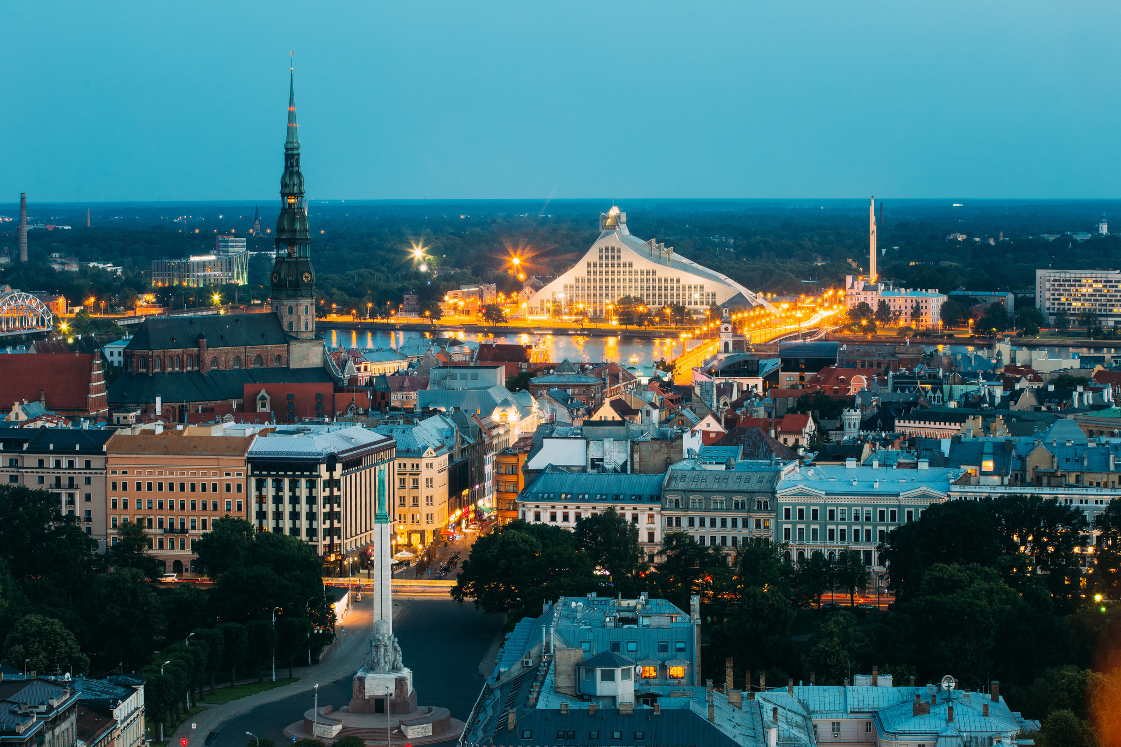

Latvia
Built to Scale.
Driven by Innovation.
April, 2026
Notes:
1

Slide 2
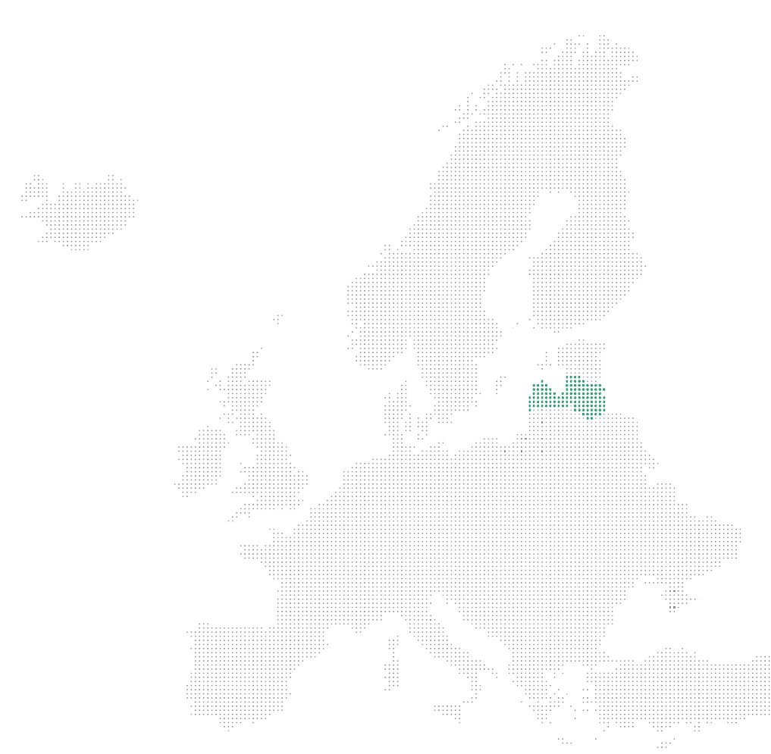

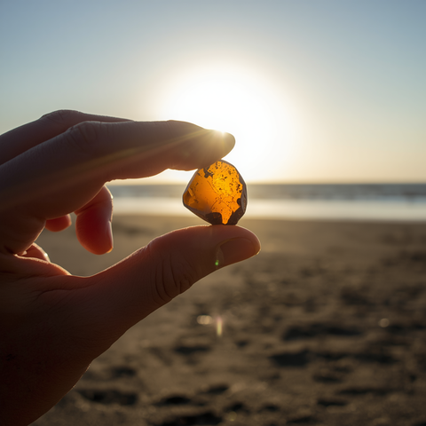

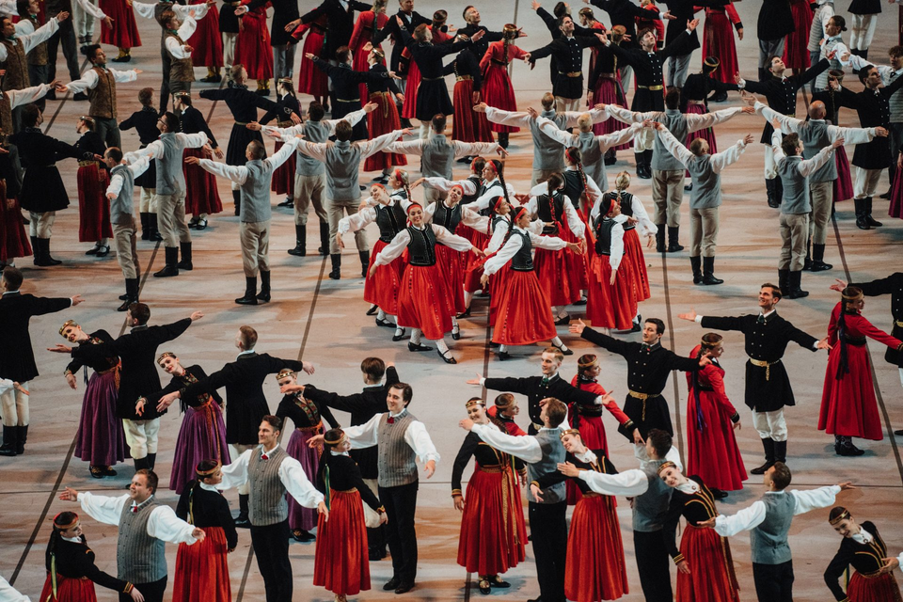
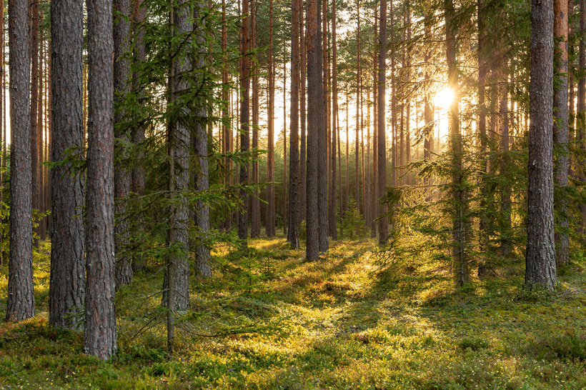
Deeply rooted in nature and tradition, Latvia innovates for greener and better future
Notes:
Latvia, a country renowned for its breathtaking landscapes and rich natural heritage, holds nature and tradition at the heart of its identity. These core values shape Latvian culture and inspire the nation’s innovations, embracing the challenges of today and the future on a global scale.

Slide 3
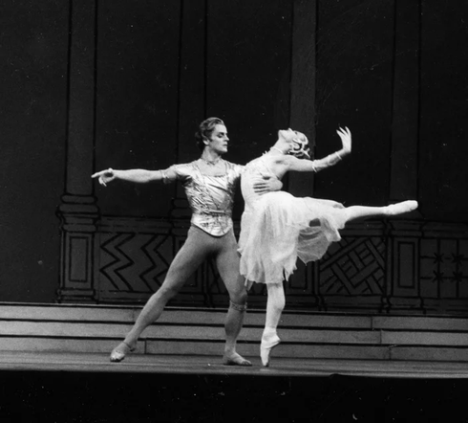


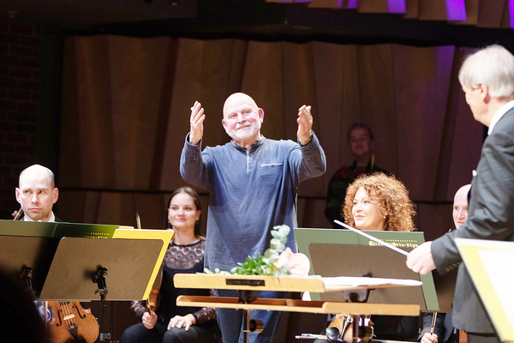

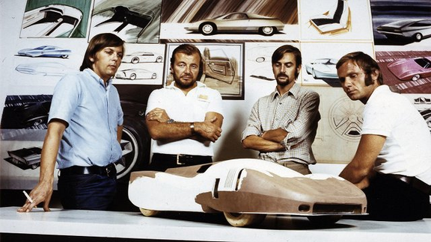
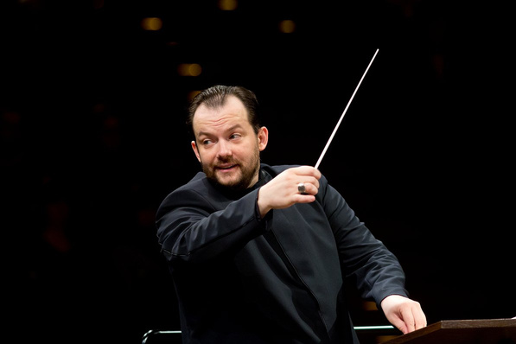

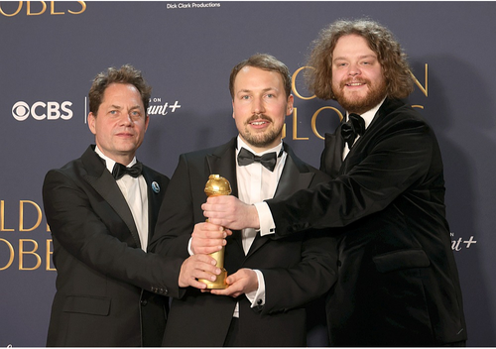
Talents and innovators who influence world's culture scene
Mikail Barishnikov
Elina Garanca
Mark Rothko
Pēteris Vasks
Ballet star
Opera singer
Painter
Composer
Anatolijs Lapiņš
Andris Nelsons
Jacob Davis
Gints Zilbalodis
Designer - Porche 911 & Chevrolet Corvette Stingray
Conductor, multiple Grammy winner
Latvian-born tailor invented denim
Academy award winner, Flow
Notes:
These core values reflect in Latvias great talents and innovators who influence world's culture scene

Slide 4
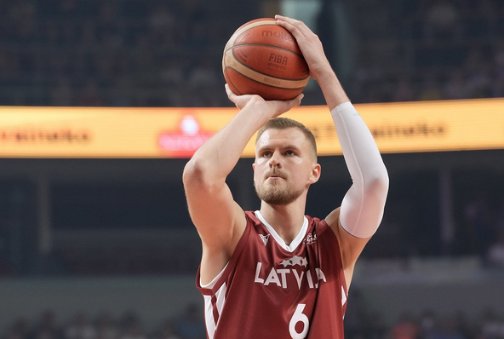
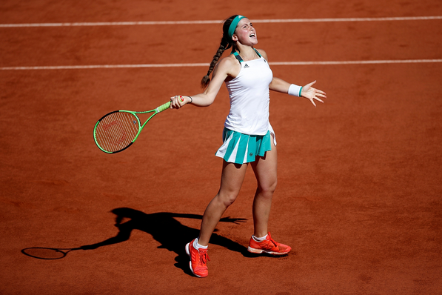
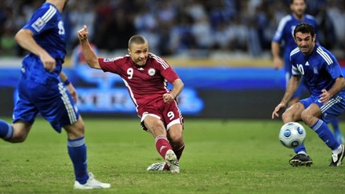
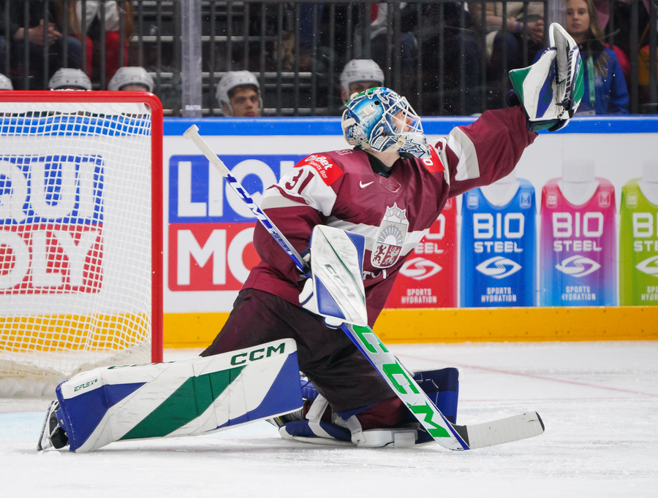
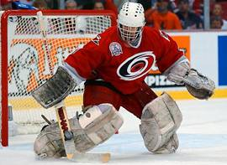
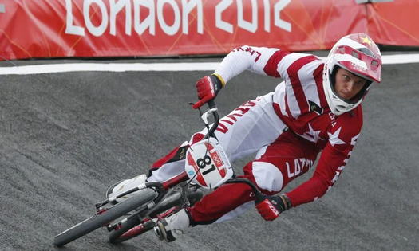

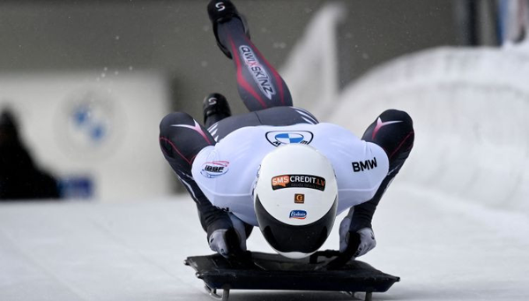
Champions who put Latvia on the world map
Kristaps Porziņģis
Jeļena Ostapenko
Māris Verpakovskis
Artūrs Šilovs
NBA champion
Grand Slam champion
Champions League and
Euro 2004 striker
NHL playoff breakout star &
IIHF World Championship MVP
Artūrs Irbe
Māris Štrombergs
Uļjana Semjonova
Martins Dukurs
Iconic Latvian
NHL goalkeeper
Two‑time Olympic BMX champion
Olympic women’s
basketball legend
One of the most decorated athletes in skeleton history

Slide 5
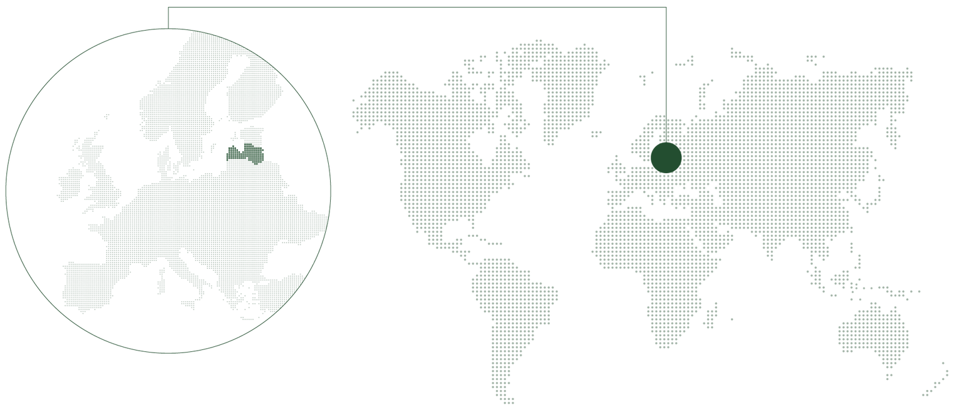









Latvia - Access to EU market
450 Million people
Time zone
(GMT+2)
Capital: Riga
Population: 1.9 million
Language: Latvian
GDP: EUR 43.0 B (2025)
Latvia’s GDP per capita growth since independence: 2× the EU average
Unemployment: 6.9% (2025)
Average gross salary: 1.815 EUR/month (2025)
Defence budget: 4.91% of GDP (2026)
Ratings: S&P Credit A, Moody’s A3
In 2025 – Joined UN Security Council
Latvia is among a group of only 20 nations that are members of all major international organisations

Slide 6
Advantages of Latvia’s business environment
Among world’s best tax regime, fast decisions, flexible solutions, and the agility to move faster than larger economies
0%
#2
80%
#4
96%
Corporate income tax on reinvested profit
#1 Corporate Tax Rate Index, 2025
(Among OECD countries)
International Tax Competitiveness Index 2025
Discount on CIT for dividends in 5 vast Special Economic Zones
In the EU for the share of renewable energy
Public services for businesses are digital, EU average - 86%
(Among OECD countries)
2025
(% of EU target, DESI 2025)
eID
98% Companies sign documents digitally
Notes:
Latvia is #4 in the EU for the share of renewable energy, 2025:
https://ec.europa.eu/eurostat/statistics-explained/index.php?title=File:Renewable_energy_2024_infographic.jpg

Slide 7
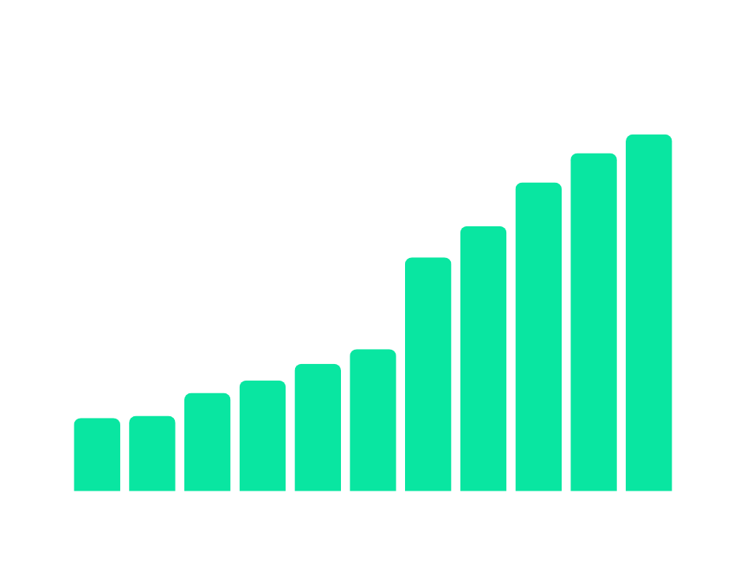
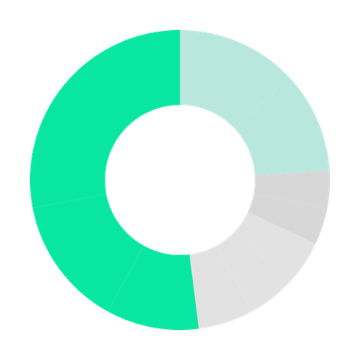
Latvia
Attractive investment location
Latvia’s FDI has doubled since 2015, reaching a record EUR 27.1 B in 2025
87% of FDI comes from the EU/EEA – proving strong investor confidence in EU leading economies
LIAA ranked #1 investment agency in the Baltics (EY Attractiveness Survey Europe 2025)
FDI in Latvia, billions of EUR
FDI into Latvia by investor country as of 2025
27.1
Non-EU
26.2
24.8
11.7
Sweden
13%
EU and EEA
21.2
28%
11%
Luxemburg
4%
Denmark
16.1
16.8
4%
15.3
14%
5%
Cyprus
14.7
Estonia
5%
Netherlands
13.5
13.6
10%
6%
Lithuania
Germany
2015
2016
2017
2018
2019
2020
2021
2022
2023
2024
2025
2015

Slide 8
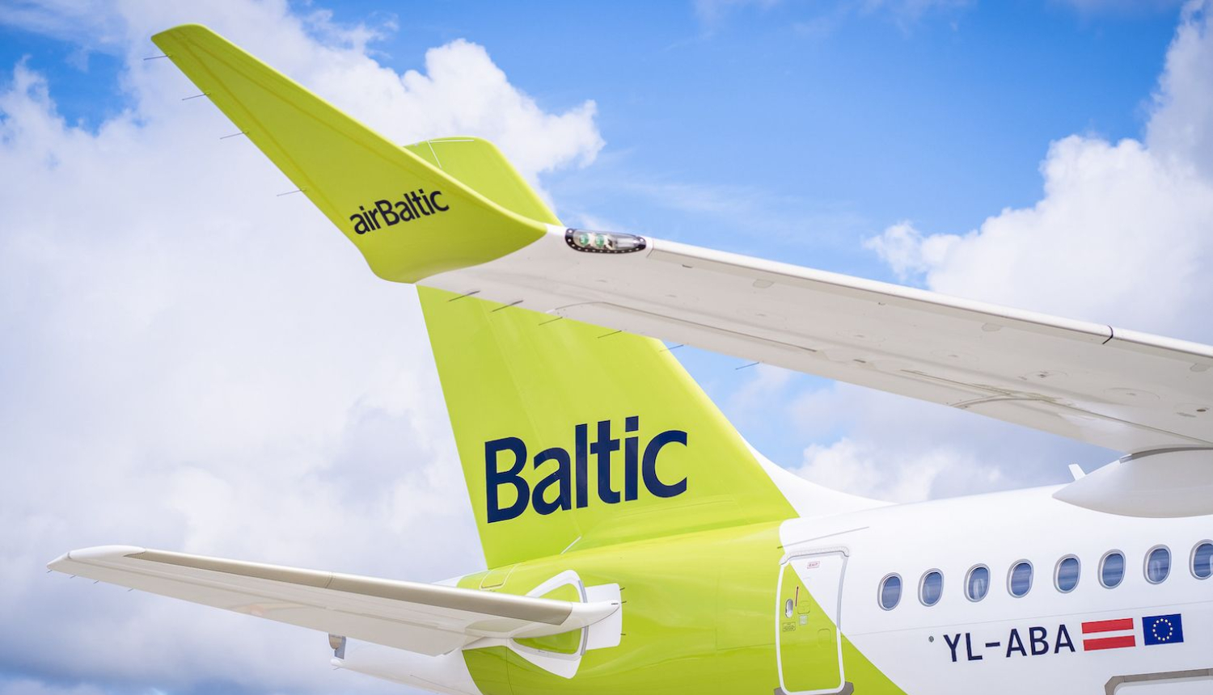

Smart Infrastructure
Modern, well-connected, and future-ready
Most connected logistics hub in the Baltics
Riga Airport – largest and most-connected in the Baltics
Densest transport and logistics network
2 day delivery anywhere in Europe
100+ direct flights
7.1 million passangers in 2025
AirBaltic
Road & rail connections
The only national airline in the Baltics & the greenest airline in EU* (Source: AirlineRatings)
Daily short flights to destinations in Europe
Quick access to Europe, Scandinavia, and Asia.
Rail Baltica will connect the Baltics to Europe with fast, green railway
Notes:
RIX - most connected. Source: https://aci-europe.org/air-connectivity.html/

Slide 9
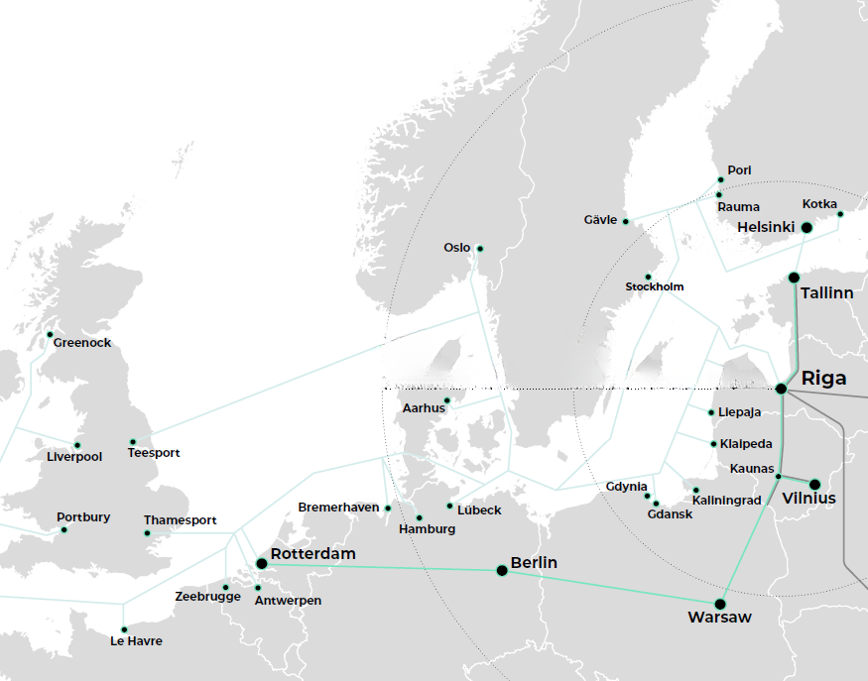
Intermodal logistics hub
#4
in EU for proportion of exports in transport services
#3
in the EU for seaborne freight per capita.
(18 t vs. 7.5 t EU average)
Source: World Bank World Development Indicators, 2024
Latvia has:
three ice-free deep-water ports functioning as one integrated logistics system;
the largest combined cargo capacity, handling
24h
1000 km
12h
500 km
⅓ of all cargo
on the EU’s Eastern Baltic coast.
Daily Logistics connections to Sweden, Germany from Liepaja and Ventspils
Strategic EU/NATO Gateway
Regular Ro-Ro and Container Services to Germany and Sweden
Image: Logistics in Latvia
Notes:
Latvia boasts three major ice-free ports — Riga, Ventspils, and Liepāja — operating year-round regardless of seasonal weather. This ensures uninterrupted cargo flow even during harsh winters, which is a significant advantage in the Baltic region.
Strategic EU/NATO Gateway:
Latvian ports serve as critical logistics hubs for both EU trade and NATO military mobility, offering direct maritime access to Northern and Western Europe, and serving as vital nodes in the TEN-T (Trans-European Transport Network).
Regular Ro-Ro and Container Services:
From Liepāja and Ventspils, there are daily roll-on/roll-off (Ro-Ro) and container freight connections to major ports in Sweden (e.g., Nynäshamn, Karlshamn) and Germany (e.g., Travemünde, Lübeck), supporting efficient automotive, timber, and industrial exports/imports.

Slide 10
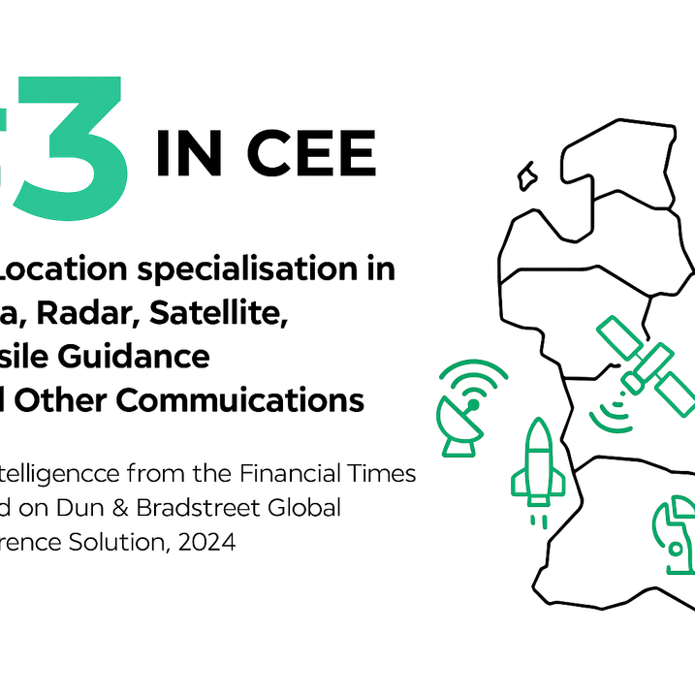
Digital infrastructure
In numbers
1st
National quantum communications infrastructure in the Baltics
World record 380 Gbit/s optical data transmission on silicon photonics chip, recognized at OFC 2024
QKD (Quantum Key Distribution) integrated with 5G, Wi‑Fi, and IoT, tested in healthcare and finance.
(Riga Technical University, 2024)
#3
In CEE for Location specialisation in Data, Radar, Satellite, Missile Guidance and Other Communications
Advanced 5G and Broadband Coverage, including sea
(fDi Intelligence from the Financial Times based on Dun & Bradstreet Global Reference Solution, 2024)
Notes:
• LMT (Latvian Mobile Telephone), Latvia’s national telecom leader, has successfully launched 5G services nationwide and is actively piloting innovations in Edge computing, IoT applications, and AI-based smart city solutions.
• This infrastructure supports the rapid growth of data-driven industries such as fintech, logistics, smart manufacturing, and digital R&D, giving Latvia a competitive edge in the digital economy.
In 2023, RTU scientists set a world record in optical data transmission with a new modulator achieving speeds up to five times faster than previous standards. Recognized at the 2024 Optical Fiber Communication Conference, this breakthrough drew global attention and confirmed Latvia’s leadership in deep tech and next-generation communication technologies.

Slide 11
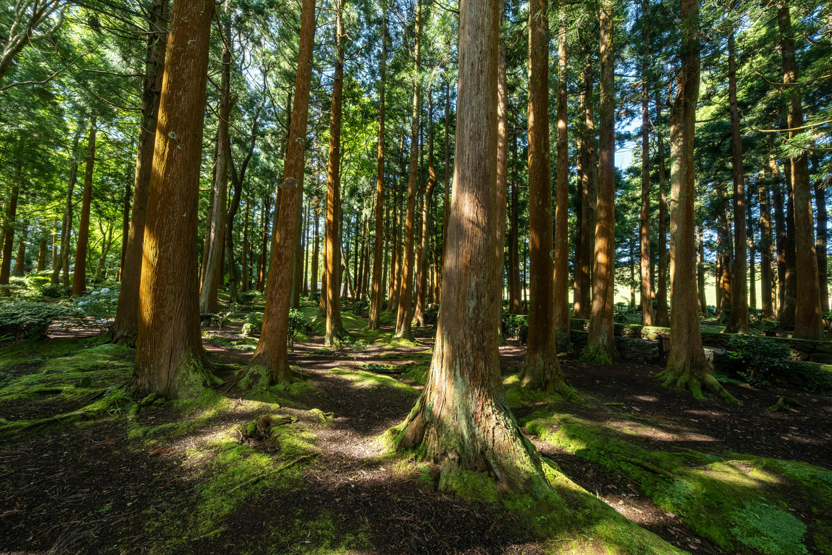



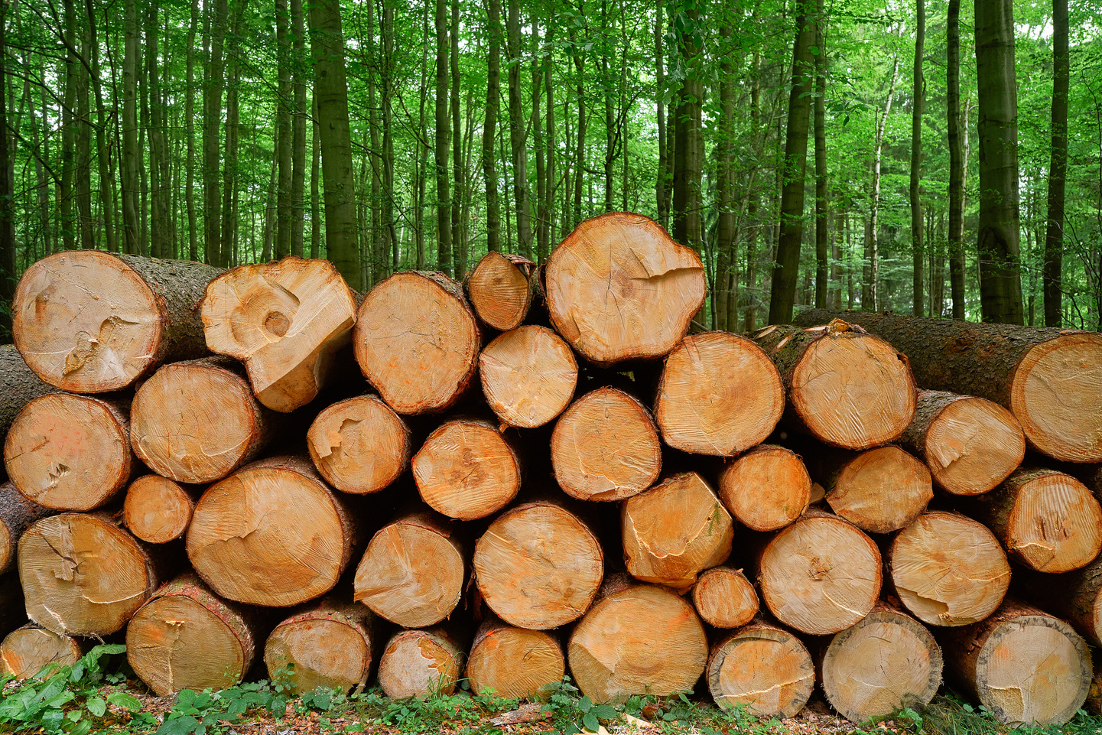
Sustainability
Vast availability of natural resources
53%
#4
Forested area territory
In EU for renewable freshwater resources per capita
8th
(Eurostat, 2025)
x4
Highest share in the EU of organic farming land - 16% of all land
Timber volume in Latvia has almost quadrupled in 80 years, now totaling around 680 million m³
(European Environment Agency, 2025)
Notes:
Sustainability in Latvia isn’t a future ambition — it’s already deeply embedded in how the economy functions. With 53% of its territory covered by forests and 16% of agricultural land certified organic, Latvia ranks among the greenest and most biologically responsible nations in Europe. These natural assets aren’t just preserved — they are strategically harnessed.
Latvia is #3 in the EU for value added from agriculture as a share of GDP and #2 in Central and Eastern Europe for AgTech foreign direct investment projects, showing both tradition and innovation at work. The forestry sector alone contributes 5% of GDP, harvests over 15 million m³ of timber annually, and accounts for over a quarter of manufacturing turnover. Nearly two-thirds of its output is exported, underpinned by the fact that 46% of forests are state-owned and certified, ensuring sustainability and traceability.
In the food industry, Latvia continues its strong performance — with 23.1% of total manufacturing turnover coming from this sector, and nearly half of production exported. With 16% of land under organic farming, the country holds the 8th highest share in the EU, making it a natural base for sustainable agri-food production.
Taken together, these figures point to a country that doesn’t just protect its environment — it builds economic value on top of it, responsibly and with long-term vision.

Slide 12
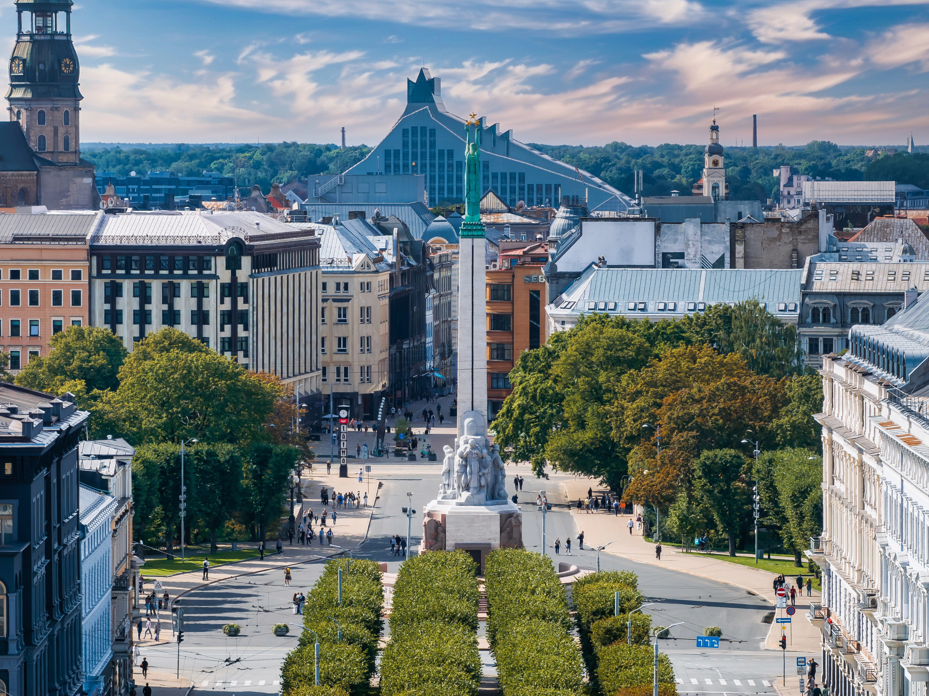

Investment portfolio
Totalling 9.5 Billion €
Infrastructure
RailBaltica
Renewable energy
RIX Airport City
€ 1.13 B
€ 5.11 B
€ 2.77 B
€ 504 M
in Latvia
“Capital goes where it is welcome and stays where it is treated well.” – Walter Wriston

Slide 13
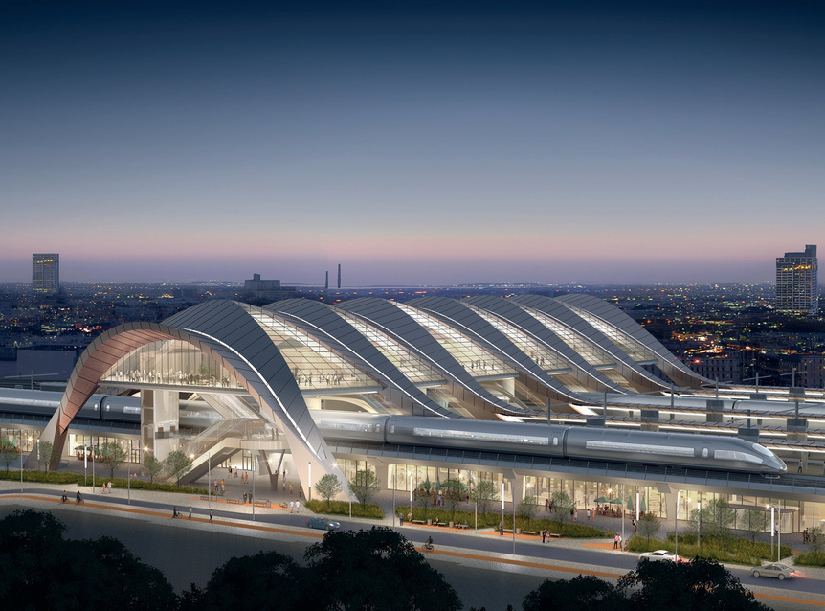
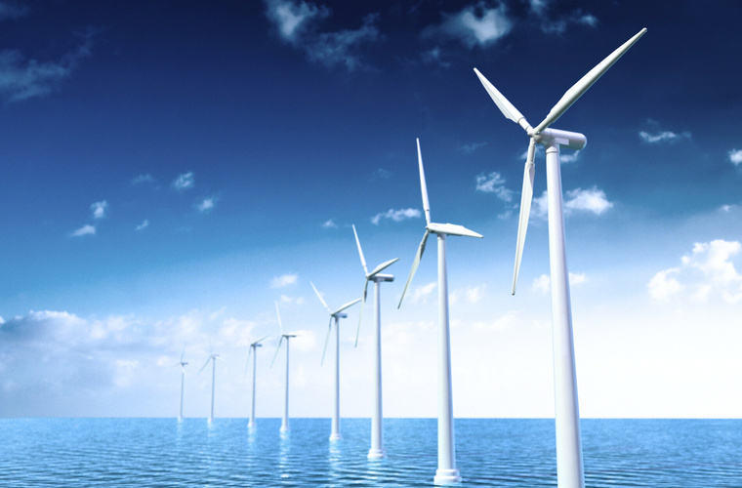
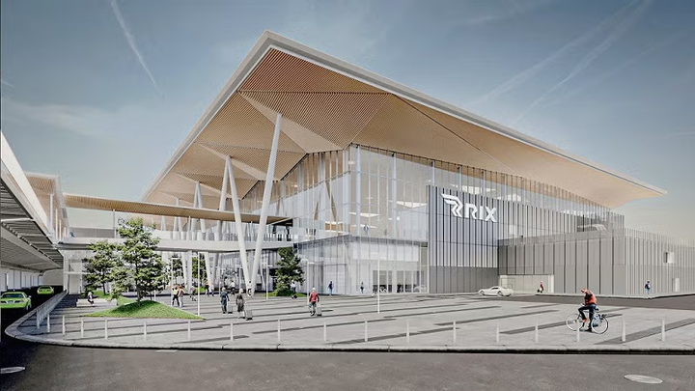
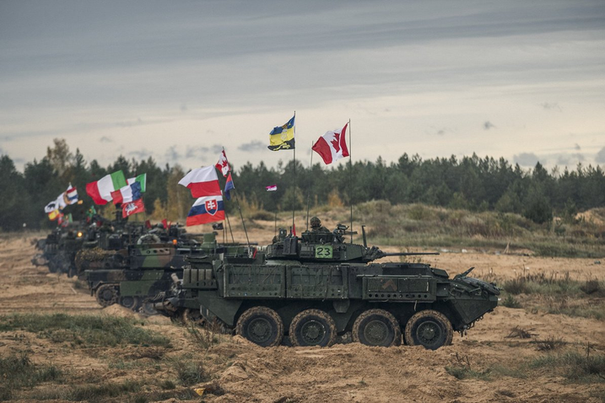
Upcoming investment projects & opportunities
Rail Baltica
Elwind Offshore
Rail Baltica is the largest Baltic infrastructure project of a century - a railway line construction, connecting Baltic states with the European railway network. Publicly funded, with PPP parts planned. Total project costs exceed € 5 B in Latvia.
An Estonian–Latvian offshore wind farm project with a potential to harvest over 7 TWh of clean energy annually with up to 1 GW capacity. Two pre‑developed offshore areas to be auctioned with guaranteed grid connection by 2029.
RIX Airport City
Military base “Sēlija”
Designed to be the most connected multifunctional business district in the Baltics spanning 24-hectare area. Currently seeking partners, investors, developers, operators and tenants to co-develop the district plot by plot.
A major Latvian defence PPP project developing residential, administrative, and road infrastructure at the Sēlija Training Area, plus warehouse facilities in Nīkrāce, providing a modern training environment for the National Armed Forces and allied units. Total planned investments € 403 M.
Notes:
Rail Baltica is the largest infrastructure project in the Baltic region in the last 100 years, stretching across five EU countries: Poland, Lithuania, Latvia, Estonia and Finland.
The estimated cost of the project is approximately €15.3 billion.
Elwind Offshore - A joint Estonian-Latvian cross-border offshore wind farm project with a potential to harvest over 7 terawatt-hours with a capacity up to 1 GW in Latvia worth of clean wind energy for the Baltic region every year​. Estonia and Latvia is predeveloping two offshore areas and auctioning these out with certainty of grid connection by 2029.
RIX Airport City: Designed to be the most connected multifunctional business district in the Baltics, RIX Airport City will span a 24-hectare area and include an airport hotel, offices, retail spaces, and a range of services. Currently seeking partners, investors, developers, operators and tenants to co-develop the district plot by plot.
Military base "Sēlija" - Development of Residential and Administrative Buildings and Road Infrastructure at the Sēlija Training Area, and Construction of Warehouse Facilities in Nīkrāce is one of the most significant defence infrastructure PPP projects in Latvia, which will provide a training environment for the National Armed Forces (NAF) and allied units.
Bez šiem ir arī : AI Gigafactory, Amber birch, Latvijas finieris, affordable housing, futbola stadions, Solidor power, LatVolt baterijas, Tet&LMT Telias daļu atpirkšana, KEPP EU semiconductors, Purple Green energy, Latvenergo green fuel production plants and data centres, Rīgas namu pārvaldnieks, virkne deep tech u.c.

Slide 14

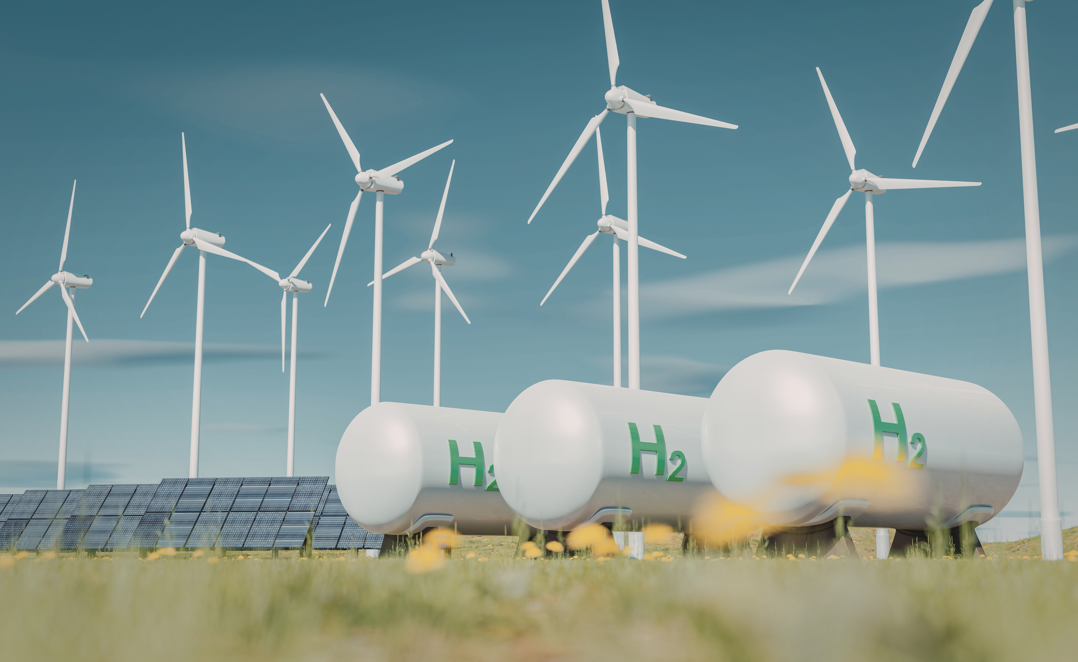

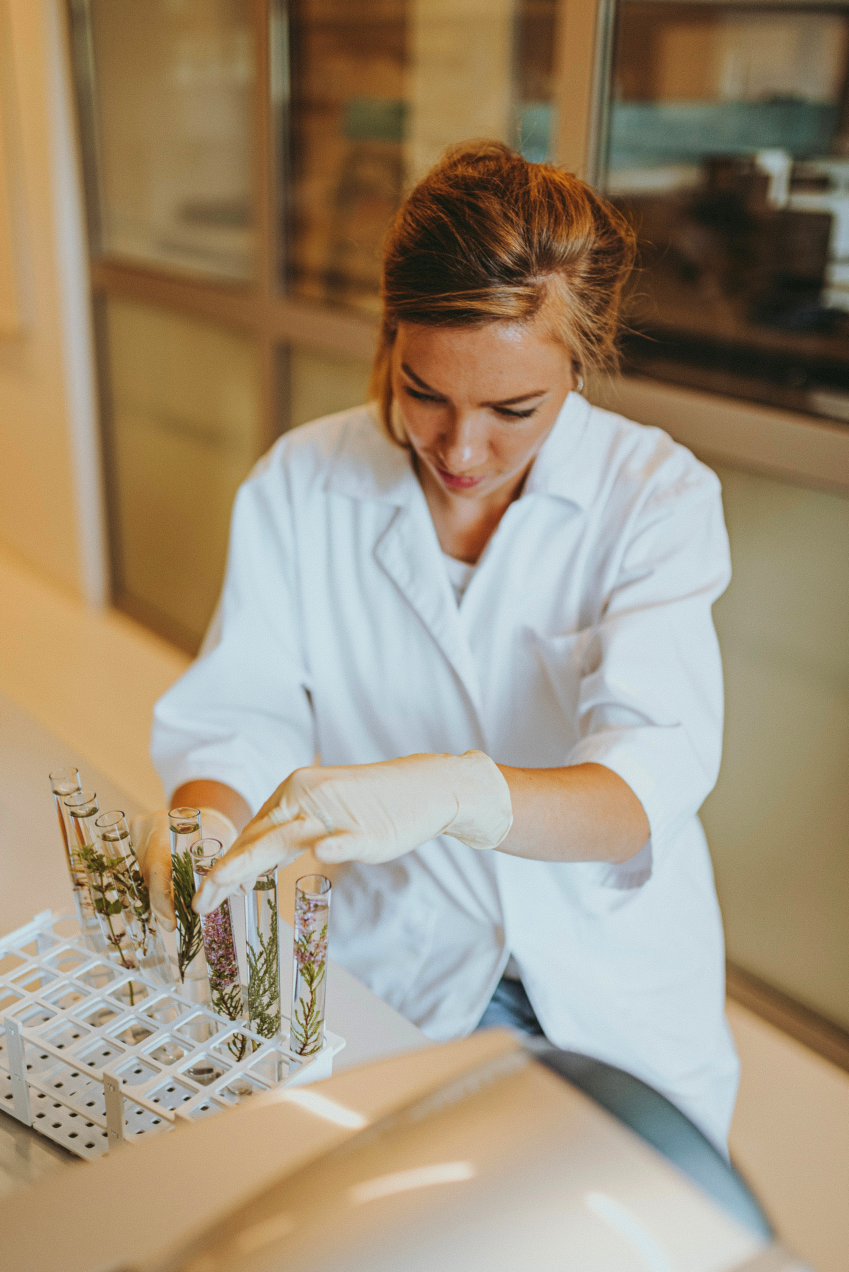
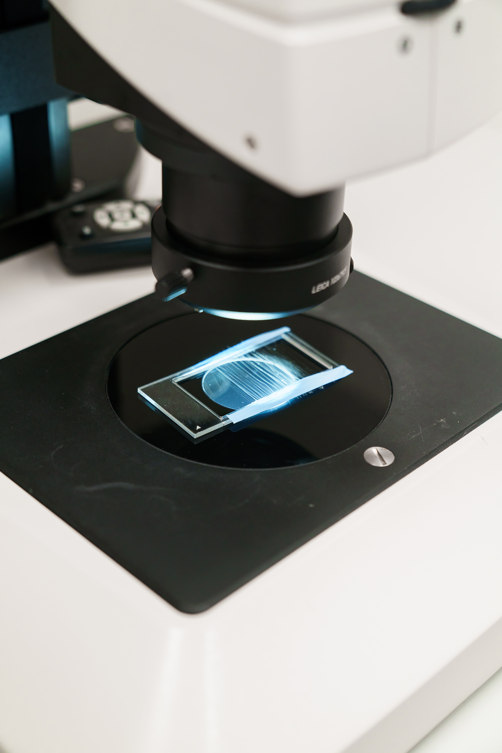
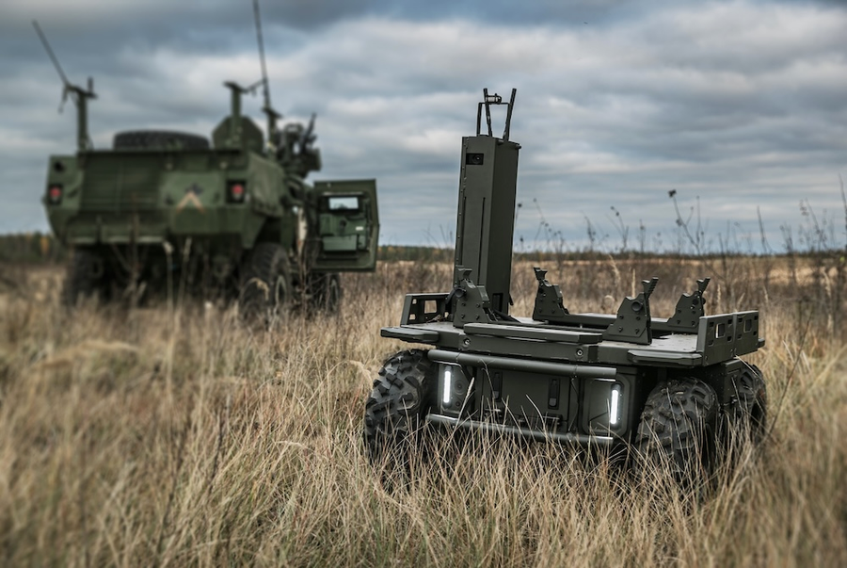

Focus - Future-ready industries
Built to Scale. Driven by Innovation.
INFORMATION AND COMMUNICATIONS TECHNOLOGY
SMART ENERGY
MANUFACTURING & ENGENEERING
SUSTAINABLE
BIOECONOMY
NEXT-GEN BIOMEDICINE
DEFENCE
Secure. Limitless. Intelligent.
Clean. Scalable.
Renewable.
Efficient. Smart. Strong.
Green.
Circular.
Resourceful.
Precise. Innovative.
Data-driven.
Dual-use. Resilient. Industrial.
State-defined national priority sectors with high growth and innovation potential and strong investment readiness.
Notes:
3

Slide 15
Information and Communications Technology
Latvia’s ICT sector offers a strong, future‑ready investment landscape built on top‑tier infrastructure, modern regulation, and a fast‑growing innovation ecosystem
7.1%
100+
€ 1.51 B
of GDP
IoT & Robotics Testbeds - large scale testing for robotics, logistics and space technologies
ICT product exports
Notes:
Latvia’s ICT sector presents a compelling, future-focused investment landscape – combining world-class infrastructure, progressive regulation and a rapidly scaling innovation ecosystem.

Slide 16
Information and Communications Technology
Emerging datacenter hotspot
Dynamic Regulator for Fintech
Secure and reliable energy supply
High share of renewable energy mix
Low risk climate
High-speed fiber connectivity
Cost efficiency
Free pre-licensing
3-6 month licensing (PI/EMI/MiCA)
Regulatory sandboxes
Innovation Hub support
Vibrant start-up ecosystem
National Artificial Intelligence Center
Startup Law support
Start-up visa
Riga city support for relocation
Beneficial employees stock options regulation
Launches AI pilot calls and enables testing in a regulatory sandbox
Provides guidance on legal, regulatory and cybersecurity aspects
Supports AI deployment and commercialization
Promotes trustworthy, responsible AI
Notes:
Latvia checks all boxes to be the next datacenter hotspot with secure and reliable energy supply, a high share of renewable energy mix, low risk climate, high-speed fiber connectivity and cost efficiency
Dynamic Regulator for Fintech
- Free pre-licensing consultations
- The licensing process for PI, EMI, MiCA and other licences takes 3–6 months (Blockben, Nexdesk)
- Regulatory sandbox and Sandbox for issuers.
Innovation Hub provides expert guidance on the compliance with licensing requirements, supervision and regulation.
Vibrant start-up ecosystem with beneficial initiatives such as Startup Law support, start-up visa, Riga city support for relocation and beneficial employees stock options regulation.
Artificial Intelligence Centre, a collaborative initiative between public administration, universities, and businesses, to promote the adoption of AI across various sectors and to develop more efficient and innovative solutions. It highlights strong public–private commitment to digitalization and cybersecurity accelerating Latvia’s innovation capacity.
Boosting digitalization and cybersecurity
Acceleration of Latvia’s innovation capacity
Promotion of AI adoption across sectors
Development of more efficient and innovative solutions
Furthermore, Latvia offers English speaking, tech savvy talent pool with tailored ICT education

Slide 17
Smart Energy
With major grid capacity available, new opportunities in CO₂ and gas storage, as well as hybrid parks, Latvia is emerging as a top location for sustainable energy investment
#2
4th
5.8+GW
Energy Security Index,
World Economic Forum, 2025
4th in the EU in share of energy from renewable sorces and consumption with over 50% from renewable sources,
2025
Available in the transmission grid for the connection of new power plants
Notes:
Latvia's energy sector stands out as one of the most secure and renewable-rich in Europe. With major grid capacity available, new opportunities in CO₂ and gas storage, hybrid parks and its role in the Nordic‑Baltic Hydrogen Corridor, Latvia is emerging as a highly attractive destination for sustainable energy investment.

Slide 18
Smart Energy
Power-to-X production:
Wind, solar and hybrid parks:
#6 lowest hydrogen cost in EU
90% green PPA
15+ yr pay-as-produced (~€55/MWh)
Nordic-Baltic hydrogen hub
#2 lowest land prices in EU
62% RES by 2030
500+ km high-wind coast (>9 m/s)
Low grid connection costs (110–330 kV)
Biomethane and natural underground structures:
Lowest biomethane cost by 2050 (€44/MWh)
4 TWh potential • €21.5M support
Injection network expanding
Strong waste feedstocks
16 CO₂ sites (~404 Mt)
Storage ban lifted (2025)
Notes:
Latvia has shown rapid expansion of EV charging networks supporting domestic and Baltic mobility corridors.
A new Nordic - Baltic Hydrogen Corridor project with the aim of transporting low-cost renewable hydrogen from Finland to Germany has the potential to make the Baltics a key player in Europe’s green energy supply chain.

Slide 19
Manufacturing & Engeneering
Advancing next-generation R&D infrastructure, deep expertise in robotics and smart systems, Latvia offers a scalable, future-ready platform for Industry 4.0 and advanced manufacturing
2
10%
#3
World records in Silicon photonics technologies for high-speed optical interconnects
of all quantum algorithms developed worldwide involved Latvian scientists, making a remarkable global impact in quantum research
World Economic Forum, 2025
In Europe for optical‑fibre export share relative to GDP,
2025
Notes:
Advancing next-generation R&D infrastructure, strong industry–science collaboration, and deep expertise in robotics and smart systems, Latvia offers a scalable, future-ready platform for Industry 4.0 and advanced manufacturing

Slide 20
Manufacturing & Engeneering
Expertise in Quantum research:
Photonics and Optical fibre:
#1 QuantERA coordinators/GDP
Global quantum applications
Baltics’ first quantum network (LatQN)
EU quantum-secure infrastructure
60% FTTH coverage
Global-scale fiber manufacturing (Corning, Prysmian, Martin Group)
Microelectronics and Nanomaterials:
Robotics and Automation
~1% water withdrawal (EU-low)
National Microchip Competence Centre (part of EU Chips Act initiative)
Precision coating R&D (ISO 4–8)
ALD capabilities
60+ years engineering expertise (robotics, embedded, smart industry)
Industry 4.0 leaders, e.g. HansaMatrix, SAF Tehnika, MikroTik.
Notes:
Expertise in Quantum research:
#1 in the number of QuantERA project coordinators relative to GDP
Latvian research results are used in international quantum applications
Development of the first national quantum communication network in the Baltics (LatQN)
Advancing quantum-secure data transmission under the EU’s European Quantum Communication Infrastructure initiative
Photonics and Optical fibre:
Latvia offers 90% fibre-to-the-home coverage - one of the highest FTTH penetration rates in Europe
Global-scale optical fiber manufacturing base supplying leading global players such as Corning, Prysmian, Martin Group
Microelectronics and Nanomaterials:
One of the lowest water withdrawal ratios in the EU (~1% water withdrawal ratio)
National Microchip Competence center is being established under the EU Chips JU initiative, enhancing research-industry collaboration and applied development capacity
State-of-the-art precision coating R&D and pilot infrastructure, including ISO class 4-8 cleanrooms
ALD capabilities, enabling sub-nanometre precision thin coatings
Robotics and Automation
60+ years deep engineering expertise in robotics, embedded systems, and smart industrial solutions
Meeting global demand for digitalization and Industry 4.0 with Hansamatrix, Saf tehnika, Mikrotik leading the way

Slide 21
Sustainable Bioeconomy
Latvia is becoming a leading hub for next‑generation low‑emission bioeconomy industries, accelerating bio-based materials, renewable chemicals, and innovative food solutions
#1
54%
12%
Latvia’s leading R&D and innovation sector with the highest funding intensity
of Latvia’s territory is covered by forests — one of the highest ratios in Europe
of GDP
Notes:
Backed by strong science–industry collaboration, Latvia is rapidly advancing bio-based materials, renewable chemicals, and innovative food solutions, positioning itself as a hub for next-generation, low-emission bioeconomy industries.

Slide 22
Sustainable Bioeconomy
Forestry and wood processing
Agriculture and food industry
Strong sustainable bio-based value chains
Development and high-value-added products
Almost half of all forest land is owned by the state that ensure comprehensive forest management policy
Abundant land with low EU land costs
Tech-driven, productive, low-impact agriculture
Growing industry in functional foods and low-emission proteins, e.g. Asns Ingredient
Strong agricultural knowledge and food producers commitment to sustainability
Biorefineries and biomaterials
Strong biorefining potential with major projects like Fibenol
Growing innovation ecosystem for bio-based materials and renewable chemicals
TRL 4–6 pilot facility bridging lab research and industrial scale
Notes:
Forestry and wood processing account for ~ 6% of Latvia’s GDP and overall bioeconomy contributes ~ 12% of national GDP
TRL 4-6 pilot facility - A dedicated pilot facility enables technology validation bridging the gap between laboratory research and full-scale industrial applications, paving the way for new advancements in sustainable materials, energy solutions, and bioproducts.

Slide 23
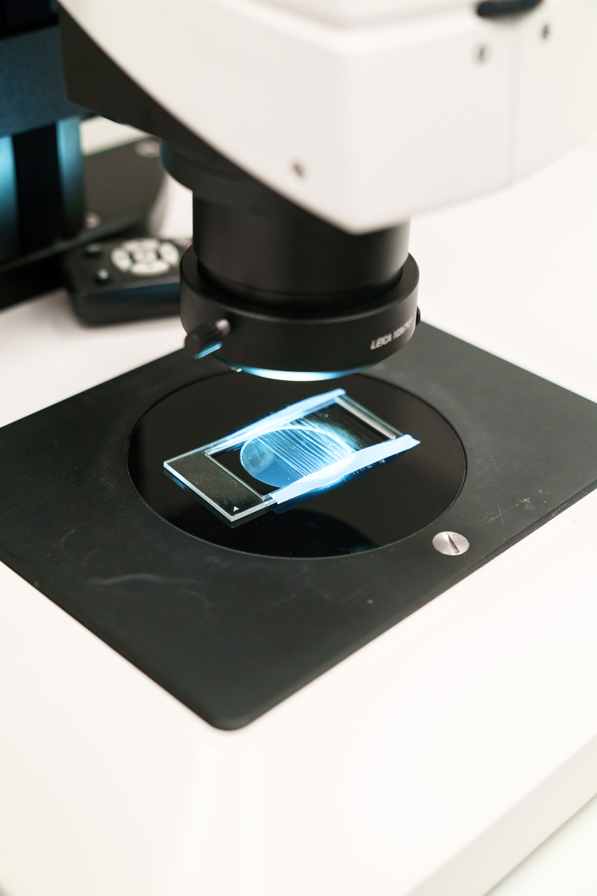
NEXT-GEN Biomedicine
Latvia's deep industry expertise and leading research institutions offer a high‑quality, cost‑efficient platform for innovation in precision medicine, biomaterials, pharmaceuticals
60+
500+
74%
years of biomedicine expertise
companies across the biomedicine ecosystem, ranging from pharmaceuticals and biotechnology to medical devices, diagnostics, and chemical production
of chemicals & pharmaceutical products are exported
Notes:
Backed by decades of expertise, world-class research institutions, advanced infrastructure, and an EU-aligned regulatory environment, Latvia offers a high-quality, cost-efficient platform for innovation in precision medicine, biomaterials, pharmaceuticals and clinical research.

Slide 24
NEXT-GEN Biomedicine
Pharmaceuticals
Biomaterials
Full value chain — from API R&D to finished drug manufacturing
GMP-certified, EU and globally compliant production
Strong, home-grown pharma companies (e.g., Grindeks, Olpha) with global export experience
BBCE is a leading R&D hub for advanced biomaterials in the Baltics
State-of-the-art infrastructure ensuring a full cycle from idea to clinical application
Pioneering biomaterials innovation — from organ-on-chip and 3D-printed tissues to synthetic spider silk
Precision medicine
National Biobank with over 42,000 samples
PMPC Centre - advancing pediatric precision medicine
PMNET Forum in Riga, connecting European experts and industry leaders in biomarker discovery and clinical translation
Notes:
Latvian biomedicine research institutions (LIOS, BMC, BBCE, ISSP UL) cover the core R&D value chain, complimented by strong biomedical research at Universities. Latvias institutional base includes the Latvian Biomedical Research and Study Centre (BMC) and the Latvian Institute of Organic Synthesis, both internationally recognised. In 2026, the two institutions will merge, forming the largest life sciences research institute in the Baltics. Furthermore Latvia hosts the Baltic Biomaterials Centre of Excellence - leading Baltic R&D hub for advanced biomaterials, providing infrastructure for clinical research, genomic analysis, and data integration for personalised care.
Riga hosts the international Precision Medicine Networking Forum, connecting European experts and industry leaders in biomarker discovery and clinical translation
One of the most competitive price-to-quality ratios for research clean-room facilities in Northern Europe.
Established EU-aligned regulatory environment ensures high quality standards for research, clinical trials and manufacturing.
Latvia's National Biobank holds over 35,000 individual samples, including unique gastric cancer collections, representing ~1.9% of the national population

Slide 25
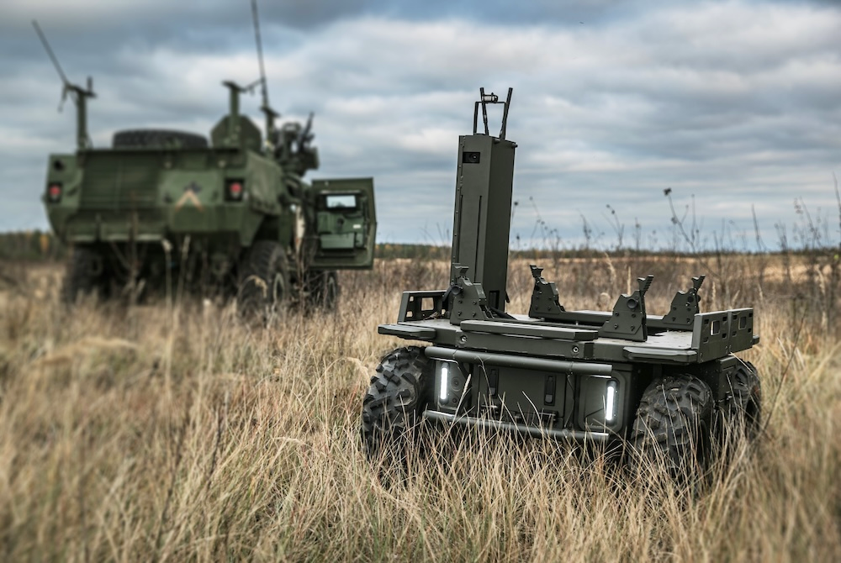
Defence
With testing infrastructure, government support, NATO-aligned R&D, and EU funding, Latvia offers a strong platform for defence innovation and manufacturing
TOP 3
#7
1.5%
NATO country for defence expenditures as % of GDP in 2025
Europe’s largest exporter of drones, exporting €47.7 million worth or 3.8% of total Europe’s drone exports volume, 2024
of the defence budget is allocated to innovations
Notes:
With advanced testing infrastructure, active government investment, NATO-aligned R&D, and substantial EU funding opportunities, Latvia offers a uniquely integrated platform for defence innovation, dual-use technologies, and scalable manufacturing.
defence budget 4.91 in 2026.

Slide 26
Defence
Environment and financing
Defence manufacturing and military testbeds
NATO member since 2004
Backed by NATO collective defence
Defence spending at 4.91% of GDP (2026)
Defence innovation system supports NATO-oriented R&D, dual-use tech and industrial prototyping
Local sourcing in defence procurement
€5.7B EU defence funding available
1st 5G military testbed in Ādaži for large-scale testing
Naval testbed in Šķēde for live UAV and defence-tech trials
Integrated defence ecosystem linking state, industry, and research
Drones and sensors
Latvia is the founder and co-leader of 18+ country Drone Coalition, investing €50M+ annually locally
Latvian drone firms win global contracts, outperforming 265+ competitors, e.g. Redwire Latvia and Atlas Aerospace
First EU country to deploy acoustic drone sensors for airspace security
Notes:
Latvia takes defence seriously.
Latvia is a NATO member since 2004 with a stable and secure geopolitical environment backed by collective defense guarantees and strong transatlantic partnerships. In 2026, Latvia's defence budget will reach 4.91% of GDP - a record 2.1 billion EUR -one of the highest in NATO, ensuring strong national and regional security.
Latvia's defence innovation system supports NATO-oriented research, dual-use technology development and industrial prototyping

Slide 27
Innovations
Areas Latvia contributes to global growth
Quantum
Naco Technologies
World-class expertise in quantum theory and algorithms with world leading quantum researchers - A. Ambainis
Deep-Tech Innovator in Nano-Coatings for Green & Space Applications
Ariane 6 flight-proven material
Cellbox Labs
Cryogenic polyurethane insulation developed in Latvia is used in the Ariane 6 launcher
Innovator in Organs-on-a-Chip for Drug Discovery
Aerones
Latvia is the 1st in the EU in the share of women in science -
50.9% of scientists and engineers
Global Leader in Robotic Wind-Turbine Maintenance
Notes:
Latvia is emerging as one of Europe’s leaders in quantum technologies.
With internationally acclaimed expertise in quantum theory—centered around the University of Latvia and Professor Andris Ambainis—Latvia plays a central role in advancing quantum algorithms and software. Backed by the €6.19M Latvian Quantum Initiative (2023–2026), the country actively collaborates with top international partners such as Quantum Delta NL, Paris Centre for Quantum Computing, SAP, Bosch, Microsoft, and national metrology institutes like PTB (Germany) and NPL (UK). This strong academic–industrial network positions Latvia as a global quantum innovation hub and the "smallest superpower in quantum."
Naco Technologies
Based in Riga, Naco Technologies develops advanced nano-coating solutions using high-speed magnetron sputtering technology to improve the performance and durability of electrolyzers, fuel cells, and hydrogen systems. Their coatings significantly reduce the need for precious metals and support scalable green energy and aerospace applications.
In January 2025, Naco raised €2.5 million in an expanded pre-Series A round led by Radix Ventures, with participation from Impact Ventures and Kendris Capital. The funding is aimed at accelerating R&D, growing the team, and supporting international expansion.
Cellbox Labs Based in Riga, Cellbox Labs develops advanced vascularized organs-on-a-chip—including gut and gut–brain axis models—that combine hardware with AI-powered software to enable precise, automated drug testing and biological research.
Aerones
Latvia-based Aerones develops AI-driven robotic and drone solutions for the inspection, cleaning, and repair of wind turbine blades and towers, serving major global operators such as GE, Enel, Vestas, NextEra, and Siemens Gamesa.
In June 2025, Aerones raised a $62 million equity round co-led by Activate Capital and S2G Investments, with participation from Carbon Equity, Overlap, Lightrock, Blume, Metaplanet, Change Ventures, and Extantia. The funding will support global expansion, manufacturing scale-up, and accelerated R&D in AI and robotics. This follows earlier funding, including a €4 million EU grant and a $30 million Series A round in 2023.
Latvia is 1st among EU countries in the share of women in science, with women making up 50.9% of scientists and engineers. The share of women in science in Latvia is 10% higher than the EU average (40.5%).

Slide 28
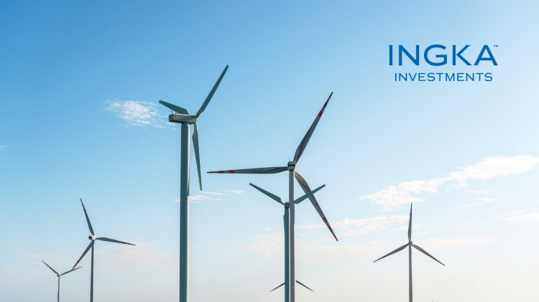
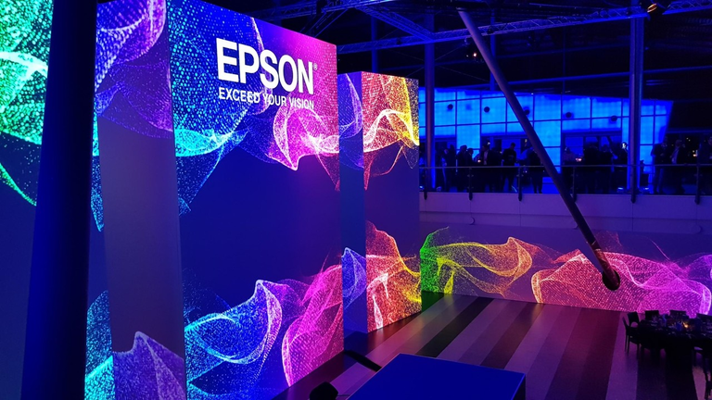
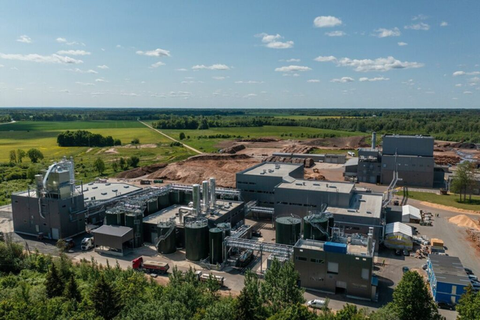


Recent Long‑Term Strategic Investments in Latvia (2025)
Ingka Investments
Epson
The investment arm of the IKEA Group has committed € 720 million to acquire forest holdings in Latvia, highlighting Latvia’s stable business environment and strong potential for long‑term, sustainable investment.
A global technology innovator, is opening its new European Business Services centre (EBS) in Riga, Latvia. It will house non-customer facing roles, making it a critical hub for Epson’s business throughout Europe.
Fibenol
Salling Group
A clean‑tech company is developing a major biorefinery in Latvia’s Valmiera Industrial Park, with a planned investment of € 600–700 million to produce high‑value biomaterials from low‑quality wood.
In 2025, Rimi Baltics was acquired by Salling Group for € 1.3 billion, marking one of the largest retail transactions in the region. The deal reflects strong confidence in the Baltic consumer market.
Notes:
Ingka Investments, the investment arm of Ingka Group (the world's largest IKEA retailer) together with Sweden's largest forest owner association, Södra, has purchased 135,000 hectares of forest land in Latvia and 18,000 hectares in Estonia. The company has been present in Latvia since 2014 and already manages 110,000 hectares of forest land in Latvia. The company has planted more than 2.5 million tree seedlings during the year, ensuring a net increase in forest area of more than 250,000 cubic meters. In addition, 21% of the company's forests in Latvia are managed with a special focus on the environment, and commercial activities are completely excluded from an area of almost 3,000 hectares, giving priority to strengthening biodiversity.
Epson - Epson, a global technology innovator, with an investment of 6 million euros is opening its new European Business Services centre (EBS) in Riga, Latvia. It will house non-customer facing roles, making it a critical hub for Epson’s business throughout Europe.
From 28 cities, across 18 countries, Riga was selected as being the most desirable based on five key factors: European location, political and economic stability, real estate and staff costing, workforce qualifications and language skill.
Fibenol is a 100% private equity-based company focused on creating sustainable biomaterials. The project stands out internationally for its role in replacing fossil chemicals with sustainable alternatives and creating globally significant lignocellulosic bioprocessing on an industrial scale, as until now, this approach has only been used in laboratories. The development of such a project allows to store carbon from low-quality wood over a more extended period, significantly reducing the emissions that fossil resources would generate.

Slide 29
Innovative & Nordic Work Ethic
Productive, cost-effective & gender balanced
95
16.3
2
25
45
%
%
€
nd
%
Multilingual
#5 in Europe
(68% in the EU on average)
hourly salary rate
(34.9 €/h in the EU)
highest share of women in managerial positions in the EU
STEM sectors students
of Latvians had tertiary education
(52% doctoral graduates are in STEM)
(44.2% in the EU, 2024)
Sources: European Commision, Eurostat 2025
Notes:
Among the EU countries, the proportion of female scientists and engineers varied widely in 2024, with the highest shares registered in Latvia (50.9%), Denmark (48.8%), Estonia (47.9%), Spain (47.6%), and Bulgaria and Ireland (both 47.3%). The lowest representation of female scientists and engineers was in Finland (30.7%), followed by Hungary (31.7%), Luxembourg (32.4%), Slovakia (33.6%) and Germany (34.6%). [https://ec.europa.eu/eurostat/web/products-eurostat-news/w/edn-20260211-1]
25% of all students in Latvia are in STEM sectors- 8,498 students, incl. 2,561 foreign students (52% doctoral graduates are in STEM)
Agile skill development following investor's growth
(We will adapt and develop education program in 6-12months)

Slide 30
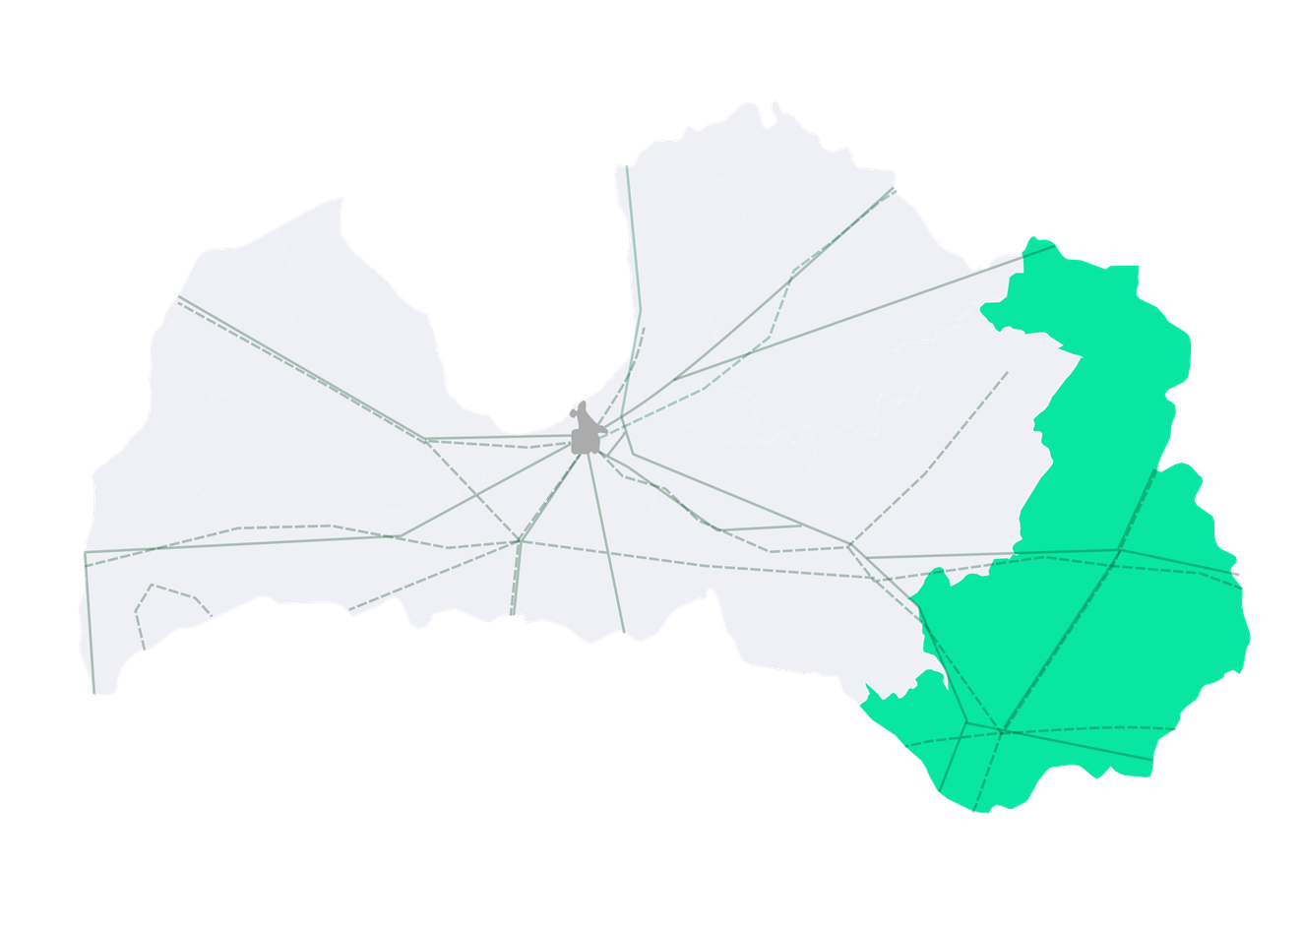

Strategic sites for investment
Infrastructure-ready Industrial Sites with access roads, external networks, and industrial zoning.
1
Liepāja Industrial Park
Karosta Industrial Park
8
Bauska Industrial and Logistics Park
2
9
Jēkabpils Industrial Area (public and privat greenfields)
Estonia
Skrunda Industrial Park (2028)
3
Kuldīga Industrial Park
10
“ALTOP” - greenfields and industrial facilities
Gulf
of Riga
14
12
Valmiera
Ventspils Airport Industrial Area
4
Ventspils
Limbaži
13
Smiltene
Alūksne
4
11
Rēzekne Industrial Park (2028)
Freeport
of Ventspils
Talsi
Cēsis
Russia
Baltic Sea
Gulbene
5
12
Valmiera Industrial Park
Valmiera Industrial and export Park
3
Kuldīga
Freeport of Riga
Tukums Industrial Park
Tukums
5
Rīga
Madona
Skrunda
7
Olaine
Ogre
6
Zemgale Industrial Park
13
Cēsis Industrial Park
Liepāja
2
6
Rēzekne
Rēzekne
SEZ
1
Liepāja SEZ
Jelgava
8
9
11
“Olaine Industrial” (public and privat greenfields)
14
Bauska
Jēkabpils
Latgale SEZ
7
Limbaži Industrial Park
Lithuania
50km
10
Daugavpils
Additional municipality and privatly owned Industrial land plots may be available upon request
Infrastructure-ready industrial
development Sites
Highway
Port
Belarus
Special Economic Zone territory
Airport
Railway
Establishing production in SEZ territory allows the investor to enjoy tax benefits, optimal logistics, good infrastructure, utilities and support.

Slide 31
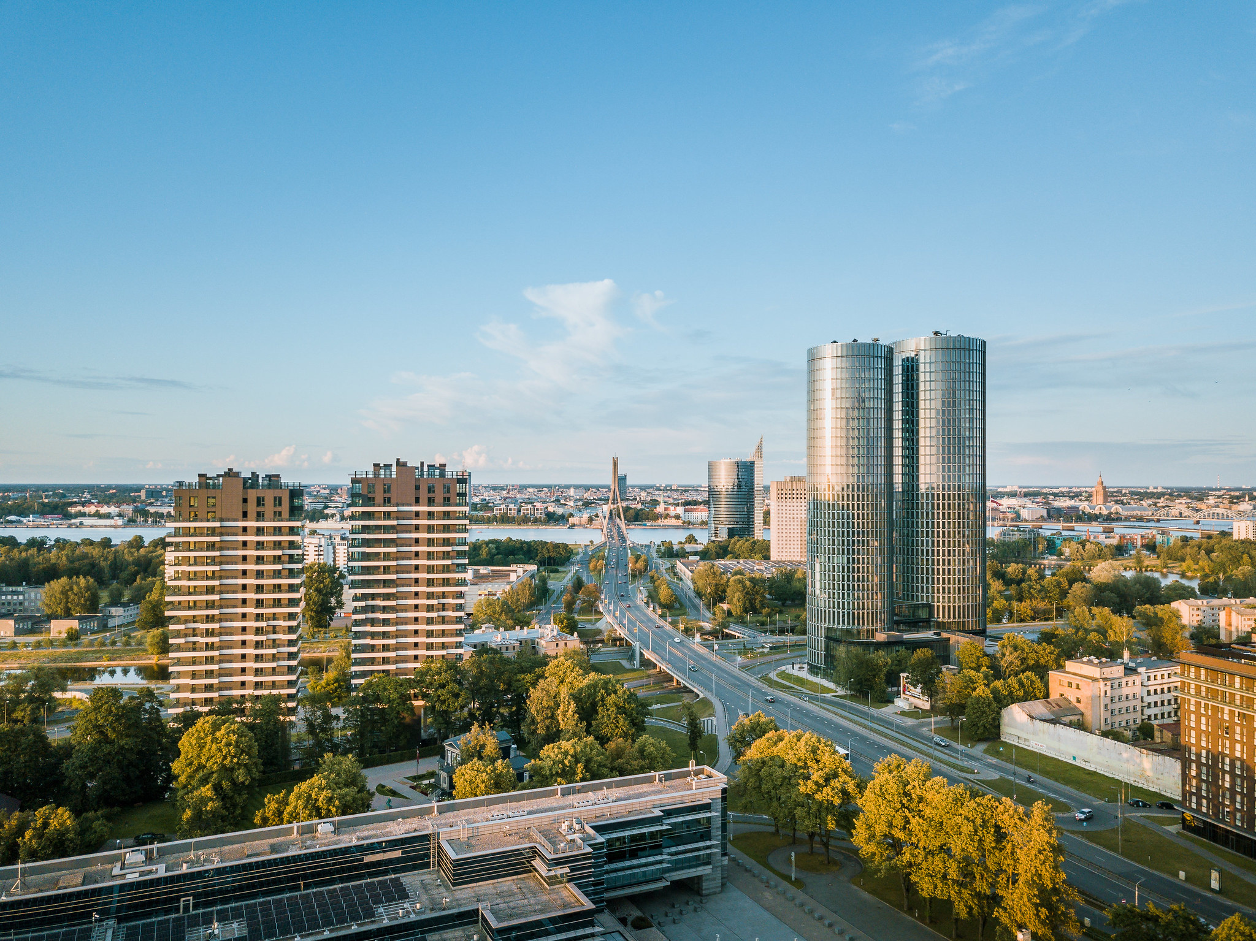
Competitive financial support & incentives
TAX
INCENTIVES
NATIONAL SUPPORT PROGRAMS
EU FUNDING OPPORTUNITIES
Special Economic Zones (SEZ):
up to 80% CIT relief
up to 100% real estate tax relief
Large investment fund grant programs for capital expenses
De minimis grant programs for:
R&D expenses
export activities
start-up support
business development
European
Commission grants:
Higher success potential via Widening Europe
Participation in international consortia
Notes:
The de minimis limit is the maximum amount of public financial aid that a company can receive from EU funds or member state budget without needing prior approval from the European Commission. It is currently capped at €300'000 over any three-year period per single enterprise.

Slide 32
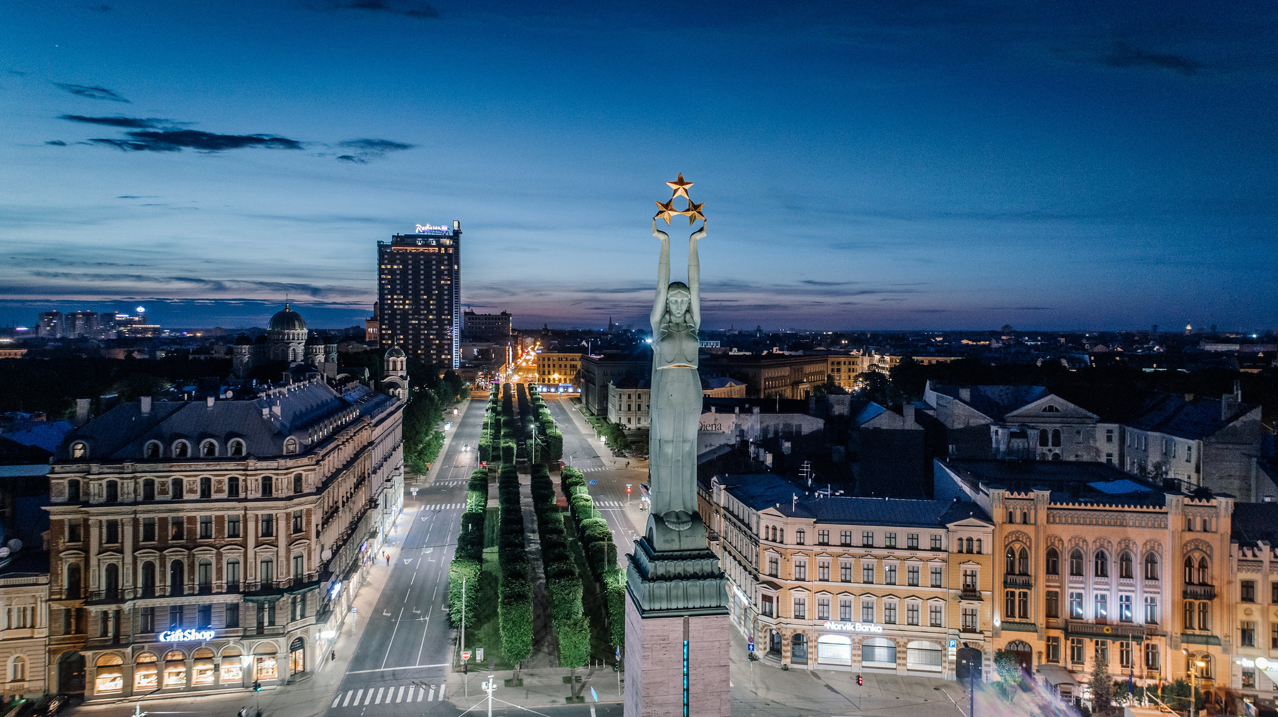
Your trusted support network in Latvia
ONE-STOP AGENCY
PUBLIC FINANCING & POLICY SUPPORT
BUSINESS &
INNOVATION ECOSYSTEM
LIAA - primary partner providing:
investment support
business setup guidance
attentive investor aftercare
National bank ALTUM - loans, guarantees, investment funds
Large Investment Coordination Council - high-level political support for strategic investment projects
Fast-track initiative - 2x faster facilitation of strategic new investments
FICIL - foreign investor advocacy & policy dialogue
Ministry of Defence – R&D support in defence & dual-use sectors, licencing
Strong industry associations and academia
Notes:
LIAA- one stop agency: 1)Providing help in making a decision – Giving investors all the facts, insights, statistics and benchmarks in order to make the best, informed decision about landing investment in Latvia.
2)Guiding the business setup process – Making all introductions with business service providers, ecosystem connections, R&D collaborations, and business setup operational support for smooth execution of settling down in Latvia.
3) Providing attentive aftercare – Support doesn't stop at establishing business – we have a whole department tasked with care for the landed foreign investors, their collaboration with municipalities, expansion, competitiveness, identifying their business problem issues and following up on them.
LIP: A flagship national instrument chaired by the Prime Minister that provides high-level, cross-government support to priority investment projects, helping to unblock bottlenecks, resolve regulatory issues, and fast-track implementation.
Direct political support for EUR 10M+ projects.
Agenda and administration by LIAA.
Among other issues, the Council:
Reviews regulatory changes;
Facilitates support mechanisms;
Coordinates infrastructure needs.
Fast-track initiative: A status enabling project permits and approvals 2x faster. Granted to new investment projects that meet the following criteria:
investment amount ≥ EUR 5 M (≥EUR 10 M if in Riga);
≥20 new jobs 3 yrs after investment
has secured min EUR 5/10 M financing for the investment.
FICIL: The strongest investor organisation in the Baltics with a mission to continuously improve Latvian business environment.
58 members, corporate and institutional
Develops and annually publishes the respected “investor sentiment index”, that include suggestions of policy changes and reforms.
Annual High Council meetings with Latvian government, yielding actual investor-initiated political commitments and policy changes.

Slide 33

LIAA global network
Stokholm
Helsinki
Oslo
Copenhagen
RĪGA
London
Amsterdam
Brussels
Berlin
Paris
Vienna
Kyiv
Toronto
Barcelona
Geneva
Turin
Tashkenta
Denvera
New York
Seoul
Tel Aviv
Tokyo
Dubai
23 representative offices
Latvian innovation and technology representative offices are located in Brussels, Geneva and Tel Aviv
23 representative offices
Melbourne

Slide 34
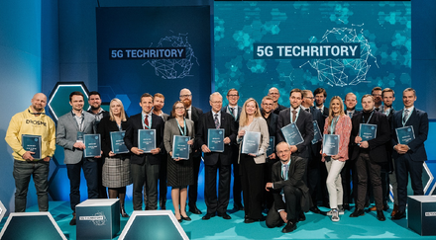
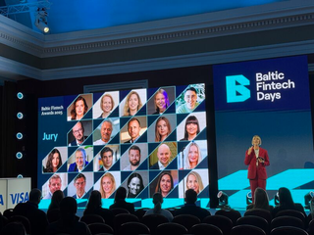
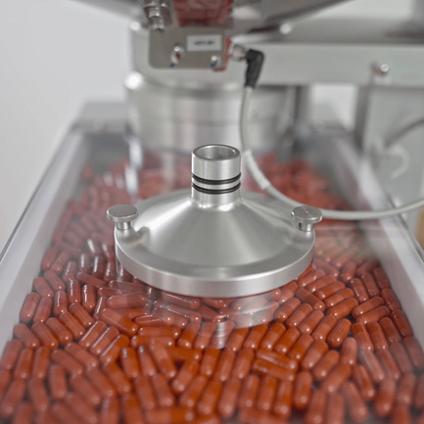
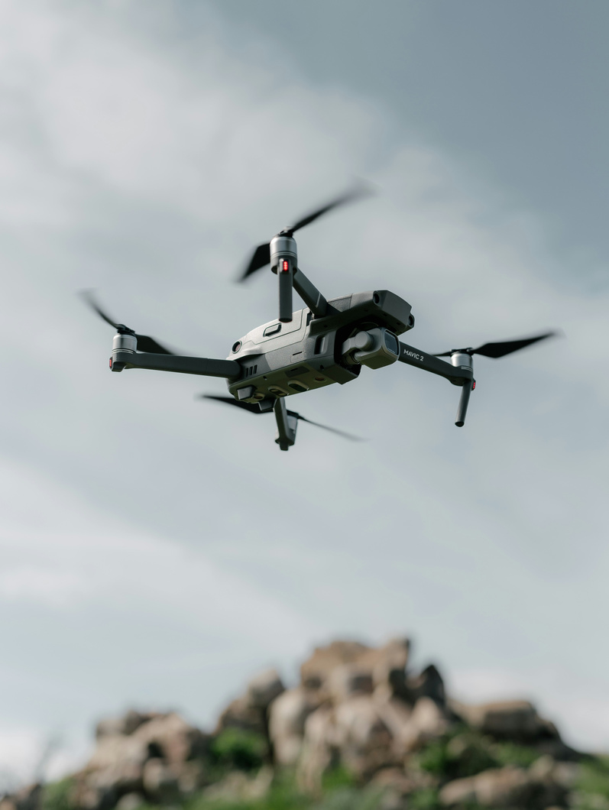
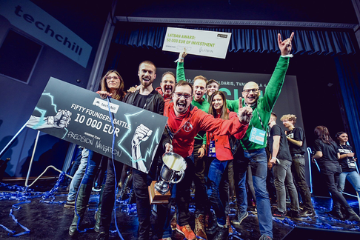
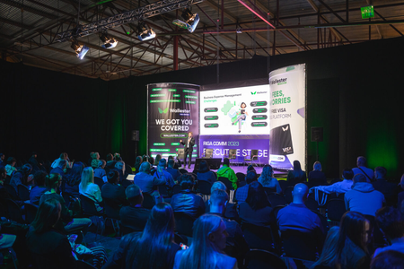
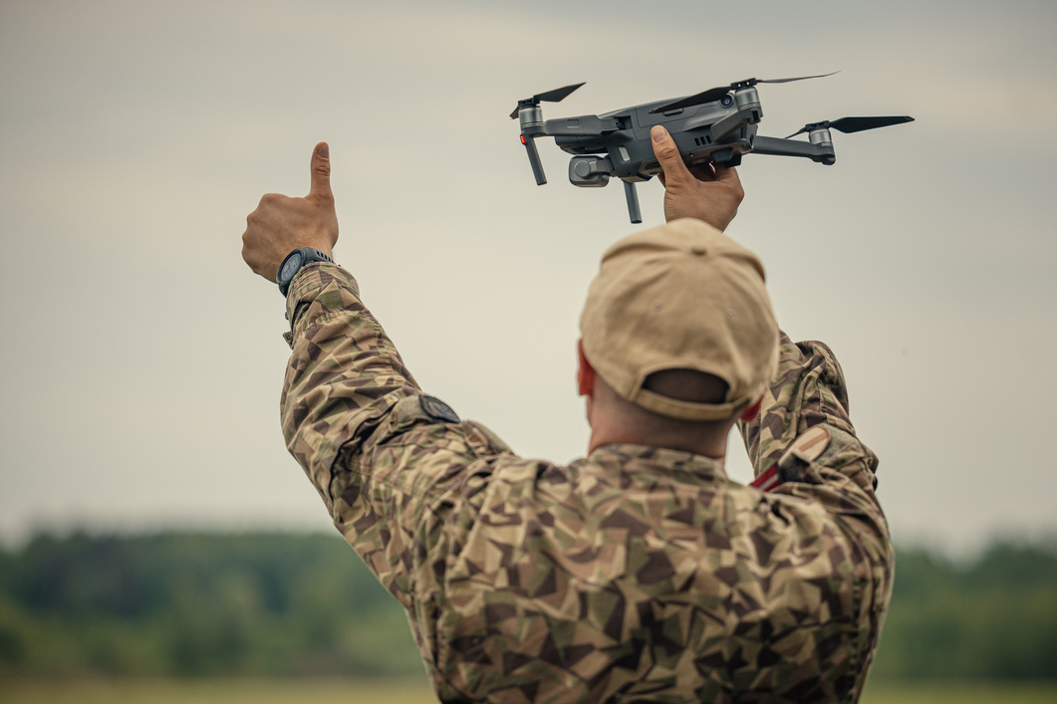
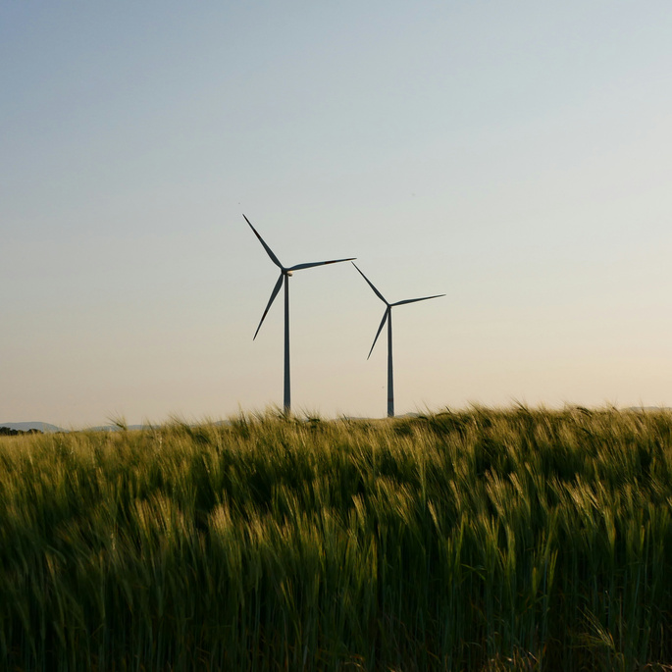





Forums | LATVIA
Techritory
An international forum on technologies and digitalisation in the EU.
Baltic Fintech days
The leading fintech industry event in the Baltics.
Rīga October
Rīga May 12-13
Deep Tech Atelier
The most significant deep tech event in the Baltics, where science, startups, and global investors meet.
PMNET Forum
A precision medicine forum on personalised and data-driven healthcare.
Rīga May 14-15
Rīga October
Techchill
The leading tech and startup event in the Baltics for innovation leaders.
Riga Comm
A business technology exhibition and conference.
International Drone Summit
An international summit on drone technologies and security.
Rīga March 25-27
Rīga October 8-9
Rīga May 27
2026
June
October
November
March
April
May
September
Wind Works
The leading wind energy forum in the Baltics.
Aftercare Forums
An international forum on investor aftercare and business growth.
Dual-Use Export Forums
On the export of dual-use technologies.
Defense Industry Expo
An international forum on technologies and digitalisation.
Rīga April
Rīga November
Rīga June 3-4
Tech Industry
The largest emerging technologies exhibition in the Baltics.
“UN:BLOCK”
The largest Web3 and blockchain conference in the Baltics.
Ādaži October
Rīga April
Rīga November

Slide 35






















We grow together!
They’ve chosen Latvia

Slide 36

Our mission – your achievements.
www.liaa.lv www.investinlatvia.org www.latvia.eu

