Slide 1
LATVIA:
Boundless creativity
and culture

Slide 2
Explore the boundless realms of Latvian creativity, where visionary minds achieve global acclaim as the world’s #1 creative nation*
*Fadel, C. (2021). Assessing countries’ competencies: The 4d index – ranking of skills, character, and meta-learning. CSE Leading Education Series Discussion Paper.
Notes:
From a vibrant contemporary art scene to the grandeur of classical music, Latvia proudly showcases wealth of world-renowned artists, musicians, opera singers, and conductors.

Slide 3
Focus on the mission Accept any challenge
Connect people
Test and create
Notes:
These stories reveal the success equation of focus on the mission, ability to face any challenge, connect with other talents and industries, and tirelessly test and create.

Slide 4
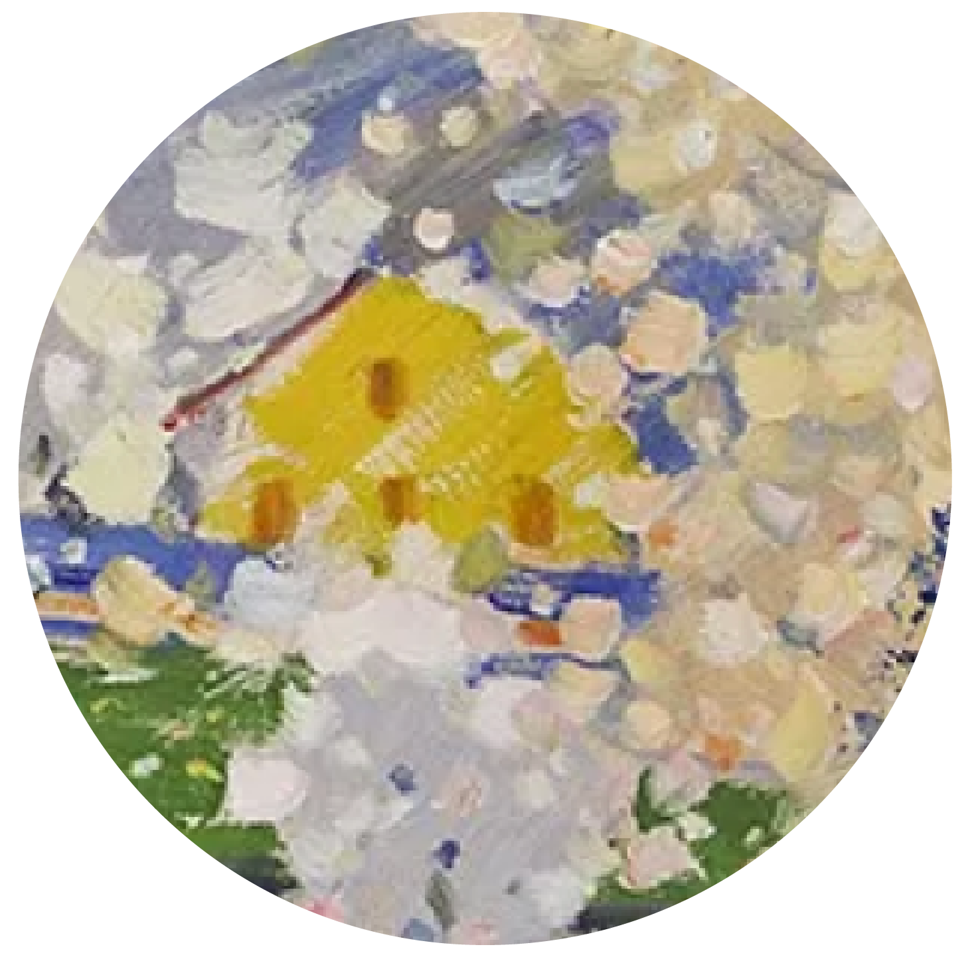
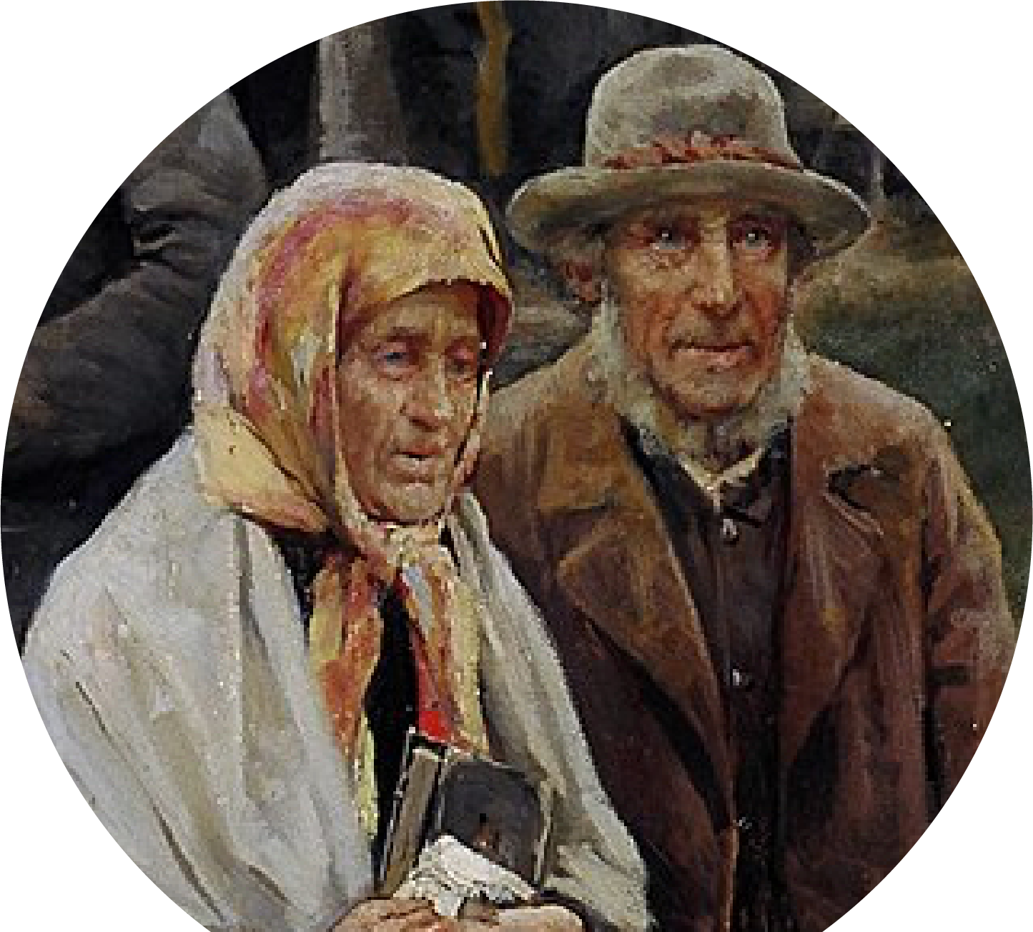
ART

Slide 5
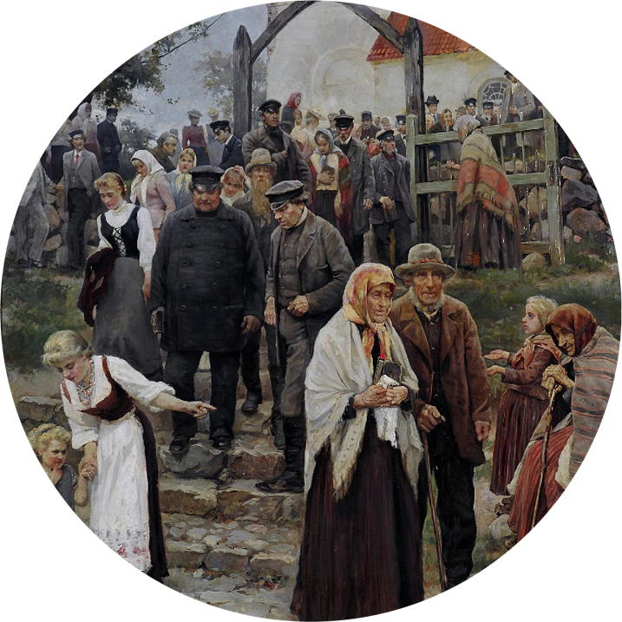
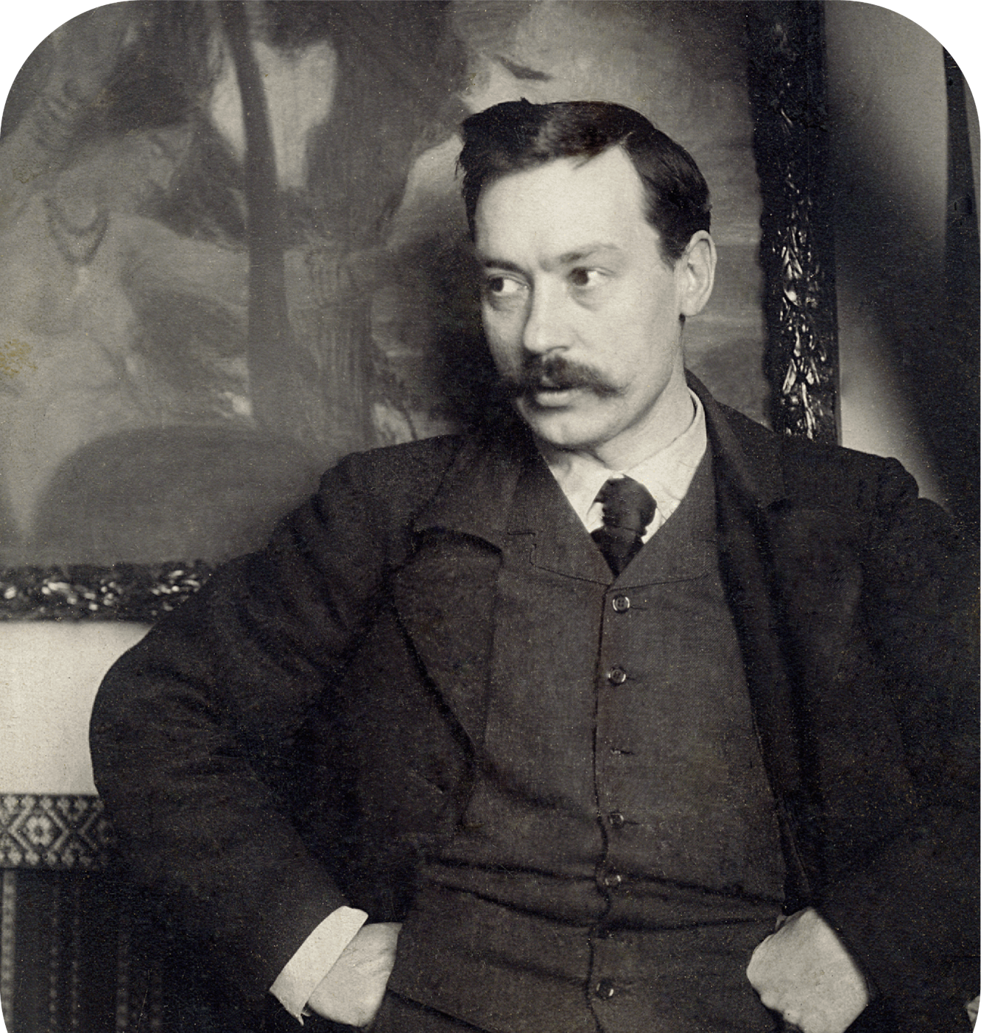
#ConnectingWorldsApart
#JanisRozentals
Janis Rozentāls
and the Dwarf
FOUNDERS OF NATIONAL
PAINTING
1886-1916
A trailblazing Latvian painter who embraced photography early on and founded the Dwarf art group that kickstarted the entire Latvian school of national painting

Slide 6
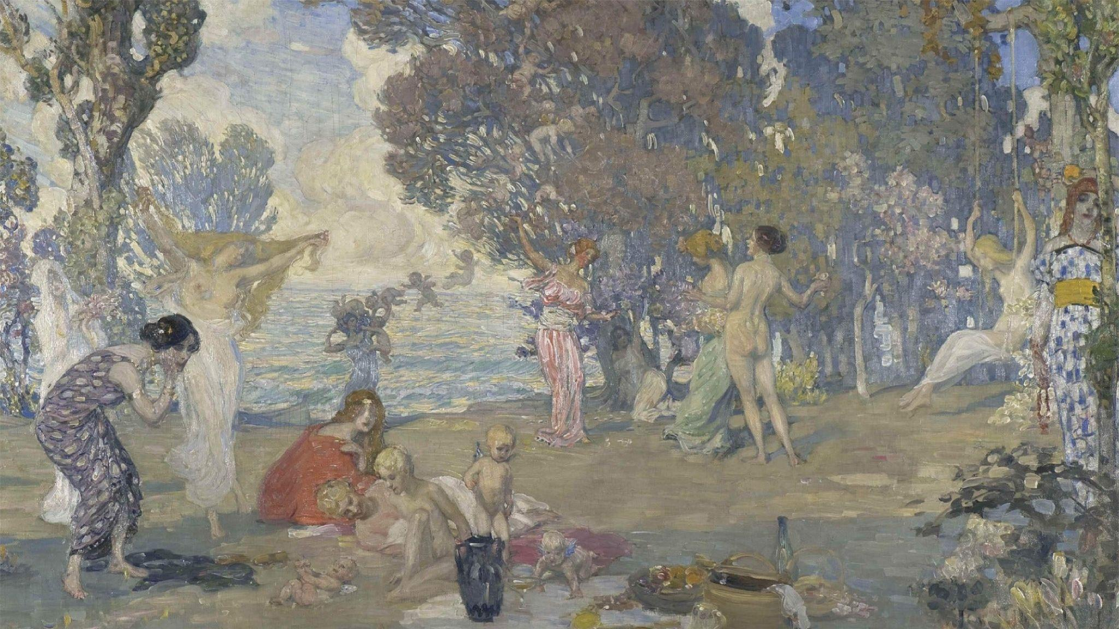
Rozentāls is one
of the symbols
of rich Latvian
Art Nouveau
Notes:
A trailblazing Latvian painter who embraced photography early on, capturing the essence of his homeland, its people, and its inspiring nature.
He founded an art group called the Dwarf that kickstarted the entire Latvian school of national painting back in the 19th century

Slide 7
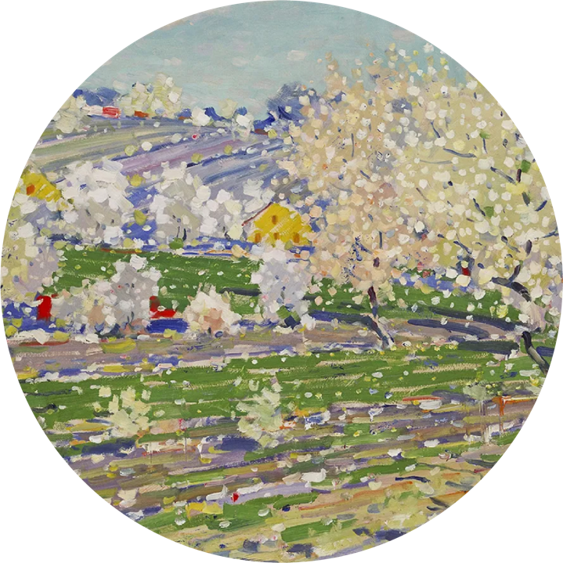
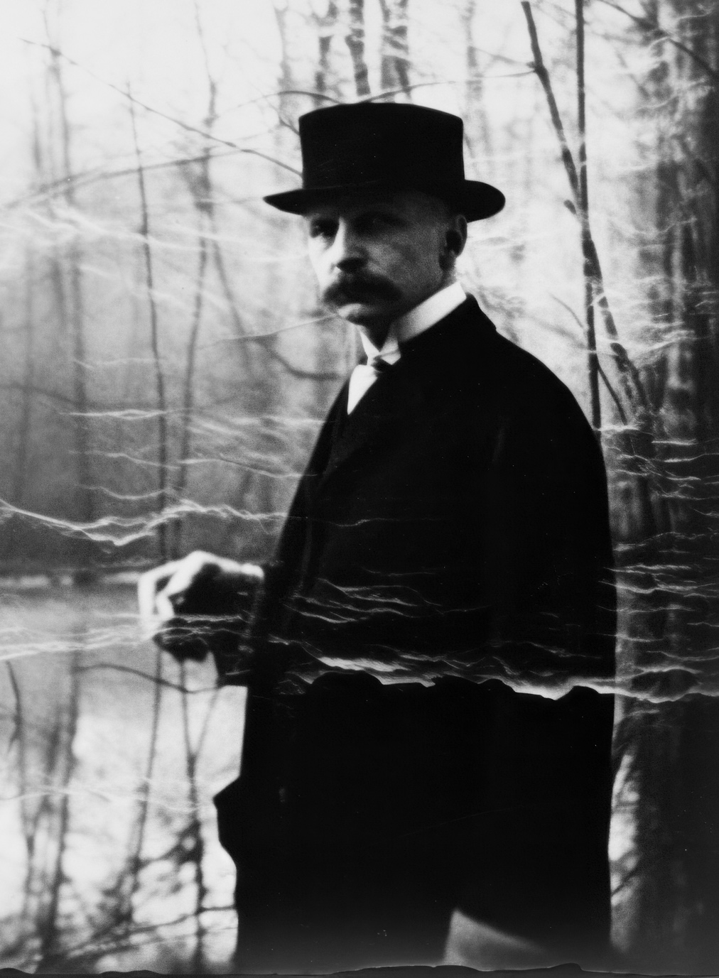
#ConnectingWorldsApart
#VilhelmsPurvitis
1872-1945
Vilhelms Purvitis
A NATIONAL SYMBOL AND PRIDE
Latvians say: “Purvitis is us!” -
a genius landscape painter became a symbol of national identity, turning the endless fields and plains of Latvia into icons
Notes:
Latvians say: "Purvitis is us!” - a genius landscape painter became a symbol of national identity
He challenged the endless fields and plains of Latvia and turned them into icons
He shaped art institutions and left a lasting cultural legacy
During the late 1930s, he held around 1000 of his own artworks in his studio

Slide 8
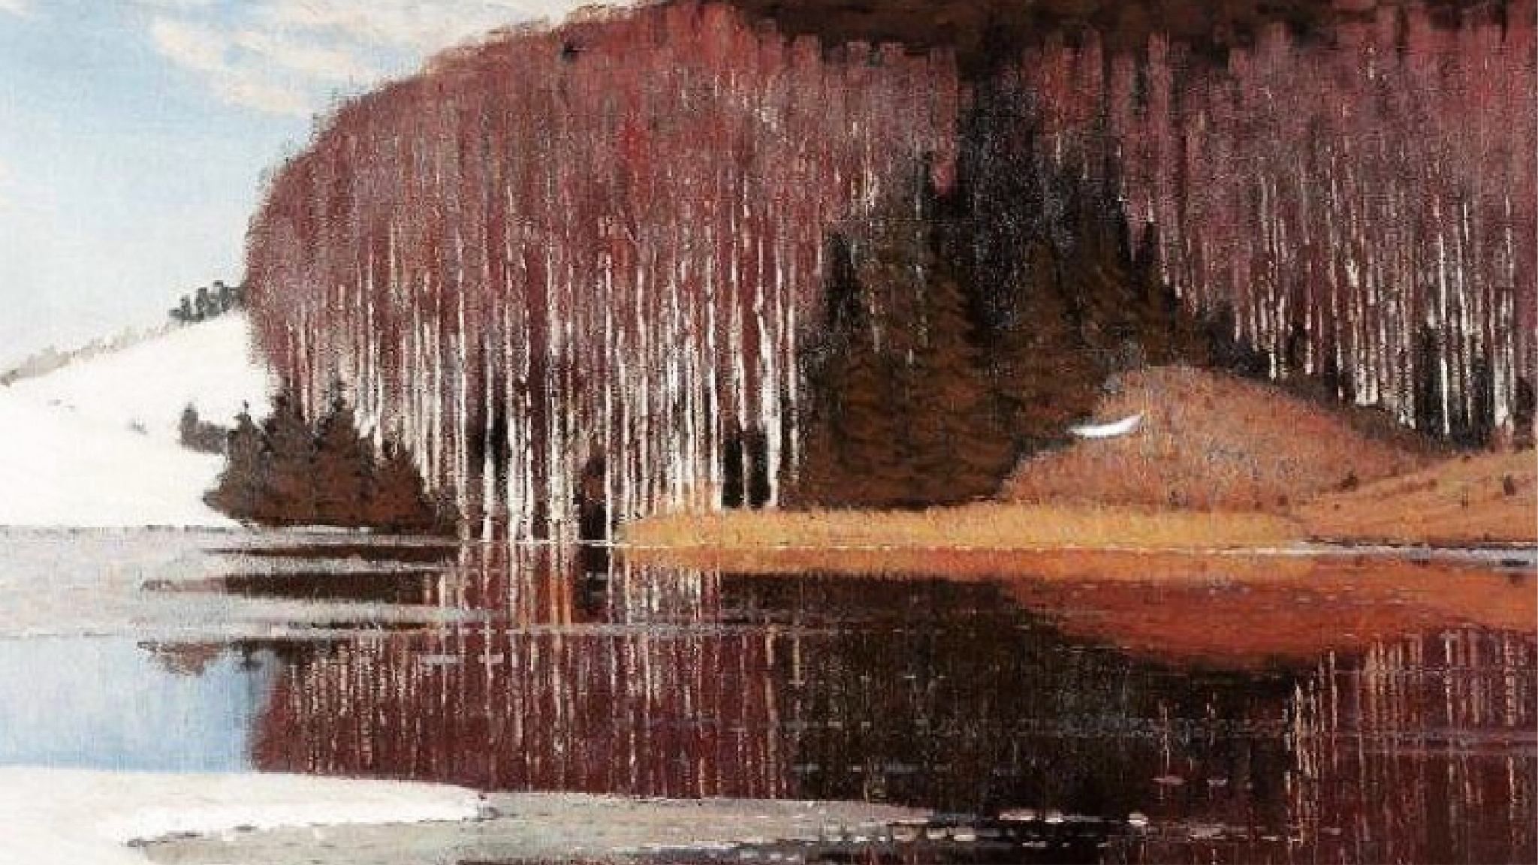
Purvitis was
a world-level
impressionist

Slide 9
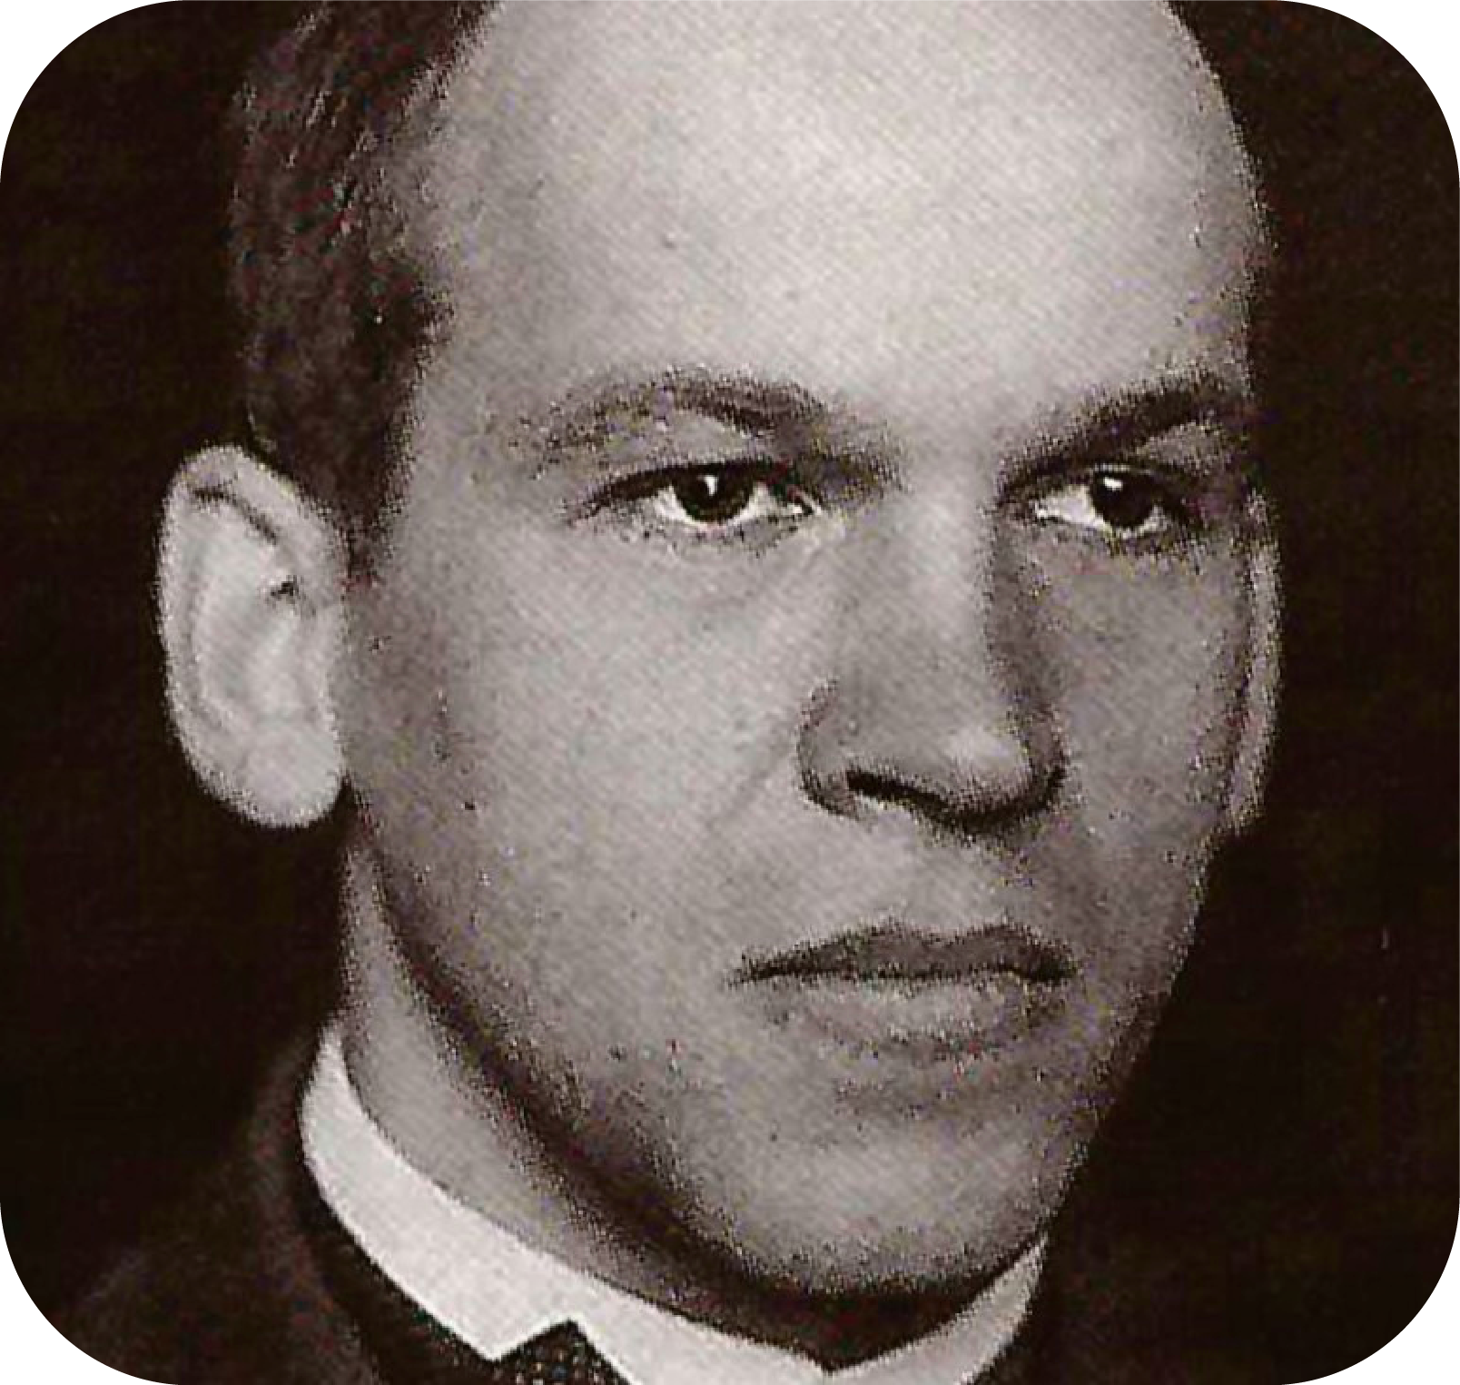
#ConnectingWorldsApart
#RomansSuta
Romans Suta
A PIONEER OF LATVIAN DESIGN
Iconic modernist Suta advocated that Latvian art maintain its distinctive essence, celebrating the joy and beauty of ancient traditions, while embracing global trends
1896-1944
Notes:
Pioneering Latvian contemporary design, iconic cubist and constructivist Suta advocated that Latvian art maintain its distinctive essence while embracing global trends
His porcelain collection "Weddings" serves as a hymn to the spiritual strength of the Latvian people, celebrating the joy and beauty of ancient traditions
Roman’s porcelain painting workshop, Baltars, stands firmly in the Latvian cultural canon

Slide 10
Suta was on the peak
of cubist and
constructivist
trends of the time

Slide 11
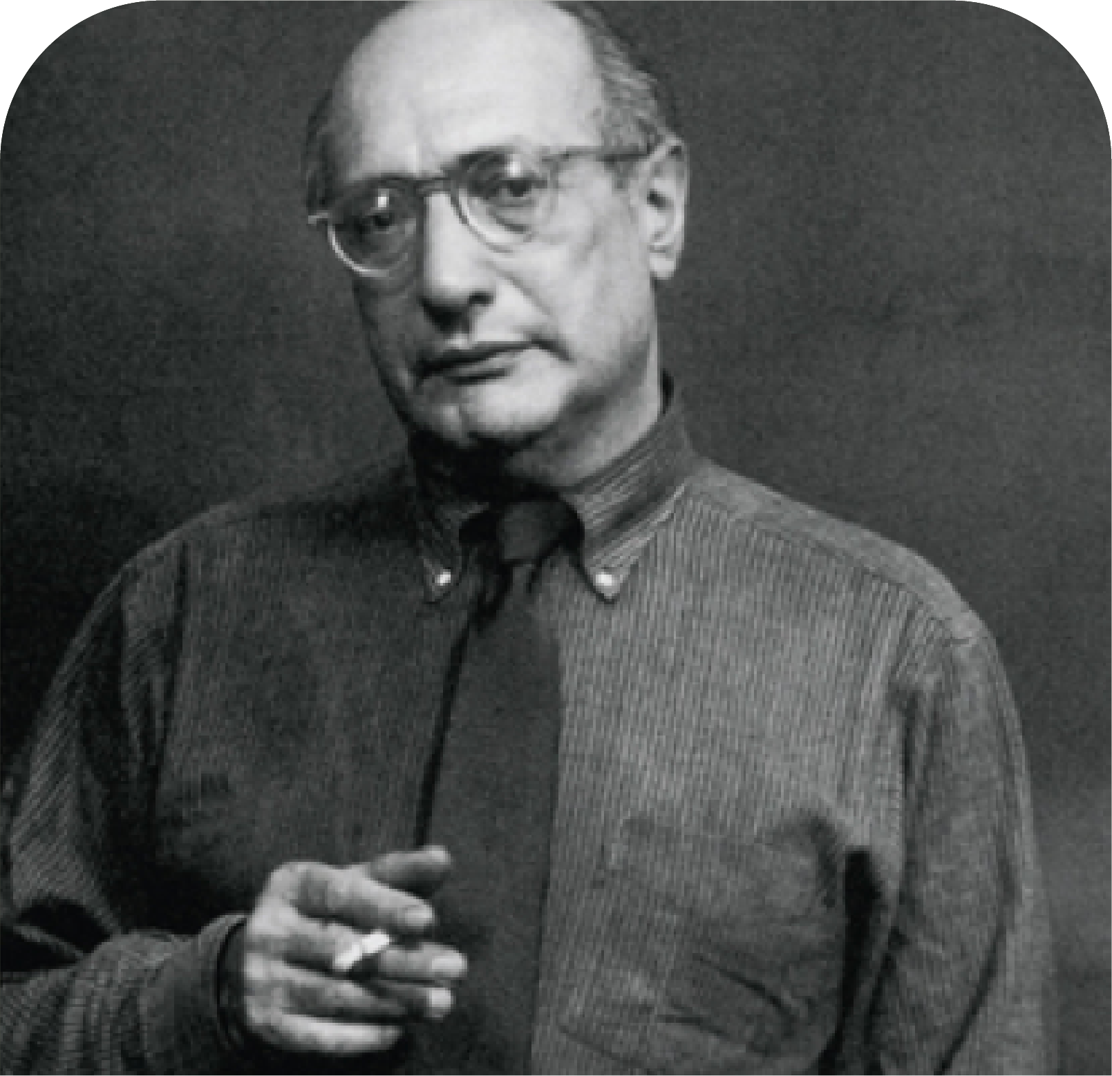
#NaturalPlayground
#MarkRothko
Mark Rothko
A LATVIAN-BORN ART SUPERSTAR
1903-1970
One of the most influential and expensive abstract expressionist painters, world-known for his large-scale rectangular color fields.

Slide 12
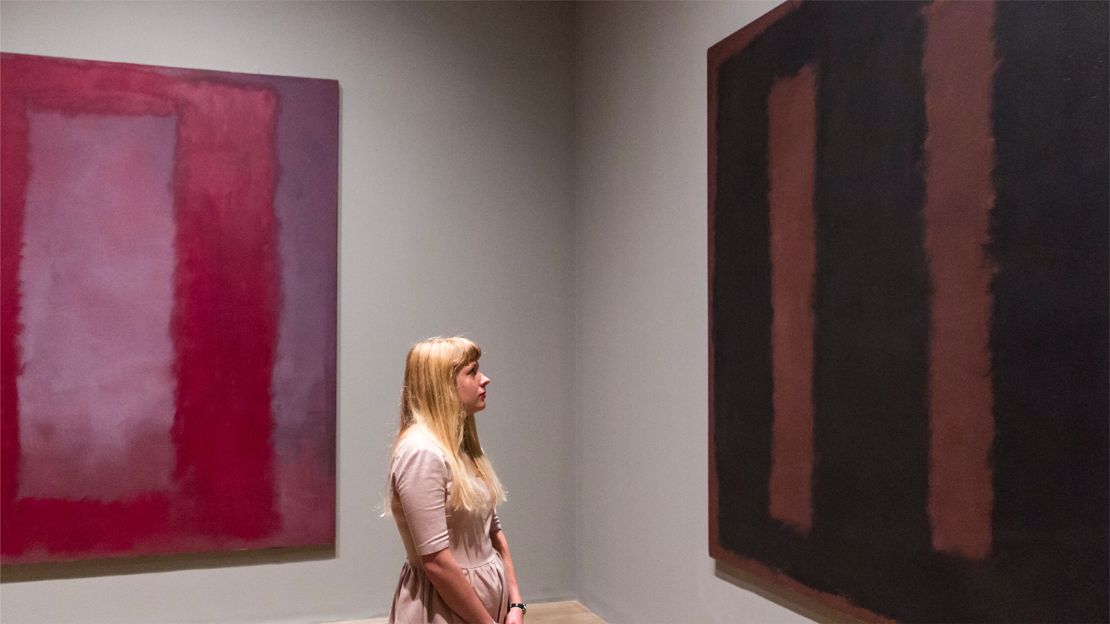
Rothko’s canvases
are exhibited in the
world’s best museums
Notes:
The influential abstract expressionist painter is best known for his large-scale rectangular color fields.
“Orange, Red, Yellow” sold for $87 million in 2012 set a world auction record for any contemporary work of art and a world auction record for the artist

Slide 13
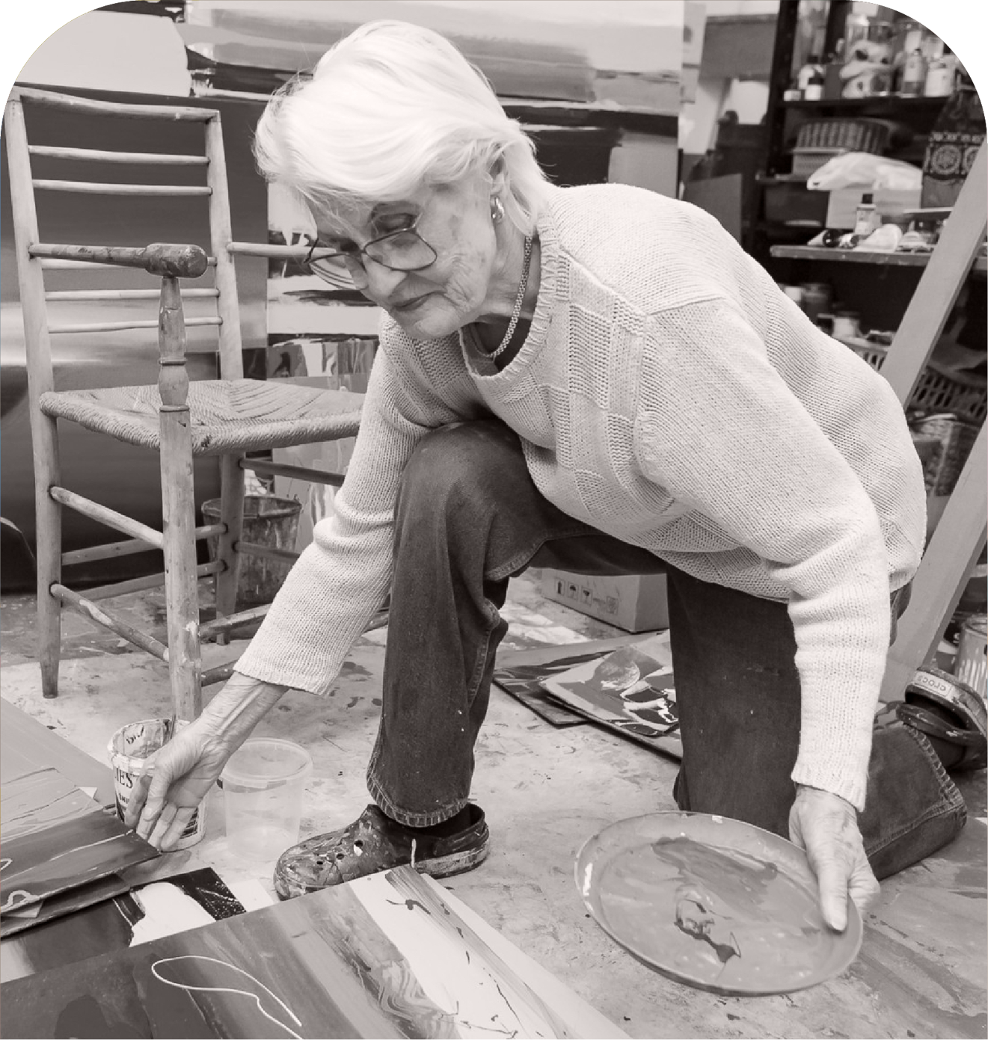
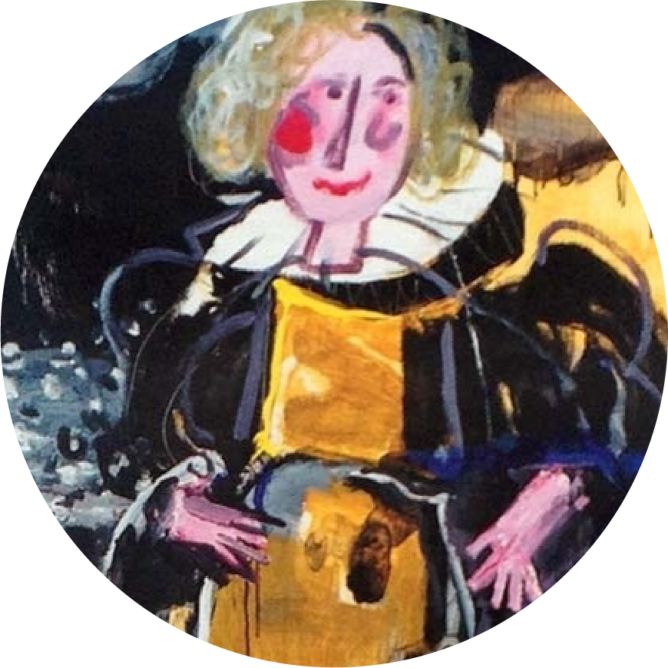
#ConnectingWorldsApart
#DzemmaSkulme
Dzemma Skulme
A FEMALE ART SYMBOL
Embodying the resilient and timeless image of Latvian woman, Skulme influenced the art landscape of post-war Latvia
1925-2019

Slide 14
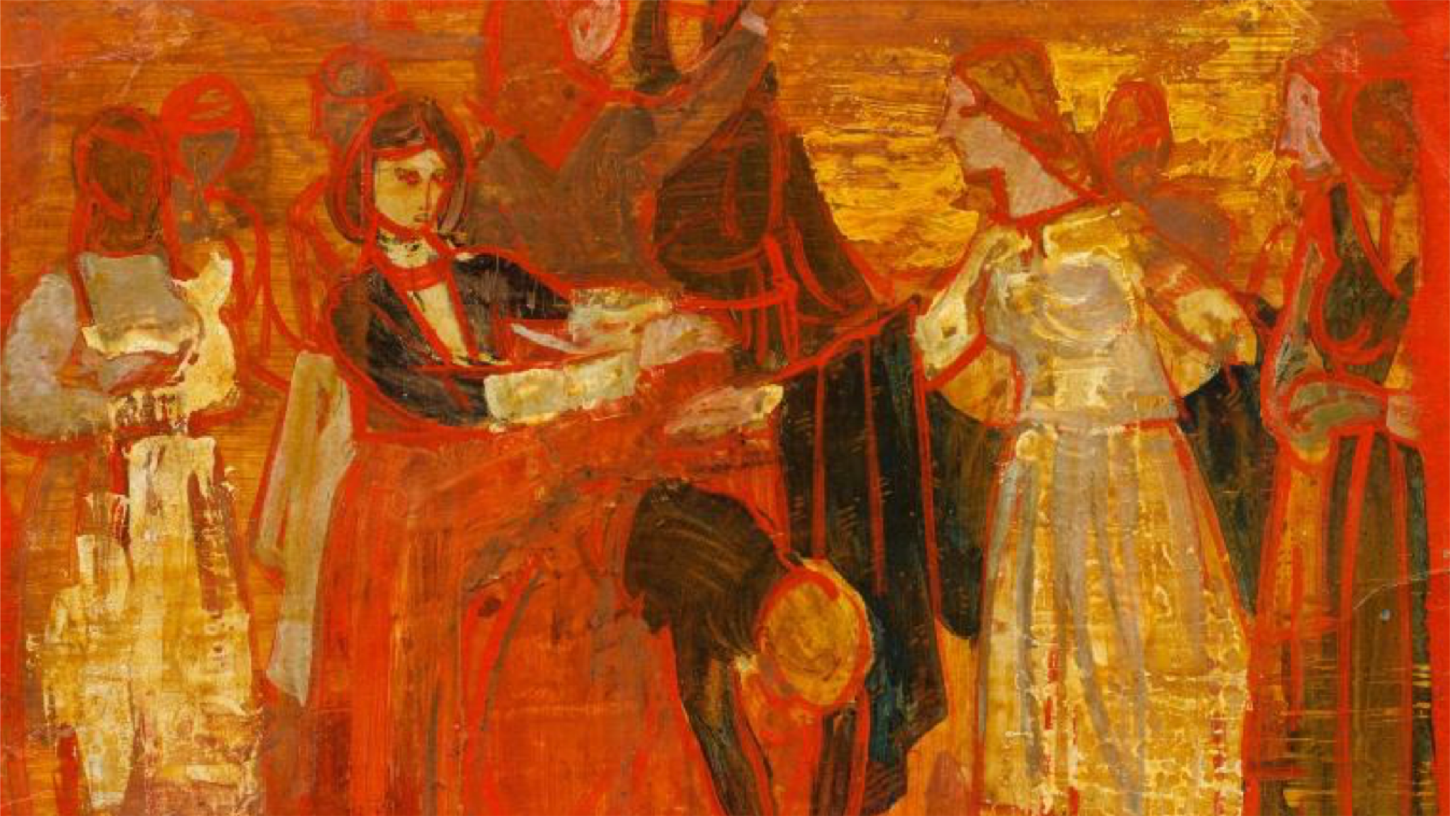
Dzemma’s art
influenced Latvia
during its fight for
independence
Notes:
A prominent Latvian painter embodies the resilient and timeless image of Latvian woman.
Skulme influenced the art landscape of post-war Latvia and our country’s fight for independence
Her strength and wisdom are fundamental values of every Latvian

Slide 15
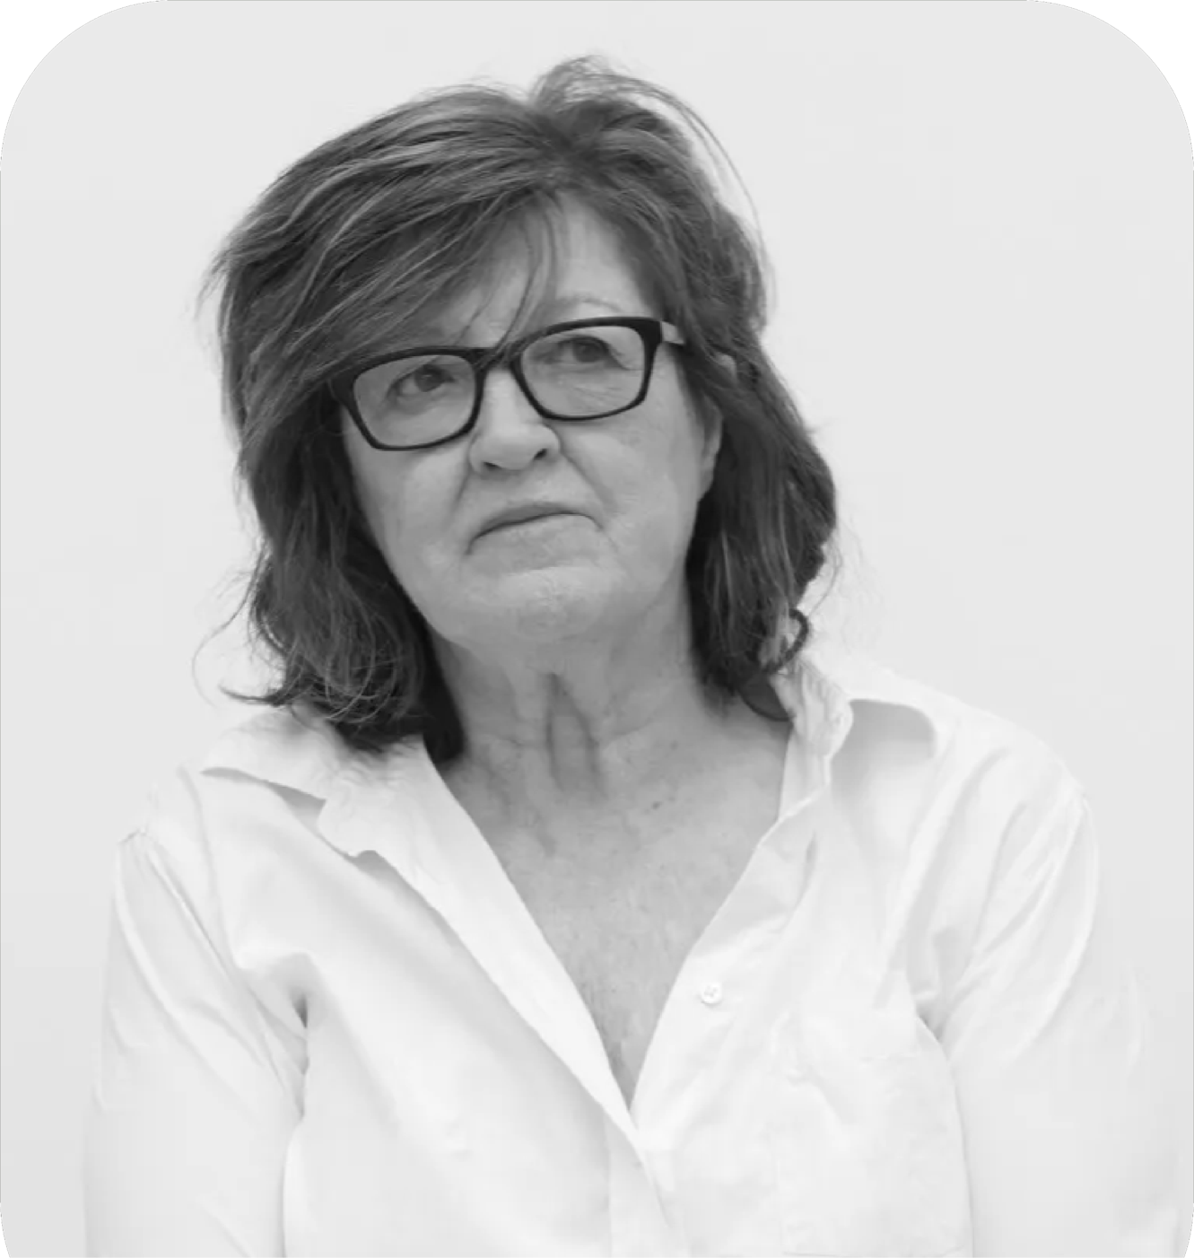
#ReadyForAnyChallenges
#VijaCelmins
Vija Celmins
A MASTER OF PHOTOREALISM
Based in New York, Vija is celebrated for her stunning photo-realistic paintings and drawings

Slide 16
Vija masterly
reproduced moving
and still objects
Notes:
Now based in New York, Vija is celebrated for her stunning photo-realistic paintings and drawings.
Celmins' works rank in the top 10 most expensive among living female artists worldwide
"When I came to America, I didn't speak the language. I drew all the time in school until I learned to speak. Everyone at school said, «That's the drawer, that's the artist.»"

Slide 17
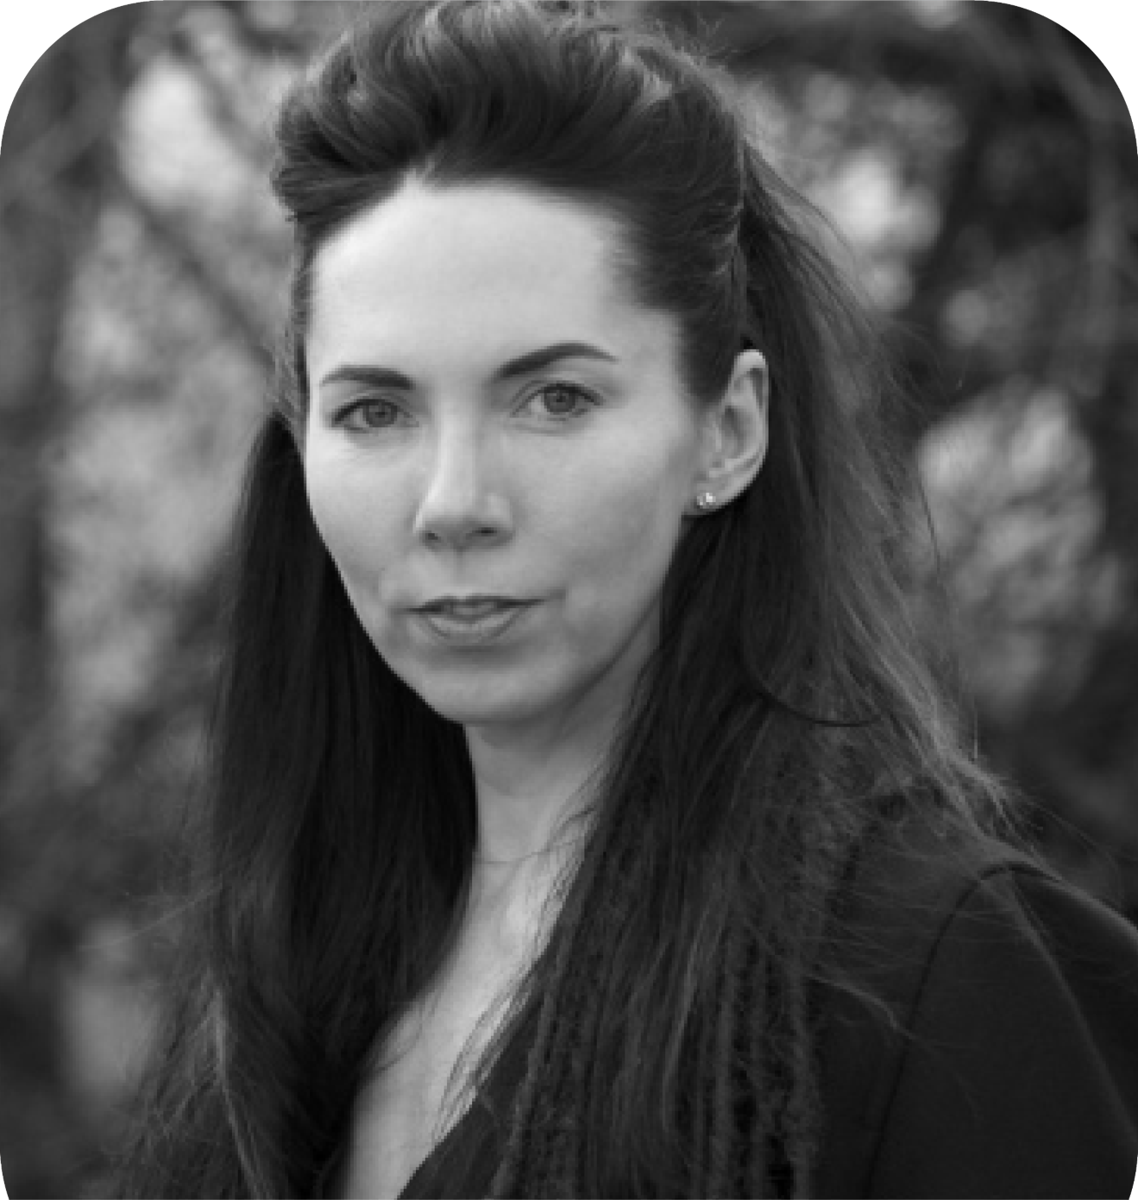
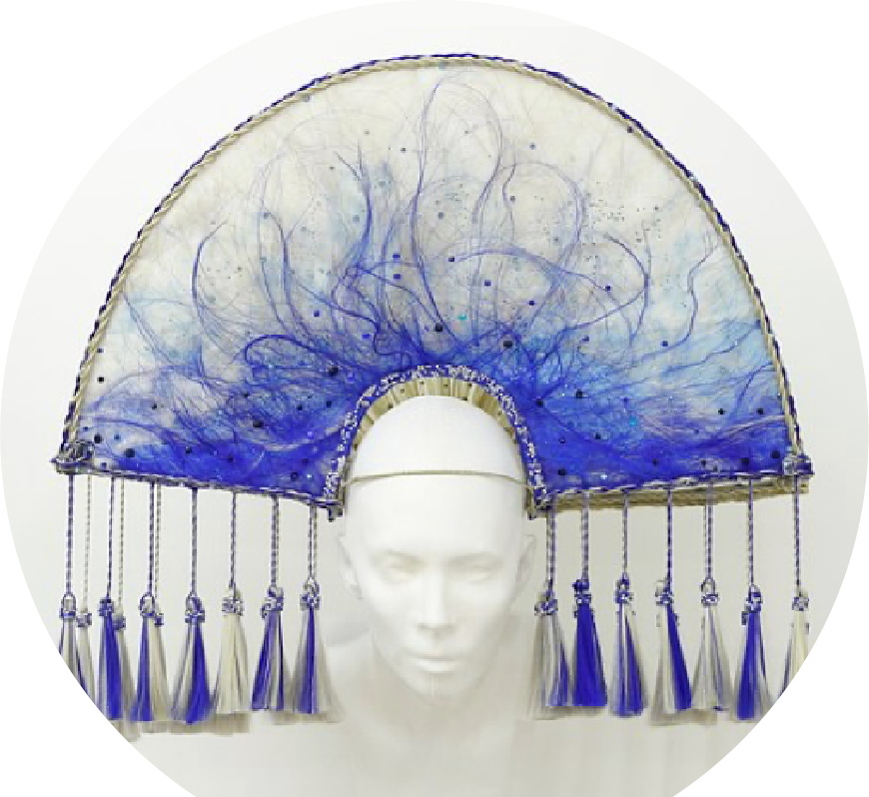
#NaturalPlayground
#KatrinaNeiburga
Katrina Neiburga
A LEADING FORCE IN
CONTEMPORARY ART
The moving image deeply inspired by real life serves as Katrina’s primary medium and expressive form.

Slide 18
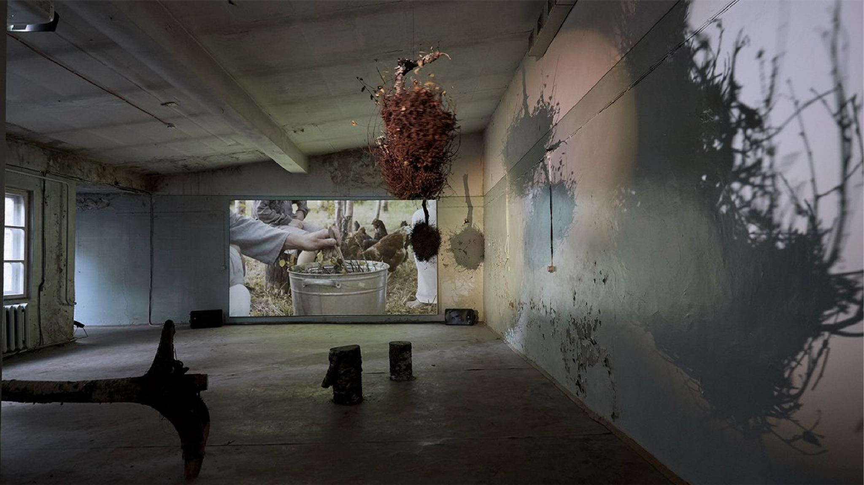
Power of Katrina’s
works is difficult
to transfer via still
images
Notes:
The moving image – performance, film, and video – serves as her primary medium and expressive form.
Neiburga's art is deeply inspired by real life – to create it, she becomes a taxi driver, documentary filmmaker, singer, set designer, or even a shoe selle

Slide 19
MUSIC

Slide 20
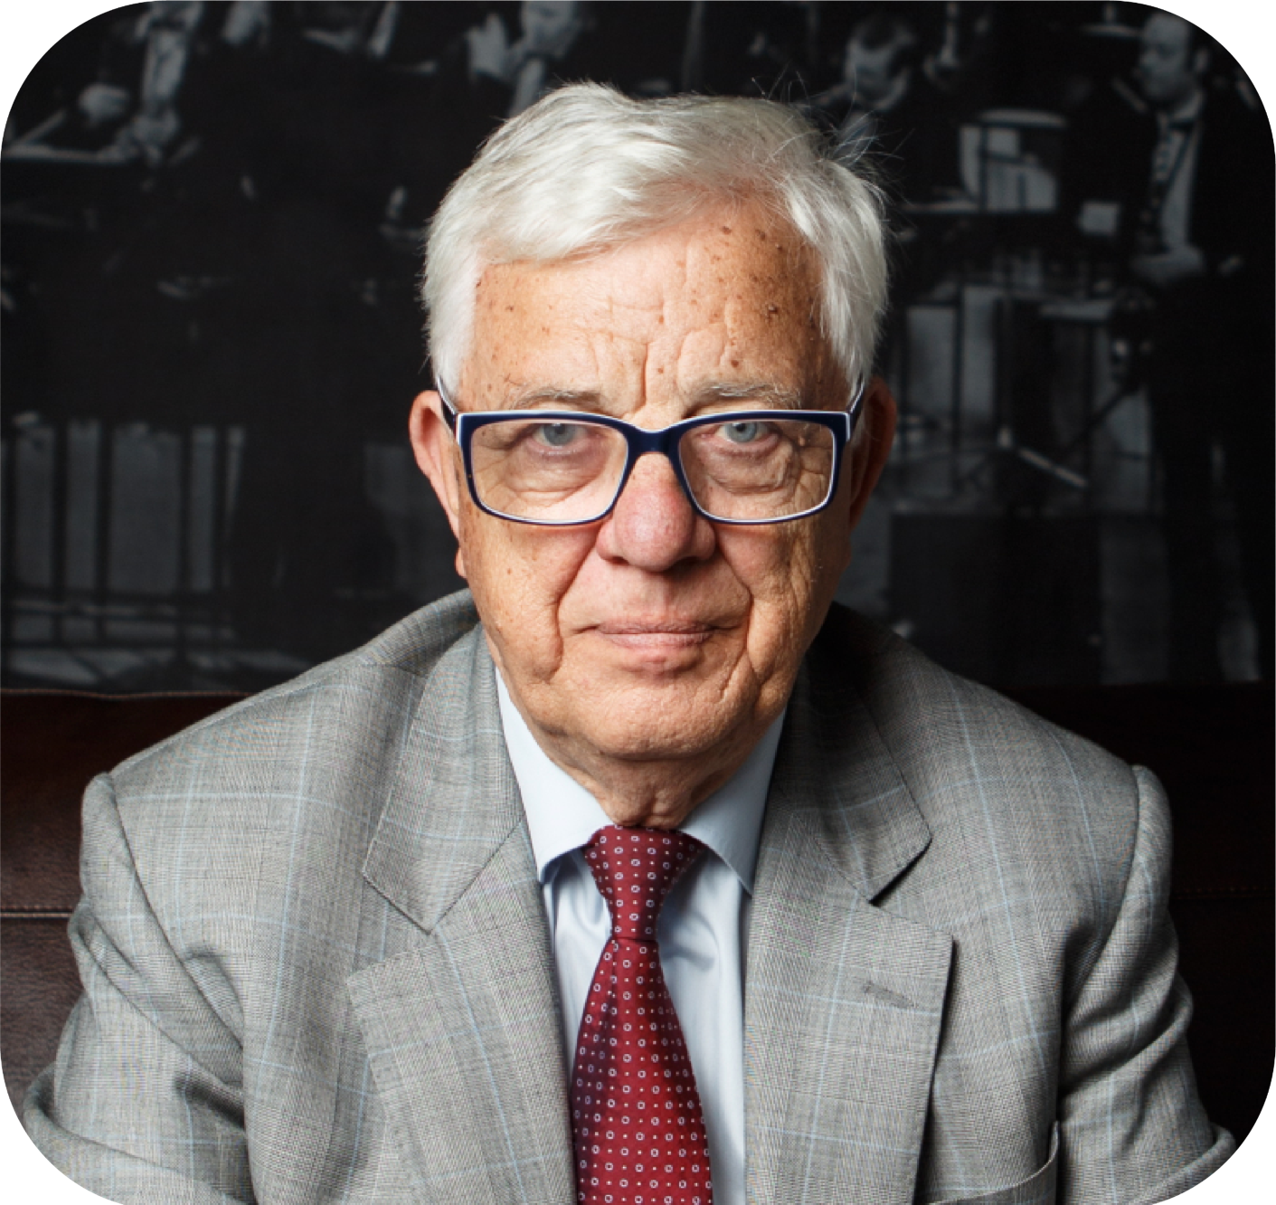
#ReadyForAnyChallenges
#RaimondsPauls
Raimonds Pauls
SIMPLY THE MAESTRO
Maestro's more than 2400 songs
for concerts, films, choirs, and performances have both democratic and elitist touches
Notes:
Maestro's more than 2400 songs for concerts, films, choirs, and performances have both democratic and elitist touches
The most popular Latvian song of all time "Dāvāja Māriņa" was premiered 39 years ago and is sung in more than 10 countries
We sing Maestro’s songs everywhere - from campfires to official events. Even Riga's Old Town clock plays the Maestro's melody!

Slide 21
#ReadyForAnyChallenges
#LolitaRitmanis
Lolita Ritmanis
A HOLLYWOOD CONQUEROR
Lolita challenged the male-dominated Hollywood music industry and became a film composer for many Hollywood films, TV series, and commercials
Notes:
Co-founder of the Alliance for Women Film Composers, Lolita challenged the male-dominated Hollywood music industry and became a film composer for over 18 Hollywood feature films, 21 TV series, animated films, and commercials
She has been honored with the prestigious Emmy award for “Batman Beyond” and Grammy in 2022 for music production

Slide 22
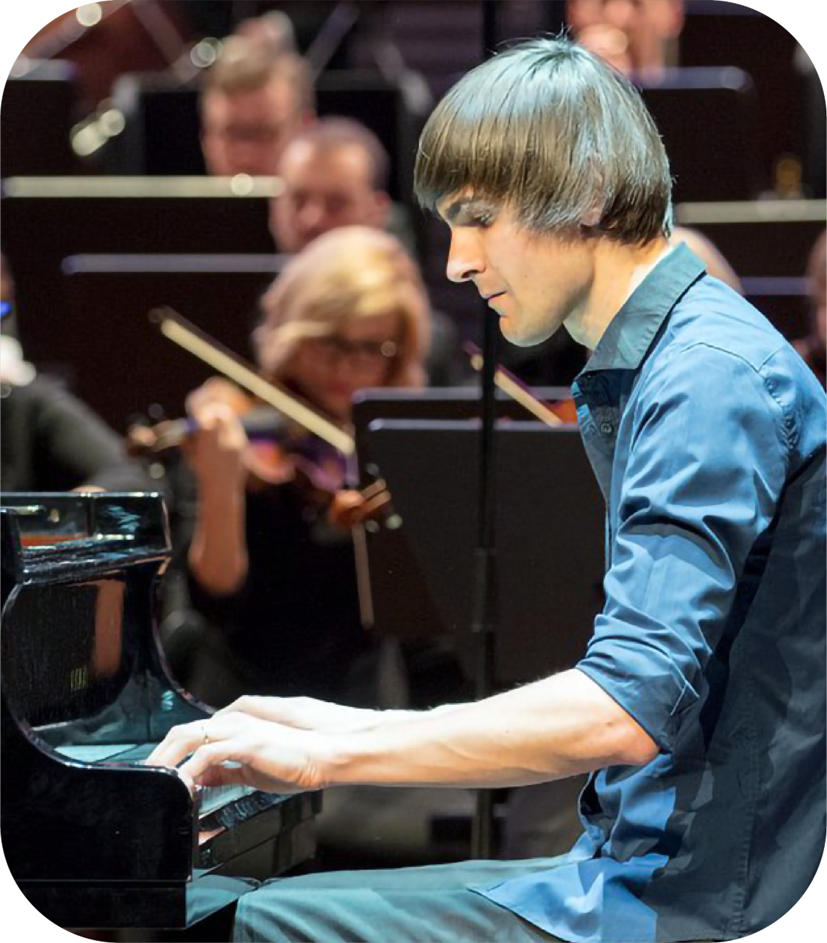
#ReadyForAnyChallenges
#VestardShimkus
Vestard Shimkus
A PIANIST PHENOMENON
Praised as “a phenomenon” and “one of the greatest pianists of the young generation”, Vestard showcases his versatility through competitions, collaborations, and improvised solo concerts
Notes:
Praised as "a phenomenon" (conductor Paavo Jarvi), “inspired” (BBC), "superb" (American Record Guide), and "one of the greatest pianists of the young generation" (Piano News).
Vestard showcases his versatility through competitions, collaborations with prestigious orchestras, and entirely improvised solo concerts

Slide 23
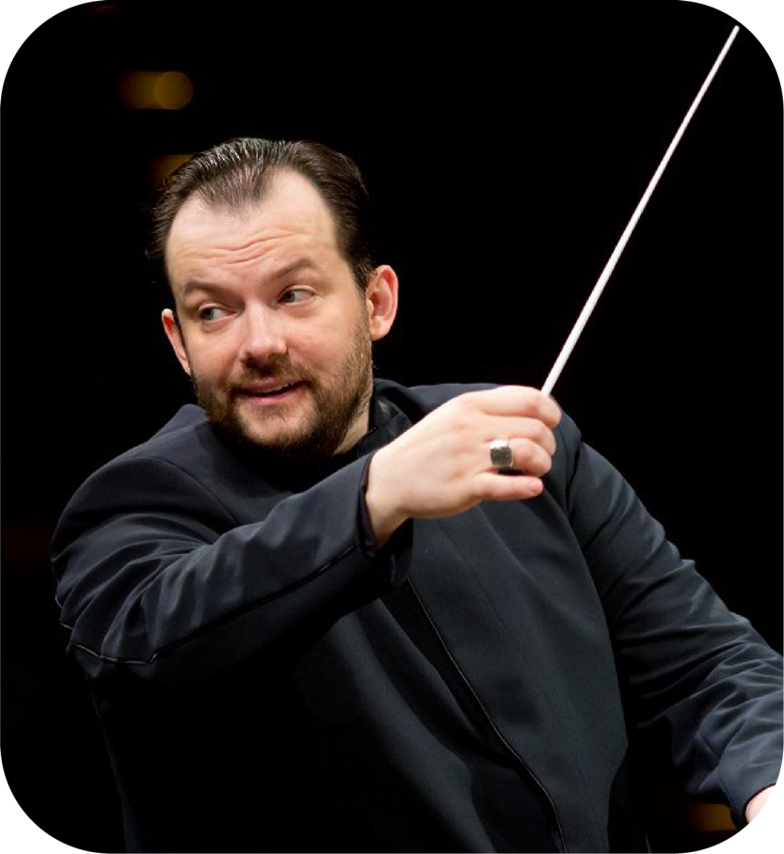
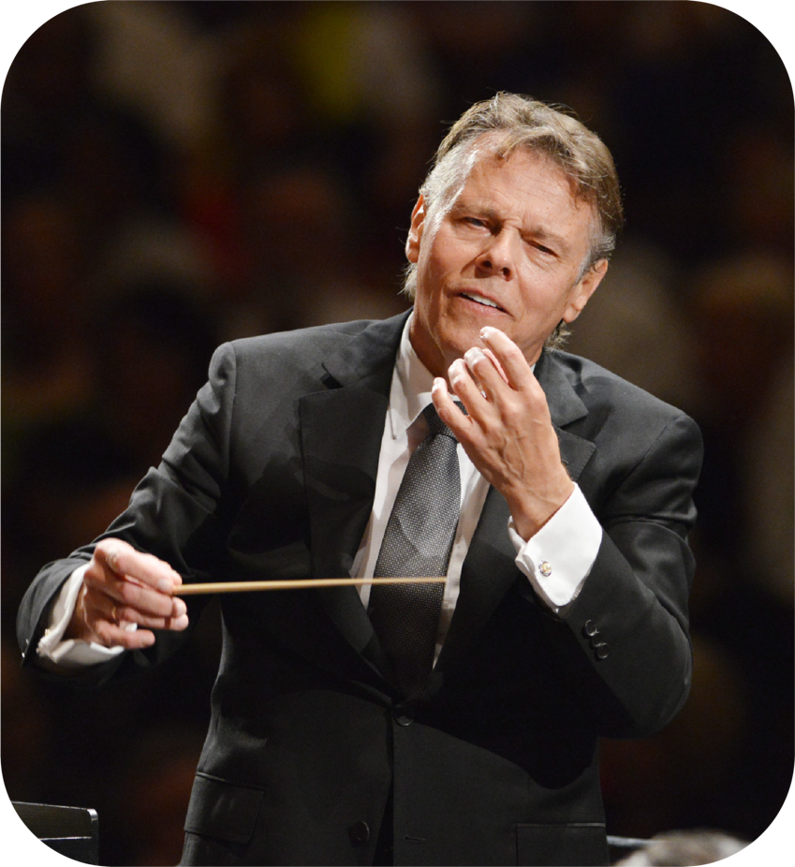
#ConnectingWorldsApart
#MarissJansons
#AndrisNelsons
WORLD-LEADING
CONDUCTORS
Andris Nelsons
Cited as one of the world’s greatest conductors, Andris worked with orchestras all around the world and was credited on 190+ records. The music director of the Boston Orchestra, Andris is famous for accentuating the contemporaneity of classical composers
Mariss Jansons
Notes:
(Maris)
Cited as one of the world’s greatest conductors, Mariss worked with Oslo, London, Boston, Amsterdam, Bavarian and Pittsburgh Symphony Orchestras
Credited on 190+ records, he was awarded with many prestigious awards, incl. Grammy and Siemens Music Prize
(Andris)
Currently the music director of the Boston Symphony Orchestra, Andris is famous for accentuating the contemporaneity of well-known classical composers.

Slide 24
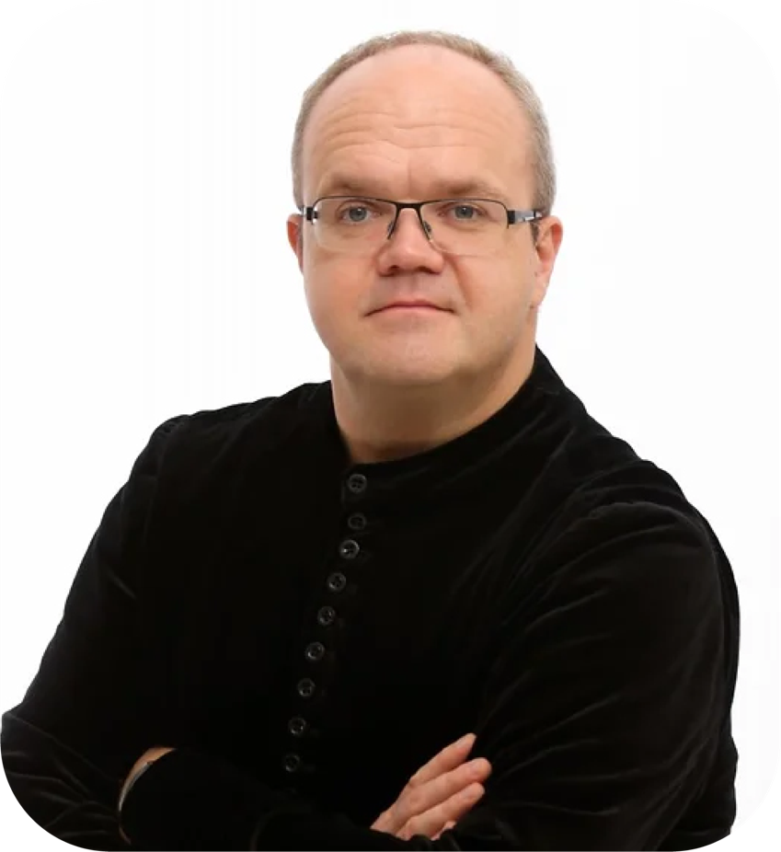
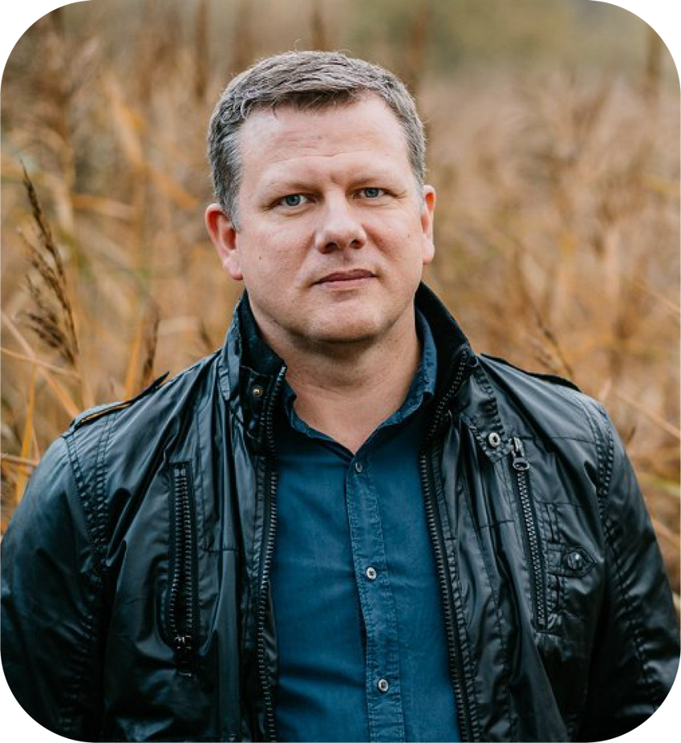
#ConnectWorlds
#MarisSirmais
#EriksEsenvalds
CHOIR POPULARIZERS
Maris Sirmais
A pillar of choral culture, Maris garnered worldwide acclaim, winning 60 competitions around the globe
One of the most performed choral composers in the world, Eriks cherishes the textures of his home country
Eriks Esenvalds
Notes:
Recognized as one of the most performed choral composers in the world, Eriks’ music resonates daily across the globe
As a composer with Nordic inspiration, he cherishes the textures of his home country.
A pillar of choral culture, Maris has the power to emotionally sway and deeply touch
He garnered worldwide acclaim, winning 60 national and international competitions.
"The choir sings, and I see tears, and people in the hall are crying too” – Maris

Slide 25
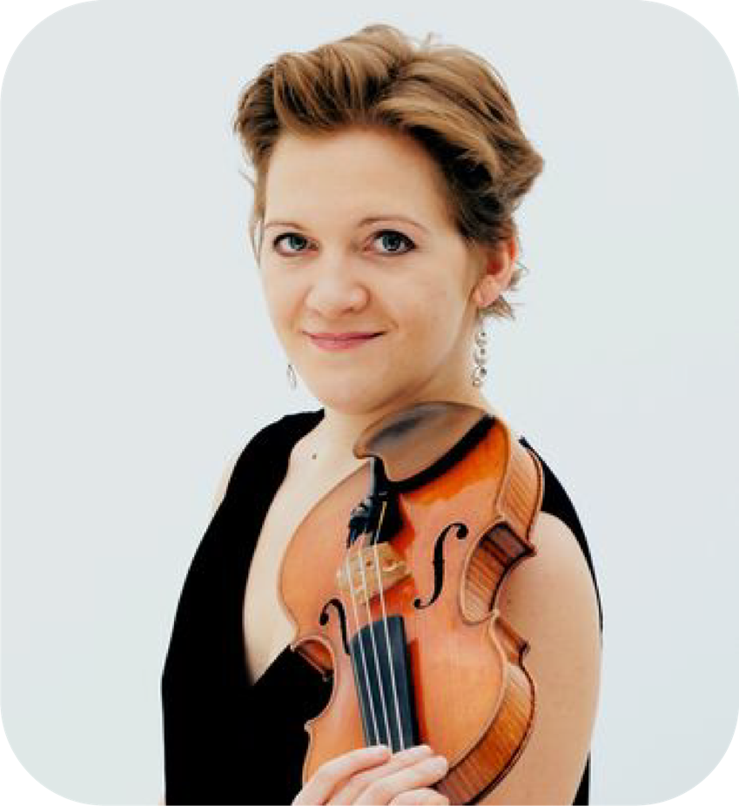
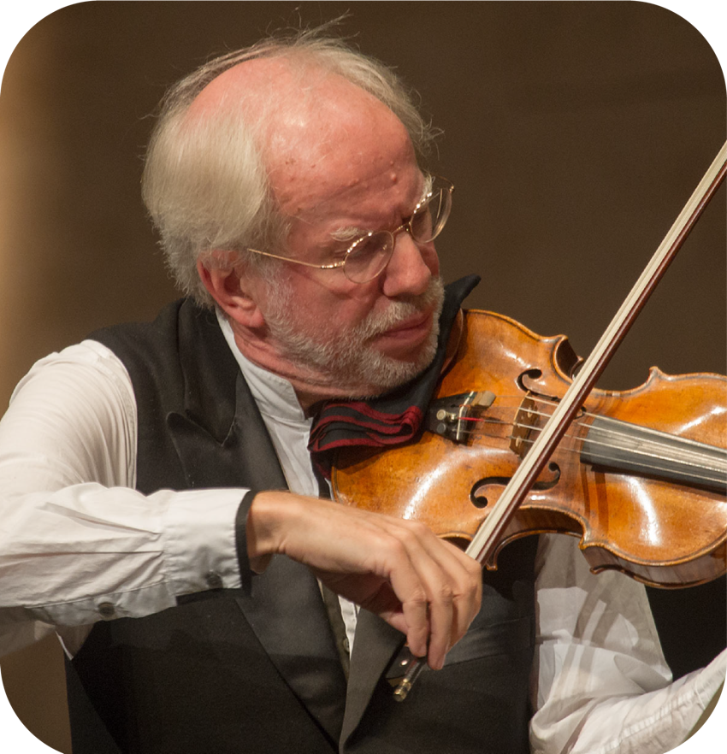
#NaturalPlayground
#GidonKremer
#VinetaSareikaVolkner
VIOLIN VIRTUOSOS
An acclaimed violinist, Vineta made history by becoming the first woman in 141 years on the first concertmaster position at Berliner Philharmoniker
UN Goodwill Ambassador, Gidon fosters young musicians from Baltics in his orchestra “Kremerata Baltica”
Vineta
Sareika-Völkner
Gidon Kremer
Notes:
Vineta
An acclaimed violinist, Vineta is one of the greatest gems of Latvian classical music
She made history by becoming the first woman in 141 years to hold the first concertmaster position at prestigious Berliner Philharmoniker
A UN Goodwill Ambassador, Gidon aims to champion new artists and contemporary composers
He fosters young musicians from the Baltic States in his orchestra “Kremerata Baltica”
Gidon
A UN Goodwill Ambassador, Gidon aims to champion new artists and contemporary composers
He fosters young musicians from the Baltic States in his orchestra “Kremerata Baltica”

Slide 26
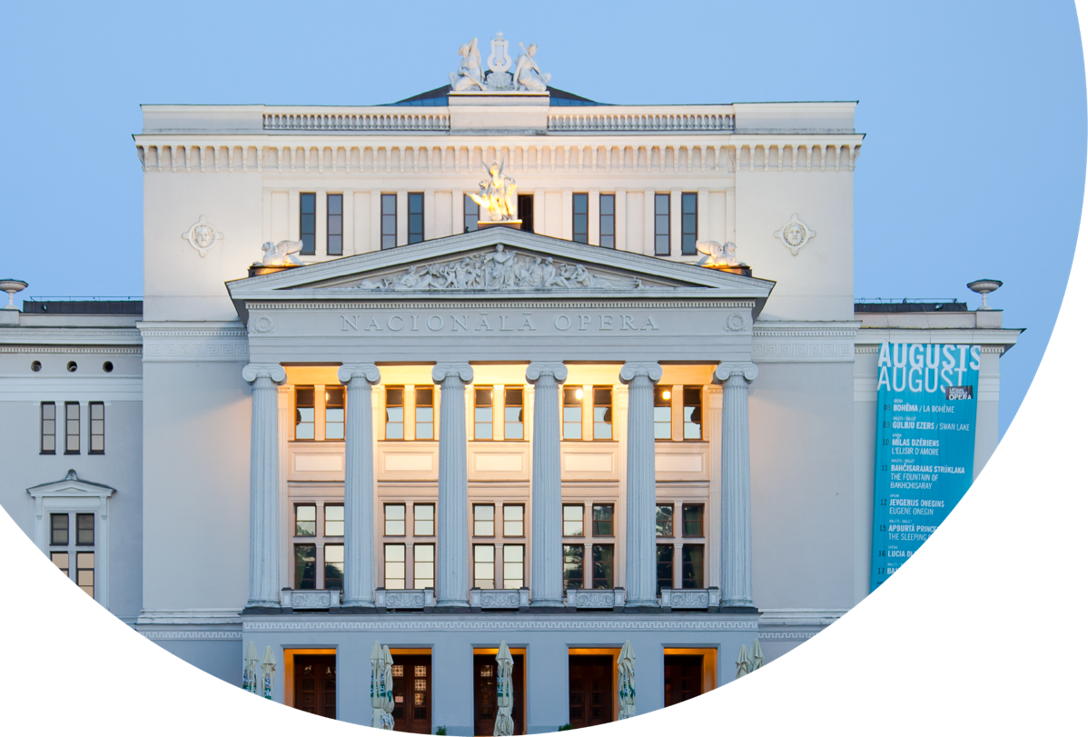
OPERA AND
THEATRE

Slide 27
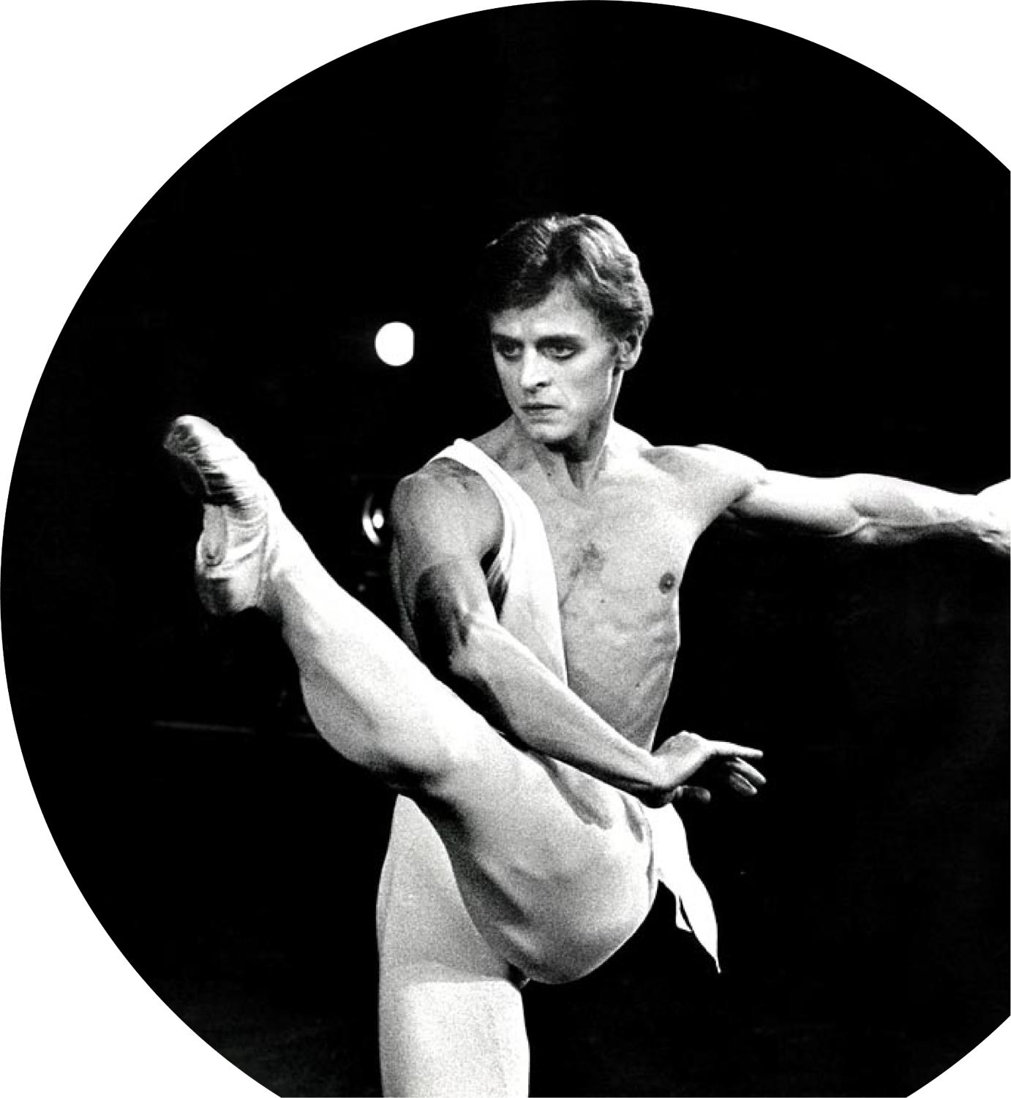
#NaturalPlayground
#MikhailBaryshnikov
Mikhail Baryshnikov
A BALLET LEGEND
The ballet star, influencer to generations of dancers globally, Baryshnikov became a voice of consciousness of the generation after fleeing the Soviet Union
Notes:
Riga gave the world Mikhail Baryshnikov, the immensely popular ballet star, and influencer to generations of dancers globally
Not meeting ballet physical standards, Baryshnikov compensated with extraordinary technical prowess
Having fled Soviet Union, he became a voice of consicousness of the generation
“I do not try to dance better than anyone else. I only try to dance better than myself”

Slide 28
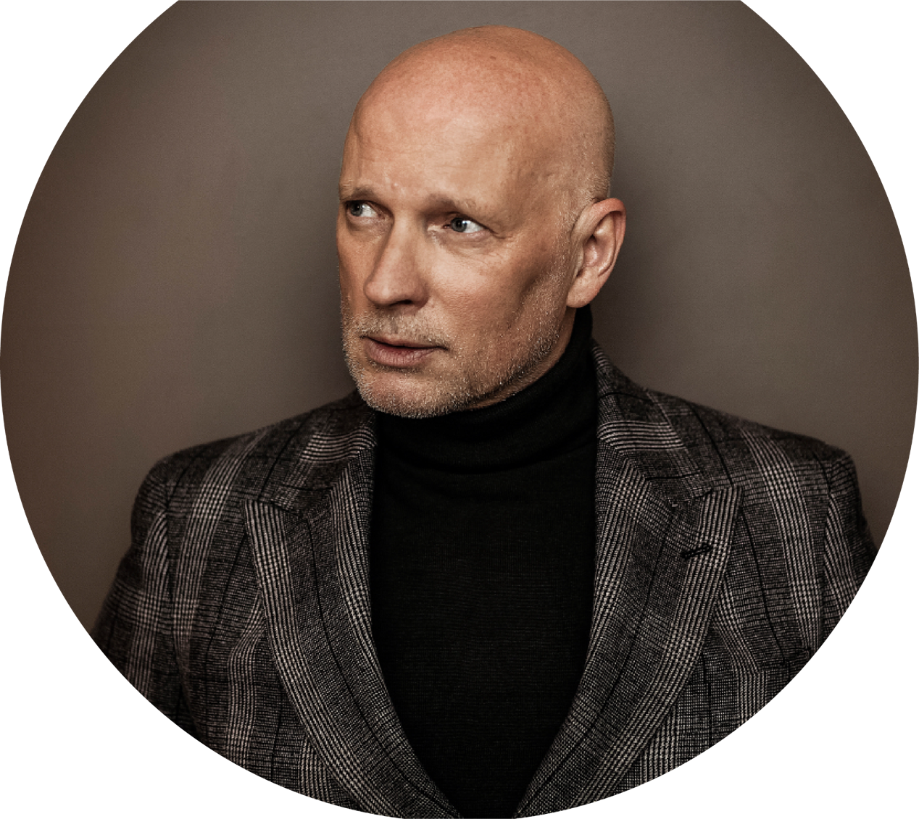
Alvis Hermanis
A THEATRE ADVOCATE
Director’s ability to illuminate the essence of Latvians and capture everyday life has earned him recognition
as one of the most visible contemporary theatre advocates
#ReadyForAnyChallenges
#AlvisHermanis
Notes:
Alvis is a theatre director and prominent figure in Latvian culture and society, a master to illuminate the essence of every Latvian
His ability to capture everyday ordinary life has earned him recognition as one of Europe's most visible advocates for contemporary theatre
"...national identity is hardly established through ideology. It arises through emotions, nature, intonations, and overall mentality. It reaches us through senses - through sound, sight, taste.”

Slide 29
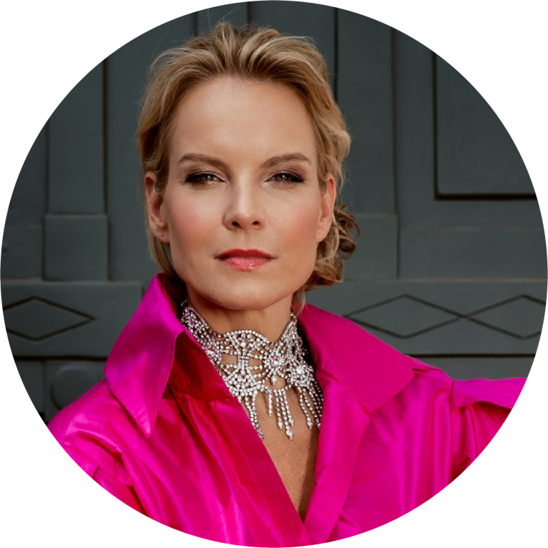
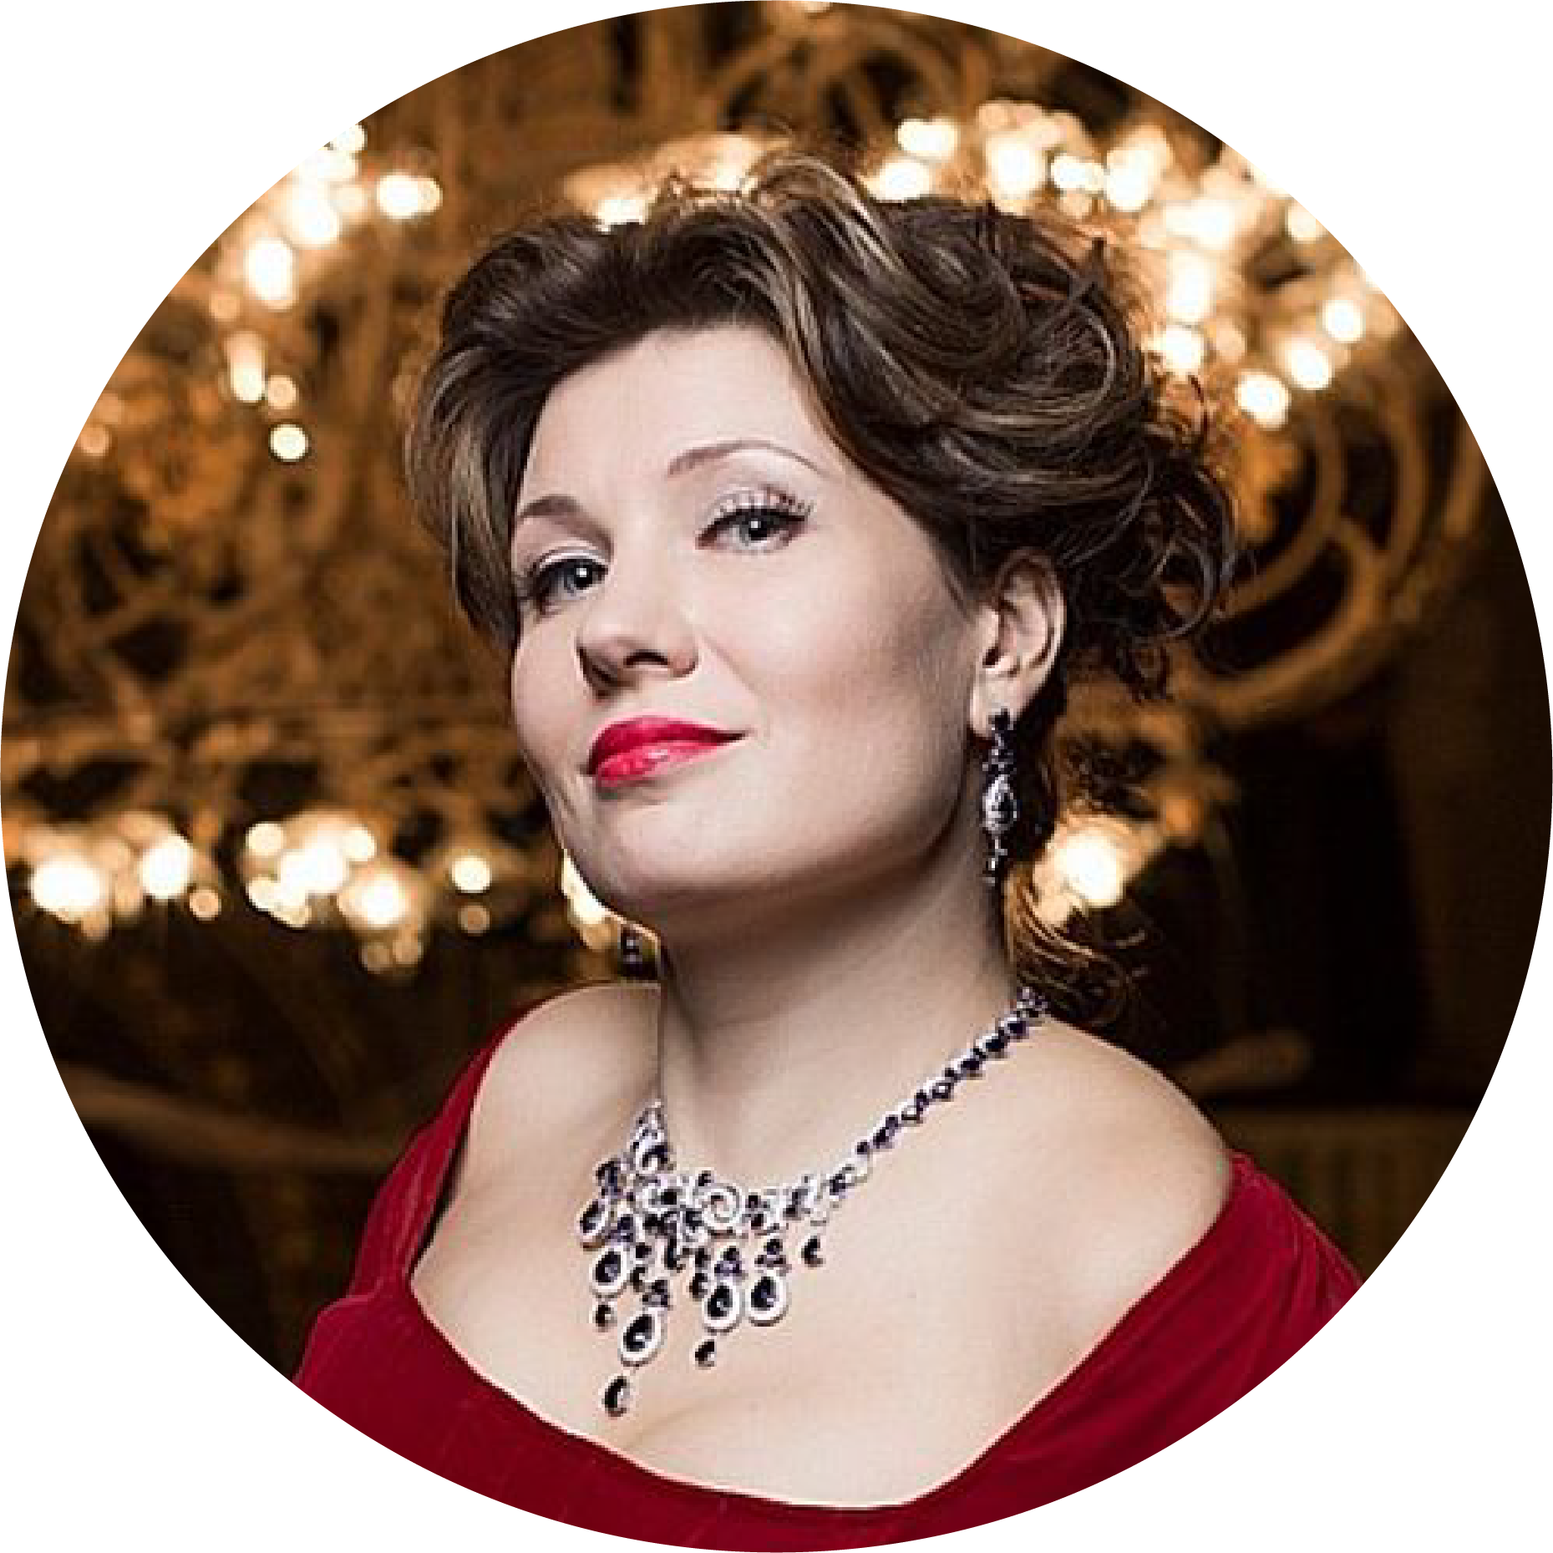
#ReadyForAnyChallenges
#ElinaGaranca
#KristineOpolais
#MarinaRebekat
Elina Garanča
EXCEPTIONAL
DRAMATISM
Three Latvian divas are among the most coveted opera singers in the world, performing lead roles in New York’s Metropolitan Opera
Marina Rebeka
THE BEST VOICE
FOR ROSSINI
Kristine Opolais
PUCCINI VOICE
Notes:
Elina Garanca is one of today's most coveted opera singers with exceptional mezzo-soprano voice and talent for portraying diverse dramatic characters. “I never wanted to be a soprano. I don’t want to be dying every night… mezzos have such fun: we get to play all the witches and bitches,” E. Garanca describes her stage life, admired by critics and opera lovers in the world's leading opera houses, the Metropolitan Opera and Vienna State Opera among them.
(Kristine)
Puccini voice - that’s how international music critics describe Kristine Opolais, unmatched lyric soprano. "She creates characters with the lithe beauty of a wild animal, fabulous passion and a melting, burnished, gripping sound,” critics also say about her. K.Opolais holds a remarkable record – Opolais made her debut in two roles in a single day at the Metropolitan Opera in New York. One of our three opera divas or "a Bounty of Latvian Performers" (The Wall Street Journal) along with E.Garanča and M. Rebeka.
(Marina)
“A big, bright voice!” – that’s what “The New York Times” writes about her. Considered to be one of the best voice for Rossini or Rossinian singer in the world Marina Rebeka, a Latvian soprano, specialises in the classic repertoire of 19th-century Italian and French operas. Marina continues to captivate audiences with leading roles at esteemed venues like the Vienna State Opera, Metropolitan Opera, and the Latvian National Opera. Marina Rebeka is one of Latvia's golden trio of opera singers, conquering the world's most significant stages alongside E. Garanča and K. Opolais.

Slide 30
AND MUCH
MORE

Slide 31
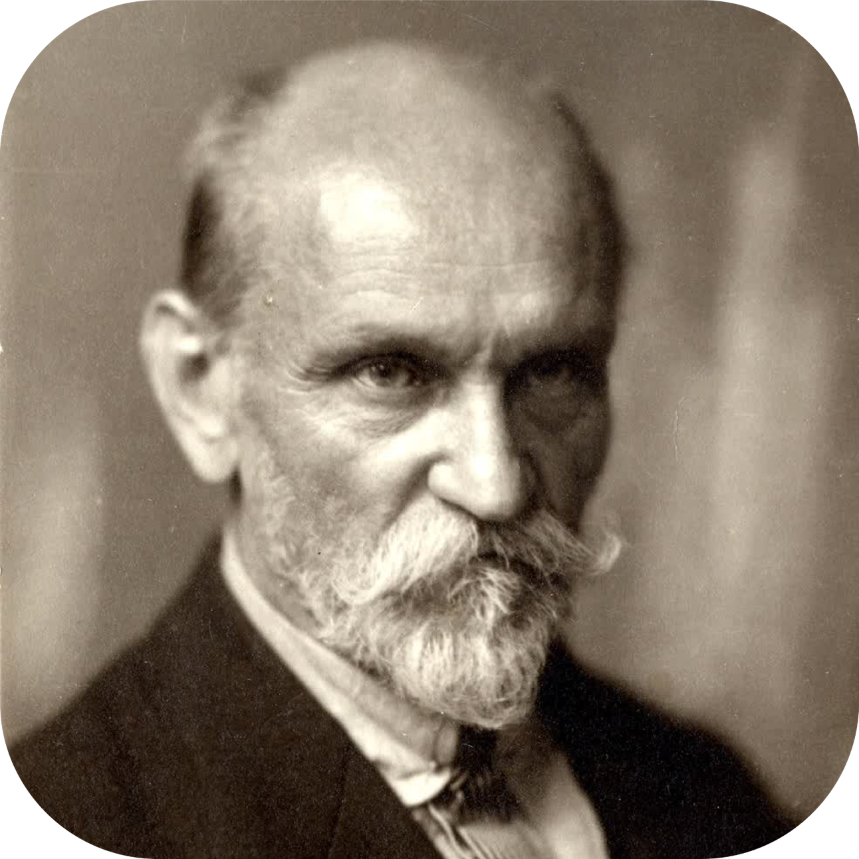
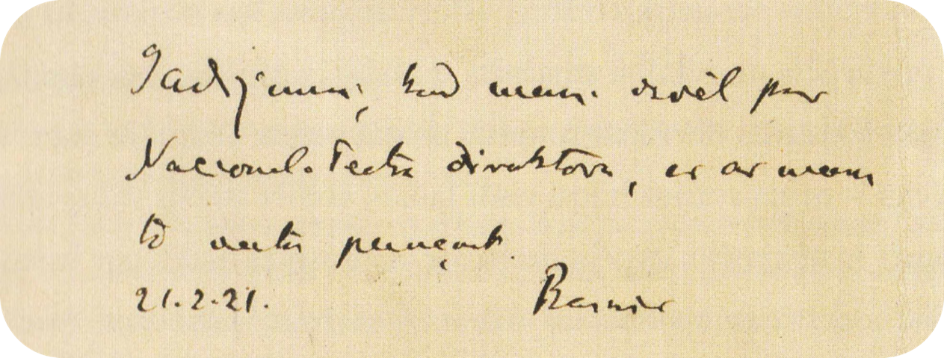
Rainis
A HERO OF LATVIAN CULTURE
A remarkable Latvian poet, playwright, journalist, philosopher, and politician challenged and enriched the Latvian language and shaped the culture and national identity of Latvians
#ReadyForAnyChallenges
#Rainis
Notes:
Rainis is a remarkable Latvian poet, playwright, journalist, philosopher, and politician
Rainis challenged and enriched the Latvian language: poetic Latvian versions of such words as love, ardor, and freedom were created by Rainis
He shaped the culture and national identity of Latvians by introducing a literary model of hero who sacrifices himself for the well-being and survival of his people

Slide 32
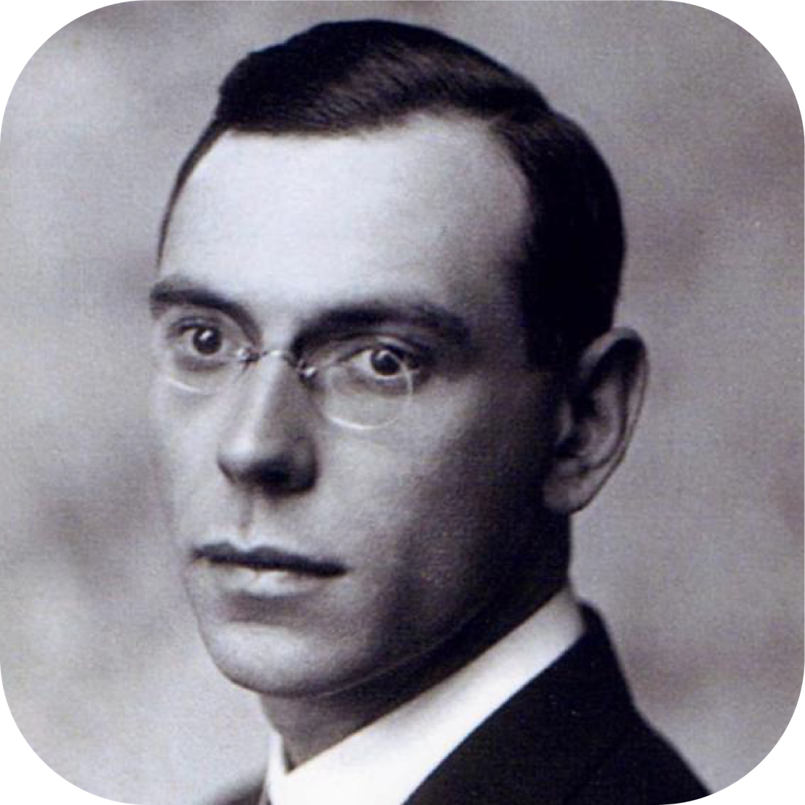
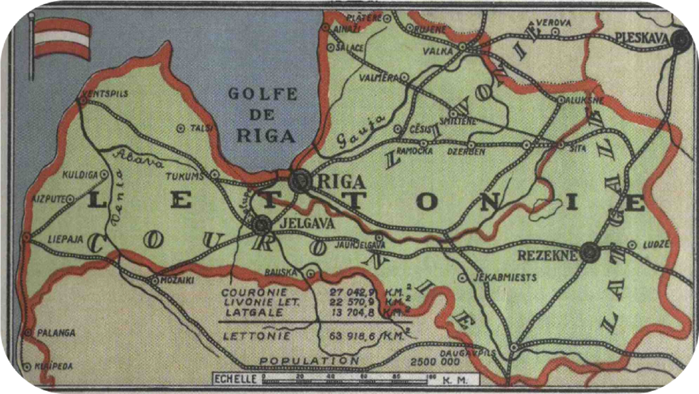
#ReadyForAnyChallenges
#ZigfridsAnnaMeierovics
Zigfrids Anna Meierovics
A DIPLOMATIC FIGHTER FOR INDEPENDENCE
In 1918 Latvia's esteemed first foreign minister was fighting for recognition of Latvia's independence, visiting global leaders of many countries
Notes:
In 1918 Zigfrids Anna Meierovics, Latvia's esteemed first foreign minister was fighting for recognition of Latvia's independence
He visited global leaders of many countries, taking the best samples of Latvian artwork with him
Throughout all his life he had been tirelessly championing Latvia's interests

Slide 33
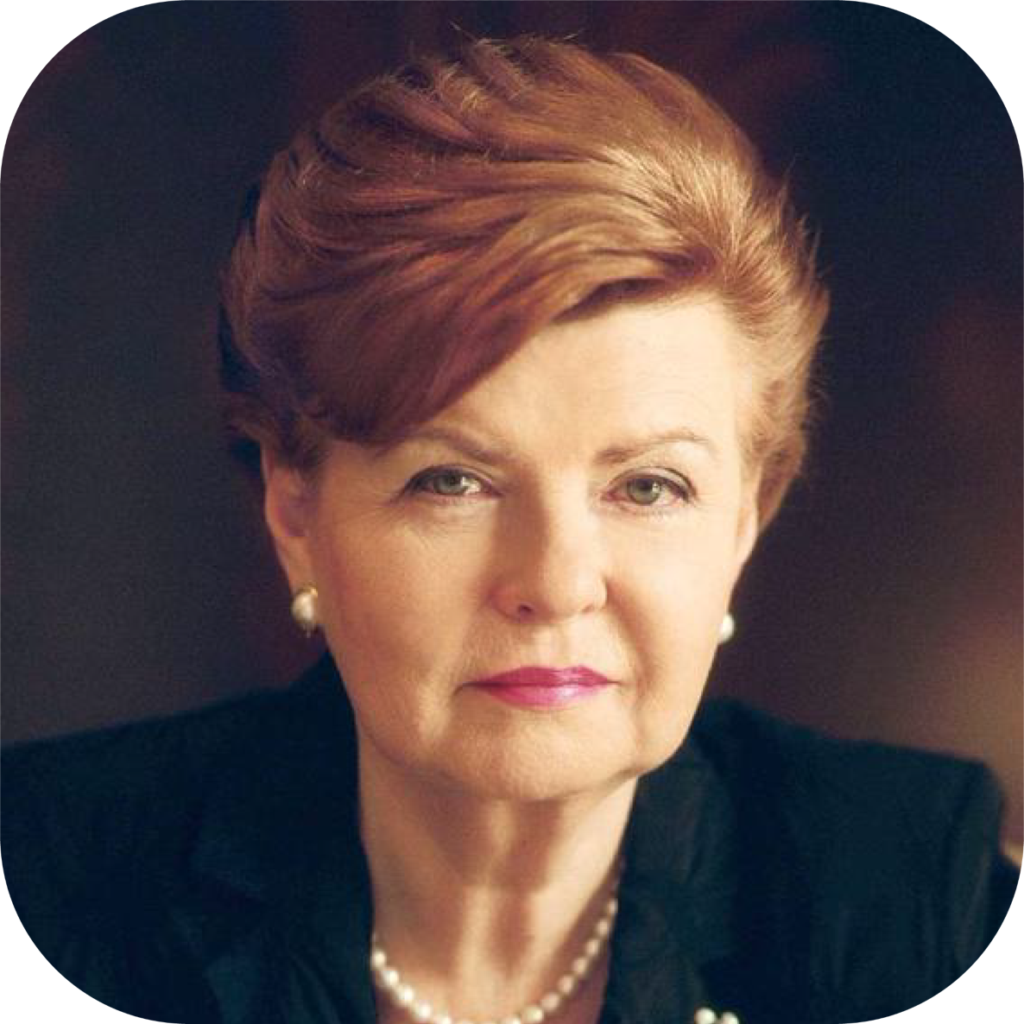
Vaira Vike-Freiberga
A LEADER THAT BROUGHT
THE COUNTRY INTO NATO AND EU
Respected global leader, she skillfully united the nation around shared ideas and cultural values
“With determination and ideas, we attract supporters and allies. With indifference and apathy –
we lose them”
#ReadyForAnyChallenges
#VairaVikeFreiberga
Notes:
Respected global leader, who helped Latvia get the EU and NATO membership
She skillfully united the nation around shared ideas and cultural values, nurturing a strong national identity
“With determination and ideas, we attract supporters and allies. With indifference and apathy – we lose them”

Slide 34
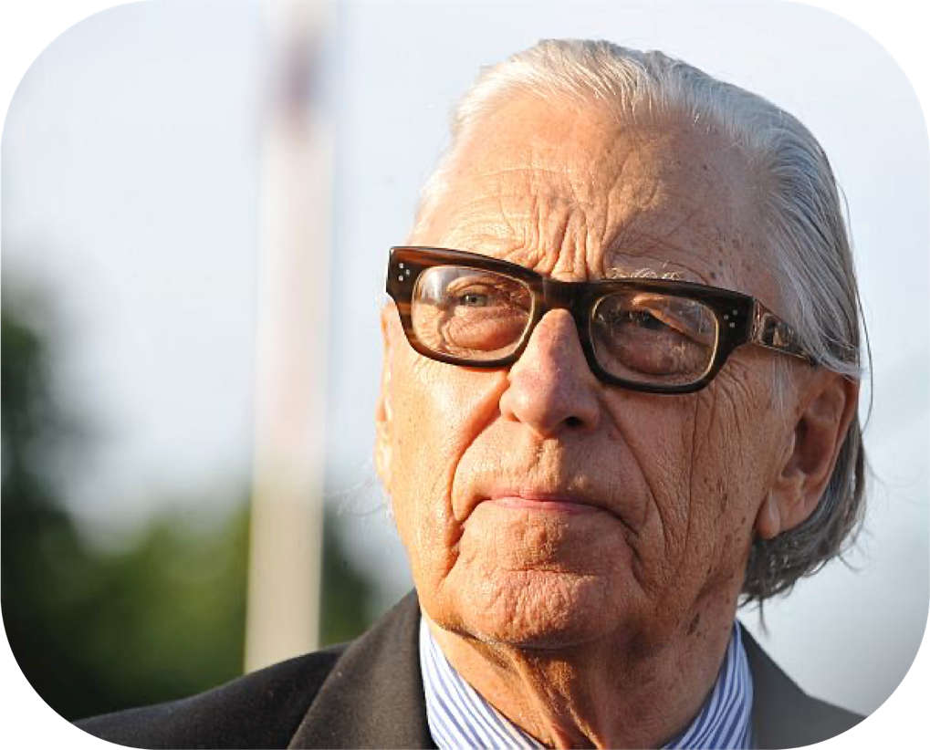
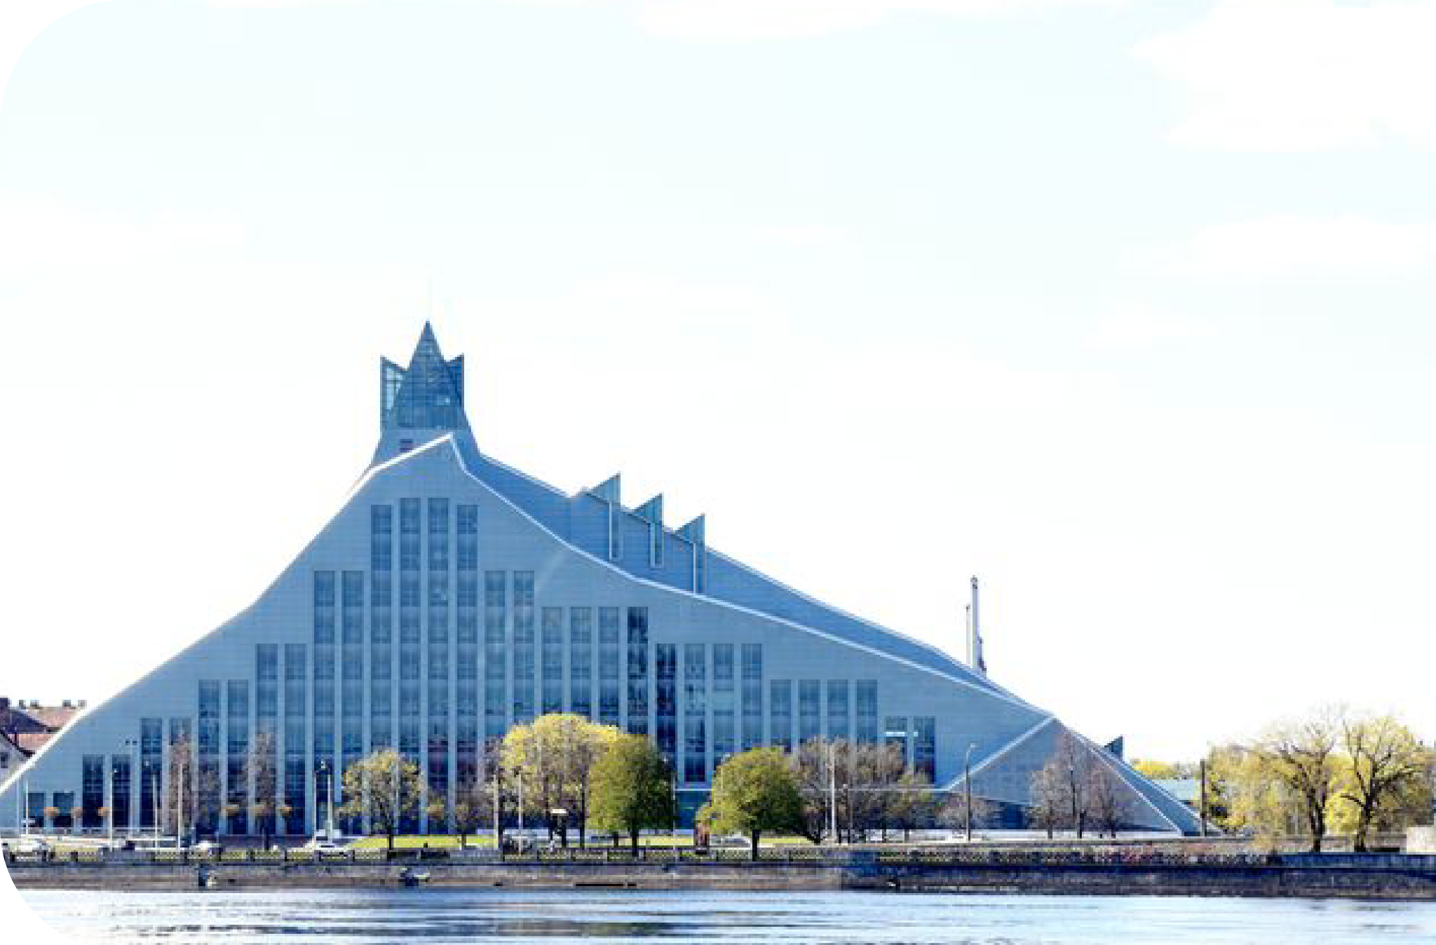
#ConnectingWorldsApart
#GunarsBirkerts
Gunars Birkerts
AN ARCHITECTURE
GENIUS OF LATVIA
A master of light, volume, and reflections, Gunars is well-known internationally and gifted his homeland the National Library of Latvia, an expressive modernist masterpiece
Notes:
A world-renowned architect, Gunars is a true master of light, volume, reflections and illumination
Internationally, Birkerts is known for such notable designs as the Corning Museum of Glass, Marquette Plaza, the Kemper Museum of Contemporary Art, and the U.S. Embassy in Caracas.
He gifted his homeland of Latvia the remarkable creation of the National Library of Latvia, an expressive modernist masterpiece infused with symbolism and significance

Slide 35
Join us on our mission where values established
by our greatest personalities set the ground for
local and global changes!
#missionLatvia

