Slide 1
Invest in Latvia: Green energy

Slide 2
LATVIA:
An Innovation Hub Driving the Transition to Green Energy

Slide 3
3rd
Among EU countries with the highest renewable energy use and one of the seven that achieved the EU’s target
42.1%
Of Latvia's energy consumption is sourced from renewable energy, primarily through strong hydroelectric power, making it the second highest rate in Europe
50%
Of Latvia's final energy consumption is targeted to come from renewable energy by 2030

Slide 4
Latvia boasts vast untapped potential for renewable energy development
This abundance of natural resources presents a golden opportunity for Latvia to become a regional leader in the transition to a sustainable energy future
36% or almost 500km of borders are along the Baltic Sea coast
Over 50% of land is covered in forests

Slide 5
Underutilised resources of the Baltic sea
The Baltic Sea on Latvia's coast has a potential to generate up to LV 15.5GW
Total untapped potential of the Baltic Sea is estimated to be around 90GW
The shallow depths of the Baltic Sea make it a cost-effective location for offshore wind park development

Slide 6
Latvia's renewable energy market is ripe with opportunities:
Energy efficiency solutions to reduce energy consumption
Wind and solar energy as alternatives to traditional fossil fuels such as coal, oil, and gas
Biomass power of converting organic materials into electricity or heat
Combined heat and power plants

Slide 7
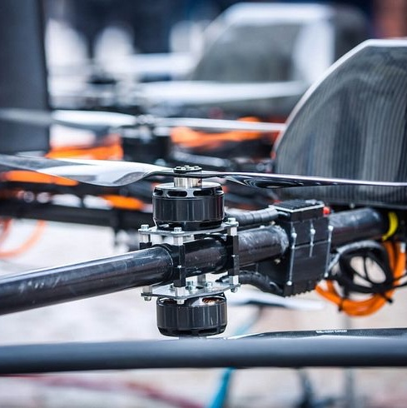
Exciting innovations are already underway, paving the way for a more sustainable future
Aerones:
World-leading robot-enabled wind turbine maintenance and inspections service provider. Serving customers representing over 50% of the world’s wind power capacity
Etgas:
Leading company that specializes in engineering, constructing, and operating biomass generation plants, and offers sustainable solutions to create a cleaner energy future

Slide 8
Exciting innovations are already underway, paving the way for a more sustainable future
Hygen:
Hygen provides decentralized refuelling solutions for bio-CNG-powered vehicles, offering a sustainable and eco-friendly alternative to traditional fuel sources
LightHouse:
With a focus on reducing costs and environmental impact, LightHouse offers lighting-as-a-service solutions that introduce LED lighting for businesses and commercial spaces

Slide 9
Exciting innovations are already underway, paving the way for a more sustainable future
Digas:
Digas offers a dual-fuel system replacing diesel fuel in locomotives with a more cost-effective and environmentally friendly
Jauda:
With over 50 years of experience, Jauda is a leading producer of electrical materials and equipment. Products include compact substations, low and medium voltage equipment, metal constructions, and metalware

Slide 10
Exciting innovations are already underway, paving the way for a more sustainable future
Fortes Energy:
Technology company developing wood gasification technology. Providing sustainable renewable energy from forest residues by producing wood-gas that is transformed into electricity and heat
EMT:
Production of energy-efficient electric motors, starters, frequency converters, and other solutions essential for a sustainable future in wind energy generation and transmission

Slide 11
Exciting innovations are already underway, paving the way for a more sustainable future
Naco Technologies:
The company empowers the green hydrogen revolution, by developing new materials in a form of nano-coatings that make hydrogen systems efficient and scalable.
This breakthrough technology significantly lowers the cost of electrolyzer and fuel cell components, reducing the noble, scarce material loading, while also increasing the overall system's efficiency and longevity.

Slide 12
Our focus: ELWIND
A joint Estonian-Latvian cross-border offshore wind farm project
Potential to harvest over 3 terawatt-hours worth of clean wind energy for the Baltic region every year, while ensuring minimal environmental impact

Slide 13
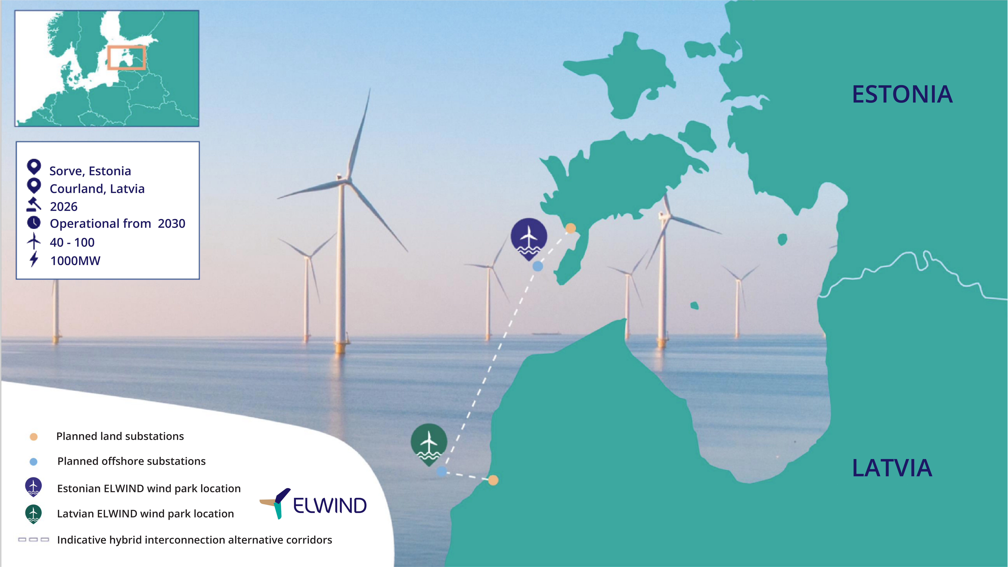

Slide 14
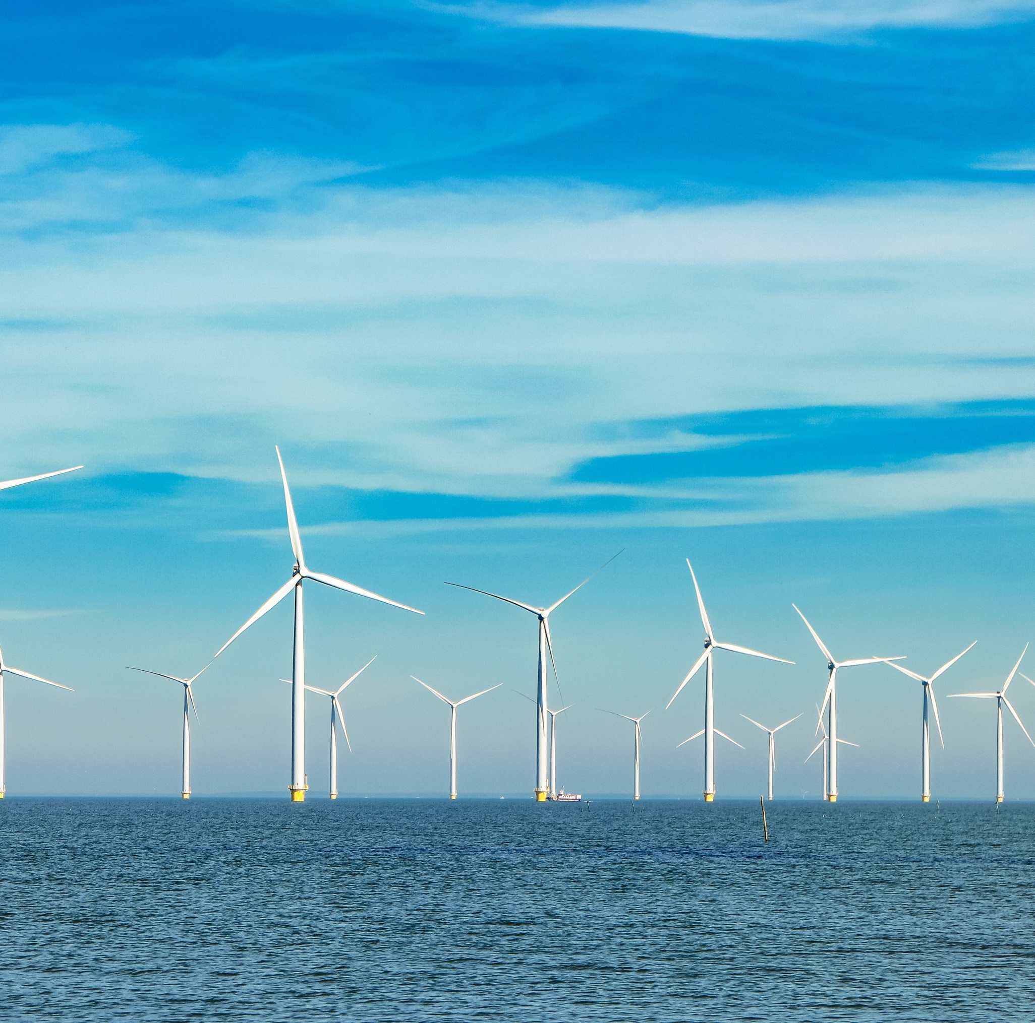
ELWIND The potential:
The joint Estonian-Latvian state-run ELWIND project, located in an optimal spot in the Baltic Sea, has a capacity of 3 terawatt-hours per year, meeting over one-fifth of the Baltic region's annual electricity demand
With an ongoing pre-development studies the project demonstrates its potential to significantly impact the regional energy market

Slide 15
ELWIND
The potential:
ELWIND focuses on clean wind energy through offshore wind development, reducing greenhouse gas emissions and land usage.
This commitment to environmental sustainability makes ELWIND essential to the Baltic region's green transition

Slide 16
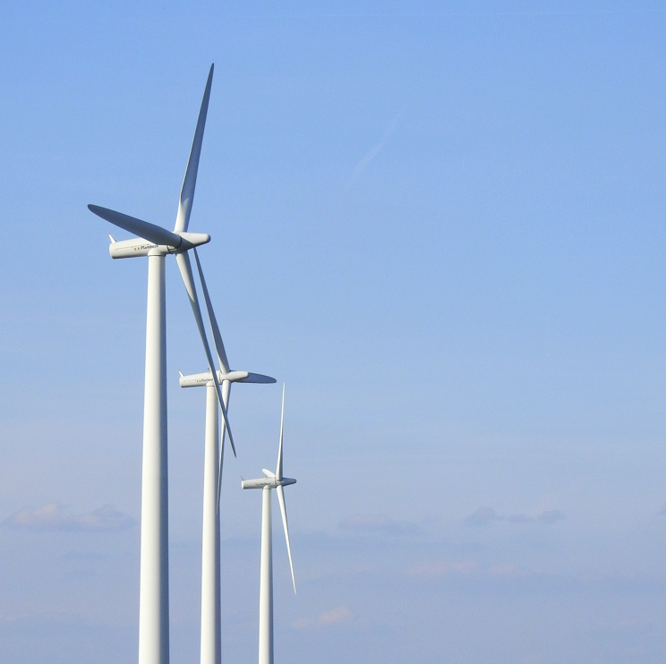
ELWIND The potential:
The ELWIND project supports regional competitiveness, energy independence, and sectoral development while offering new opportunities in business, learning, research, and employment
Investing in ELWIND supports a cutting-edge initiative for energy security and a cleaner future

Slide 17
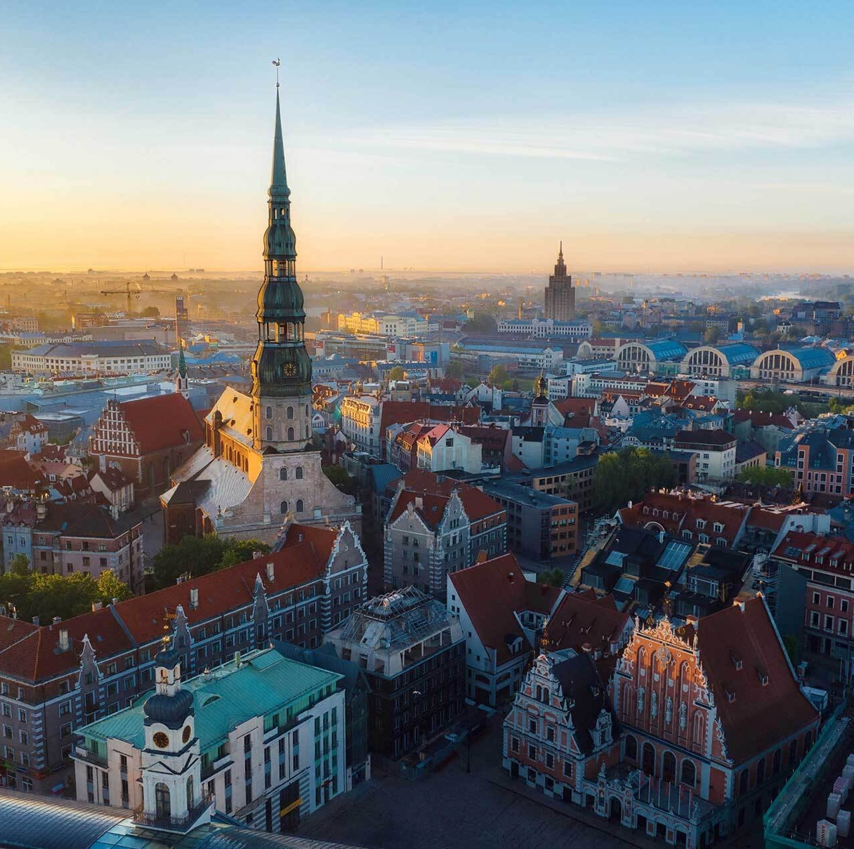
Green Channel
Accelerated services for sustainable investments in Latvia

Slide 18
Green Channel
The "Green Channel" initiative in Latvia offers a streamlined administrative process for investment projects in priority sectors, reducing bureaucratic hurdles and saving time and costs for businesses
By applying for and obtaining priority investment project status, businesses can receive state administrative services for construction, territorial planning, and migration in a prioritized (accelerated) manner, making it easier and more attractive to invest in Latvia

Slide 19
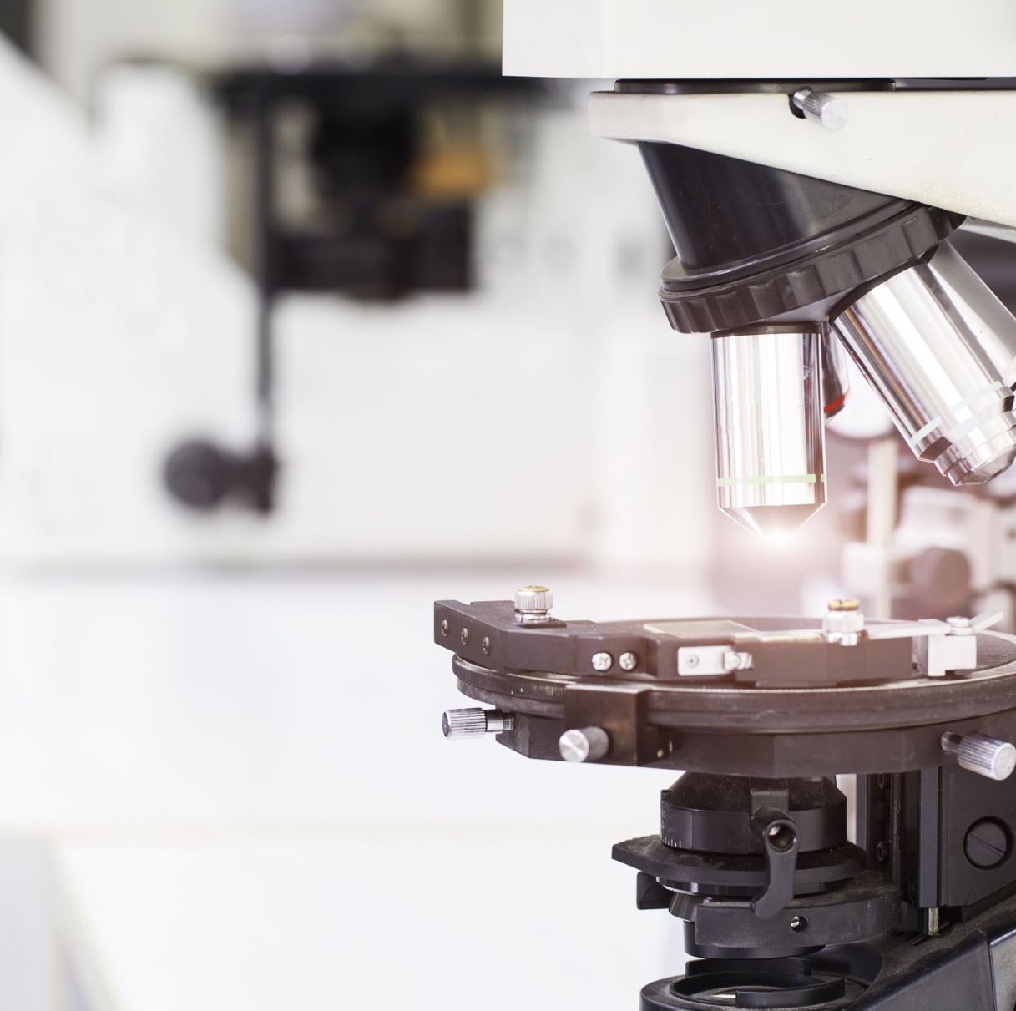
Green Channel
Smart energy projects enjoy exceptionally advantageous criteria to access the green channel:
Investment projects require a minimum of €5,000,000 within three years, or €10,000,000 if located in Riga's administrative territory
The planned amount of investment in research and development, including employee competence development, in a three-year period after the implementation of the investment project is at least 250,000 euros

Slide 20
Baltic Electricity Grid Synchronization by 2025
AST & EU Funding:
Latvia's AST manages grid infrastructure and has secured EUR 170 million from the EU for the Baltic Synchronization project
Goals & Timeline:
Aiming to synchronize Baltic power systems with CESA by 2025, the project focuses on grid reinforcement, frequency regulation, and IT control upgrades. AST is part of the "Baltic Offshore Grid Initiative"

Slide 21
Thank you!
Join us today to support the advancement of sustainable energy in the Baltic region

