Slide 1
Latvia:
The inspiration and success in the world of athletes

Slide 2
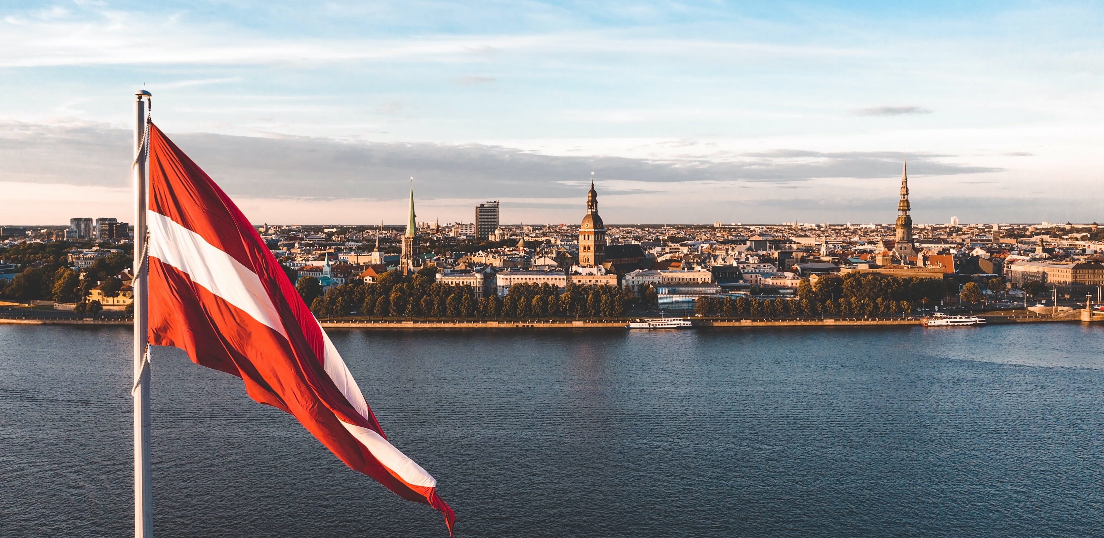
At #missionLatvia today we’re mobilising scientists, innovators, entrepreneurs, investors, policymakers, and society to work towards resolving critical environmental, economic, and societal challenges.

Slide 3
But it is
Our values
Our experiences
Our heroes
that make a strong ground for todays mission to happen.

Slide 4
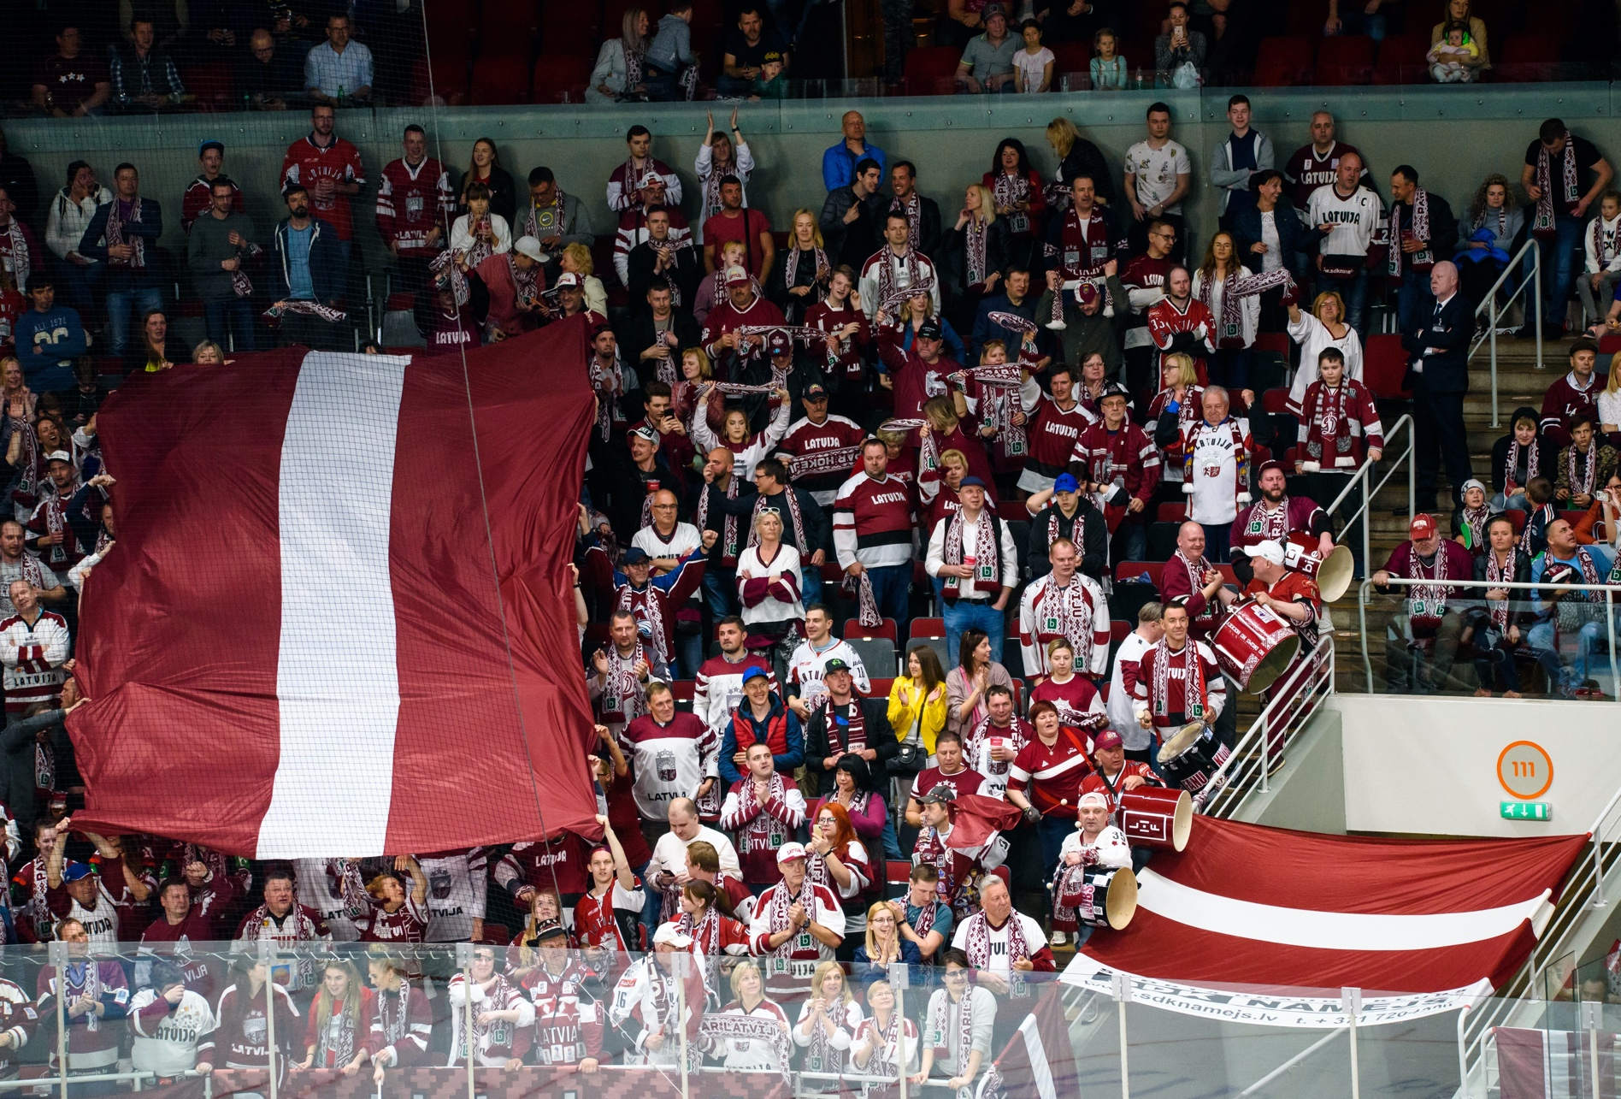
Our athletes are our heroes.
They have relentless determination and an indomitable spirit in conquering their chosen disciplines.
We believe that we are ready to:
face any challenges;
connect with industries, professionals, and countries;
test, create and complete the mission.

Slide 5
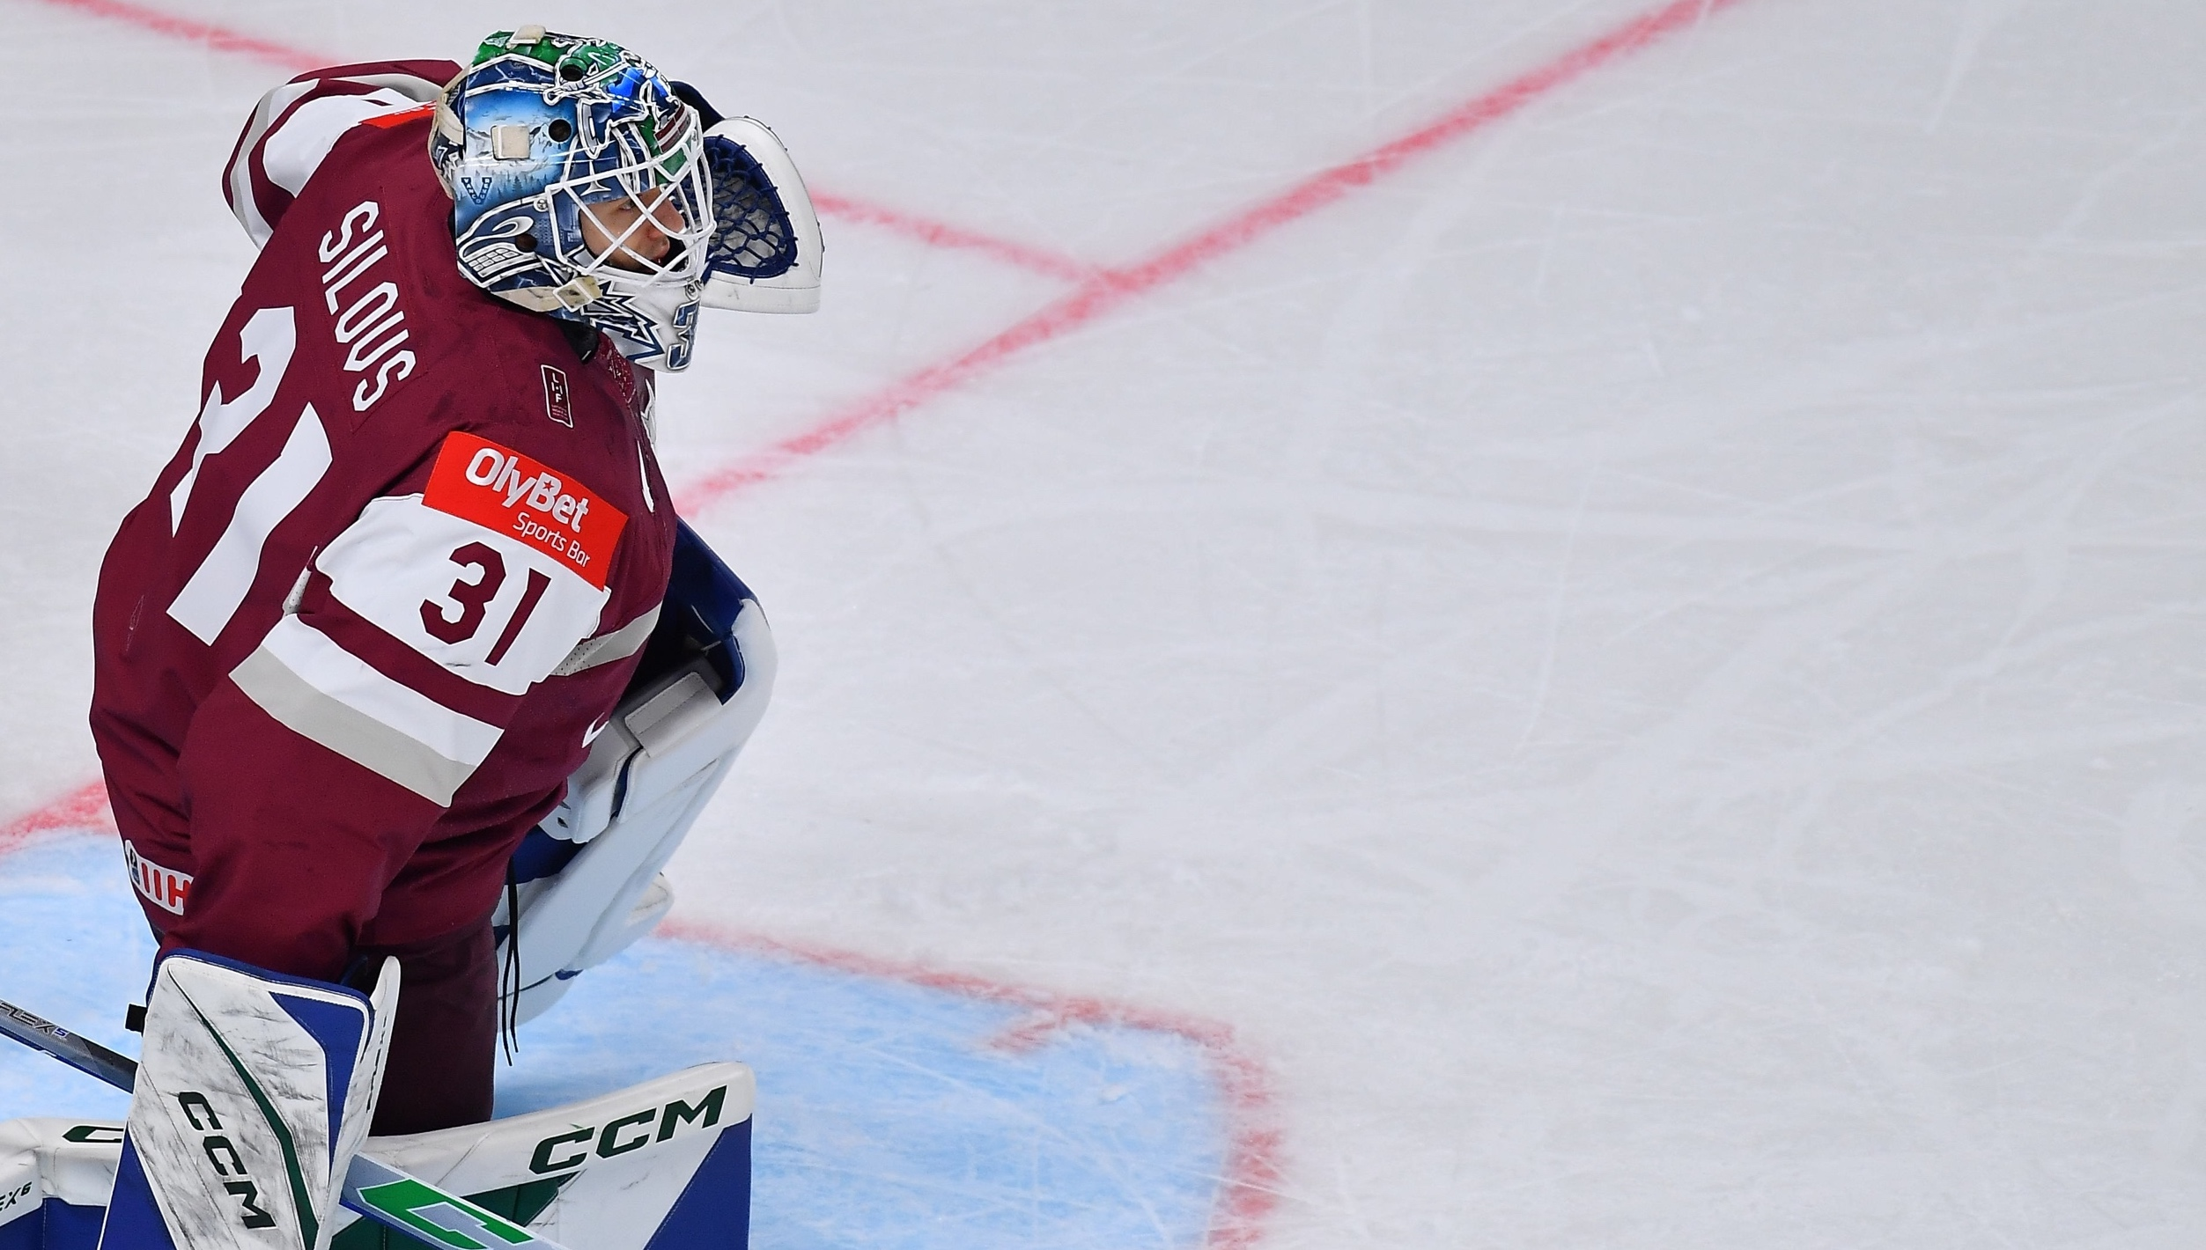
It is in Latvian nature to create, adapt and do complex things fast, creatively and on a global scale – in sports just as well as in any other discipline!
The stories of our athletes are powerful testaments on how to
be ready for any challenges
and turn them to success.

Slide 6
Mikhail Tal, the Chess magician.
He proved that meeting challenges requires thinking outside the box. He excelled in chess, but found the long session dull.
As World Chess Champion, he fearlessly sacrificed pieces to launch devastating attacks, leaving an incredible mark on the game.
#ReadyForAnyChallenges
#MikhailTal #ChessMagician

Slide 7
Janis Robins
BMX racer Maris Strombergs.
He became the first Olympic gold medallist in men’s BMX racing, a legend with numerous world titles.
His achievements elevated the sport’s status, inspiring young athletes and motivating municipalities to invest in infrastructure.
#ReadyForAnyChallenges
#MarisStrombergs #BMXLegend

Slide 8
Janis Robins
Latvian NBA star Kristaps Porzingis.
Often called “The Unicorn” of basketball, whose exceptional height did not hinder his speed and coordination.
He became the first Latvian player chosen for the NBA All-Star Game in 2018 through hard work, trust, and involving his family in managing his athletic journey.
#ReadyForAnyChallenges
#KristapsPorzingis #BasketballUnicorn

Slide 9
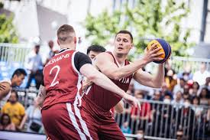
Janis Robins
The Latvian men’s 3x3 basketball team.
From the “Ghetto Games” street sports movement in Latvia, they embraced the Olympic inclusion of 3x3 basketball.
Secured their spot at the Tokyo 2021 Olympics.
Made history as the first-ever Olympic champions in the sport, winning the gold medal.
#ReadyForAnyChallenges
#3x3Basketball #FirstOlymicGold

Slide 10
Latvia lacks deserts and a renowned automotive industry. However, our innovative engineers thrive in creating solutions where none exist.
Engineer and rally driver Andris Dambis.
He introduced his own creation, OSCar sports cars. He competed successfully in the Dakar Rally, making history in 2012 by participating in the world’s first electric off-road rally with the OSCar eO.
#ReadyForAnyChallenges
#AndrisDambis #OffroadRally

Slide 11
You can be brilliant in your talent and skills, but sometimes you are not a fighter alone. Our athletes learned to use their resilience and collaborative skills to bring together all resources for their single mission.
Our athletes are restless in connecting different worlds and the right dots to turn their dreams into reality and achieve goals.

Slide 12
The Latvian ice hockey team’s World Championship’s bronze.
By trusting the young and talented goalkeeper Arturs Silovs, seizing every opportunity, and drawing inspiration from the unbeatable Latvian fan team, luck was on their side.
#ConnectWorlds
#TeamLatvia #IceHockey

Slide 13
Skeleton racer Martins Dukurs.
He dominates the sport with 11 World Cup titles and an impressive streak of eight consecutive victories.
As a six-time world champion and double Olympic silver medalist, Dukurs established Latvia as a winter sport kingdom, leveraging available resources such as family skills, funding, training infrastructure, and state support.
#ConnectWorlds
#MartinsDukurs #Skeleton

Slide 14
Madars Apse, a renowned professional skater.
His story proves that transforming your skateboard passion into revered profession is possible.
It is possible to connect with the community that shares your passion and make your hobby your career.
#ConnectWorlds
#MadarsApse #Skateboard

Slide 15
Karlis Bardelis, a world traveller.
In 2013, he set a Guinness World Record by roller-skating 6200km across 11 countries.
Now, he embarks on global expeditions, cycling long distances on land and crossing oceans in a row boat.
Karlis’ journey proves that relying solely on your own muscles can take you around the globe and create a story that attracts followers and TV shows.
#ConnectWorlds
#KarlisBardelis #Expeditions

Slide 16
Pauls Jonass, a motocross prodigy.
Pauls started conquering races at just 9 years old. His story blends talent, family support and wise competition choices.
With an impressive track record, including the title of the first Latvian to triumph in the MX2 class at the World Motocross Championships, Pauls continues his inspiring journey in the MXGP World Championship series.
#ConnectWorlds
#PaulsJonass #Motocross

Slide 17
We have it all:
Four seasons
Technology
It allows great athletes to be born and raised, trained and tested. Our athletes use it as a natural playground from their childhood activities to professional sports.
Skilled experts
Sea and lakes
Vast plains and plains
Long forest roads

Slide 18
Latvia’s nature offers picturesque trails and vast fields.
Janis Dalins, a true legend in race-walking.
He became the first Latvian to win an Olympic medal and secured his place in history as an inaugural European champion and set records in the 5000 m walk and 40 km marathon.
#NaturalPlayground
#JanisDalins #RaceWalk

Slide 19
Javelin throw legend Inese Jaunzema.
Without dreaming of fame, she found joy in sports, friends, and community.
Inese secured Latvia’s first-ever Olympic gold medal in 1956 and set Latvian record five times, becoming the nation’s beloved athlete. Her story is a statement to the limitless training ground in Latvia.
#NaturalPlayground
#IneseJaunzema #JavelinThrow

Slide 20
Uļjana Semjonova, a basketball legend.
She trained and built her career in Riga, Latvia. Standing at least 2.13 m tall, she dominated women’s basketball in the 1970s and 1980s.
She is the first non-US woman inducted into the Basketball Hall of Fame and is also recognized in the FIBA Hall of Fame.
#NaturalPlayground
#UljanaSemjonova #Basketball

Slide 21
Being a winter wonderland suitable for all kinds of winter sports, Latvia gives a good natural training ground for hockey player.
It has all resulted in number of NHL players among them and two Stanley Cup holders – professional hockey players Teodors Bļugers and Sandis Ozolins.
#NaturalPlayground
#TeodorsBlugers #SandisOzolis #Hockey

Slide 22
Jelena Ostapenko, the young Latvian tennis player.
She achieved a remarkable milestone at the 2017 French Open, becoming Latvia’s first Grand Slam singles champion.
Her story is an inspiring testament to harnessing personal power, exemplified by her bold and captivating on-court personality. Ostapenko’s dynamic playing style has consistently ranked her among the top players in women’s tennis.
#NaturalPlayground
#JelenaOstapenko #Tennis

Slide 23
You’ve heard the stories
of our greatest athletes,
their ability to meet any challenge and turn it to a result, their vision of how to bring together all puzzle pieces of success and how to use our natural resources for training and inspiration.

Slide 24
You’ve heard the stories
of our greatest athletes,
their ability to meet any challenge and turn it to a result, their vision of how to bring together all puzzle pieces of success and how to use our natural resources for training and inspiration.

Slide 25
Let us recognize our values and embrace the athlete spirit within us, as it leads us towards missions of regional and global significance.
Join us on this journey.

